Slide 1
Equity, Diversity and Inclusion
2025 Update
Rebecca Jaremko Bromwich
and
Alisha Chohan

Slide 2
Equity, Diversity, and Inclusion in Nunavut: Challenges & Importance
Nunavut is an Inuit Territory but the current population is composed of various Indigenous communities, immigrants and settler populations
Increasing Inuit representation in government and corporate leadership.
Providing culturally relevant education and workplace training.
Ensuring accessibility to equitable employment and career growth opportunities.
Addressing language barriers and incorporating Inuit Qaujimajatuqangit (IQ) principles.
Geopolitical tensions and changes to (banning of) EDI in USA do not change our obligations

Slide 3
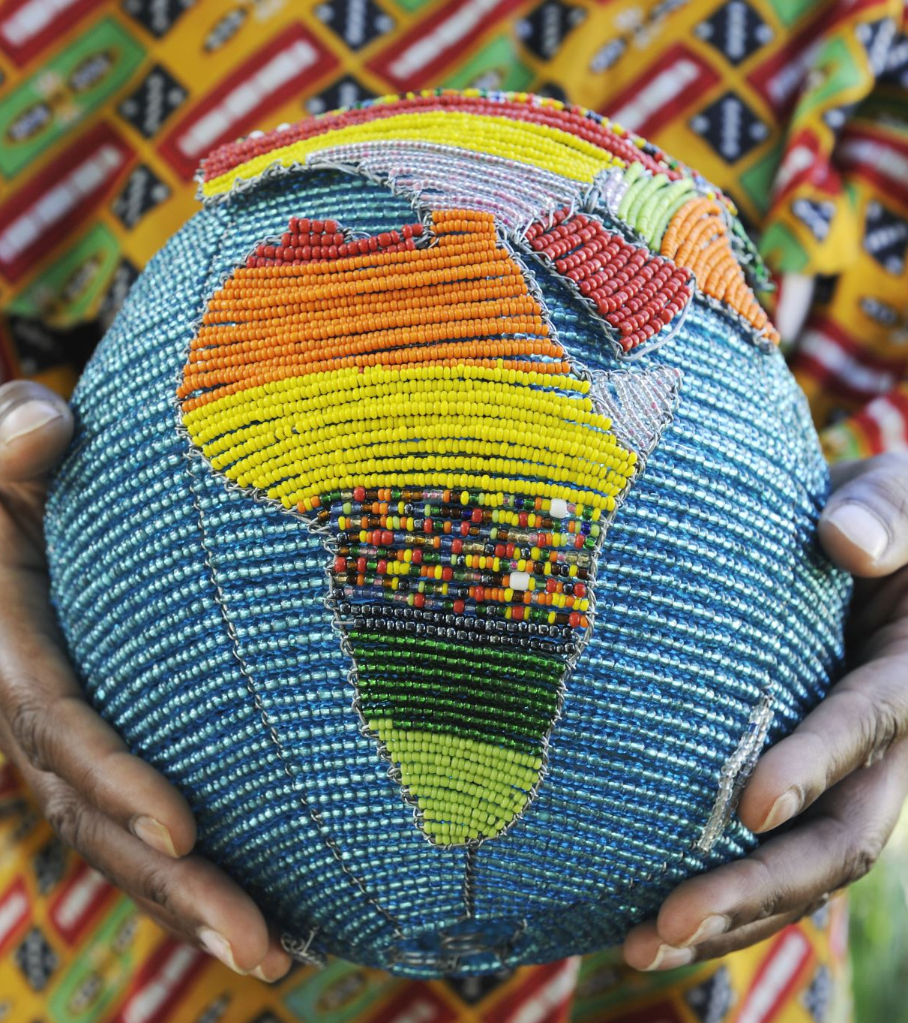
Difference between the Settler-Colonial, Immigrant & the Indigenous Experience
Settler-colonial experience dictates the Canadian identity, norms, culture, legislations, and trends
Focal point of most governmental programs and funding
Immigrant populations come with a unique cultural identity and assimilation degrees
Asylum seekers and war-torn refugees add another lens as they often cannot return to their homeland
Indigenous peoples are the original settlers of this land
Yet Indigenous communities, norms, practices and are stigmatized

Slide 4
THE GROUND-LINE OF VISIBILITY: HOW MUCH DO YOU REALLY KNOW SOMEONE?
Unconscious bias operates at a very subtle level and below our awareness
It results in almost unnoticeable behaviours – micro behaviours – such as:
paying a little less attention to what the other person says
addressing a person less warmly or talking less to them
These are cumulative and may create disadvantage
“This is what people perceive about me”
Visible characteristics of a person
Age
Gender
Gender expression
Race & ethnicity
Physical ability
“This is what people don’t realize about me”
The underlying characteristics which make up the vast majority of someone lie below the surface, out of sight
Nationality
Education
Heritage
Gender identity
Talents
Languages
Non-visible disabilities
Religion
Life experiences
Education
Beliefs
Marital status
Sexual orientation
Career responsibilities

Slide 5
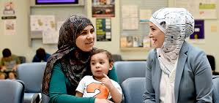
Immigration and Refugee Concerns
Language Barriers
Working Motherhood
Child-rearing Practices
Cultural Differences
Gender Roles

Slide 6
EQUITY, DIVERSITY AND INCLUSION: WHY WE WORK ON IT NOW
As part of being a Canadian lawyer and citizen, it’s the right thing to do
We want people to stay with our organization, so they need to feel they have work satisfaction
Different types of people give different types of ideas. We want to have as many perspectives as possible

Slide 7
THE POWER OF DIVERSITY AND INCLUSION IS BRINGING IT TOGETHER
Diversity
People with a variety of inherent factors (traits we were born with) and acquired factors (traits we gain from experience)
Inclusion
Creating an environment in which people feel involved, respected, valued, and connected—and to which individuals bring their “authentic” selves (their ideas, backgrounds, and perspectives) to their work with colleagues and clients
Improved business performance
Our job is to turn employee potential into performance regardless of the size, shape, colour, or level of ability/disability of our people

Slide 8
SOCIAL, INFORMATION, AND CAPACITY BIAS

Slide 10
WHO IS WHO? MATCH THE PERSON TO THE PROFESSION. ONE ENGINEER, ONE PRO ATHLETE, ONE CEO
A
B
C

Slide 11
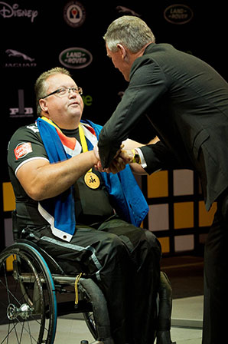
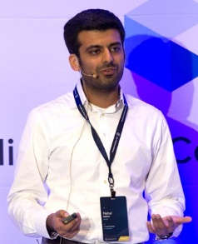
HOW ACCURATE WERE YOU? HOW DID YOU DECIDE? WHAT ASSUMPTIONS DID YOU MAKE?
Glenn Barnes
Competitor at the Invictus Games
Tiera Guinn
Engineer at Boeing, working with NASA
Nehal Madhani
CEO of Alt Legal

Slide 12
UNCONSCIOUS BIAS
What is unconscious bias and what are the impacts?
Impact on Environment
It is the impact of unconscious biases and assumptions that impede organizations in moving the needle in terms of creating a safer and more inclusive environment.
Impact on Inclusion
Our unconscious (implicit) biases and assumptions impact our ability to be inclusive.
Bias
A bias is a mental shortcut that influences decisions and behaviours.

Slide 13
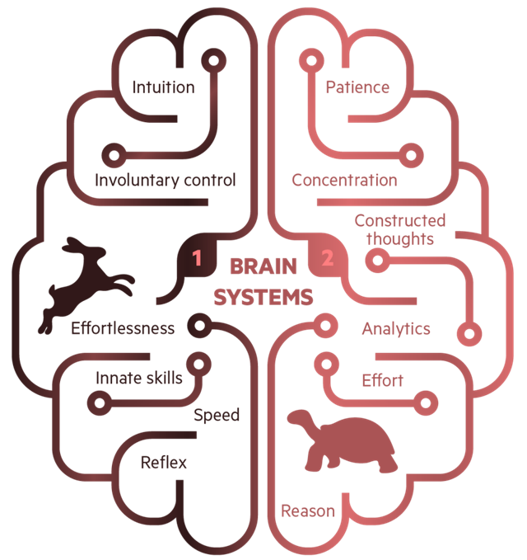
THE COGNITIVE SCIENCE BEHIND BIAS STEMS FROM TWO SYSTEMS OF THOUGHT
Story oriented
Unconscious
Requires time
Reflective
Slow
Minimal energy
Planner
Conscious
Factual
Automatic
Assumptive
Logical
Pattern Driven

Slide 14
SOCIAL BIAS: I’M JUST LIKE YOU…
Fundamental, simple, fast and leads to false consensus effect

Slide 15
INFORMATION BIAS: I HEAR YOU, BUT…
A slippery slope of opinion, biased information selection, double standards of evaluation and emotion – leading to over-confidence, and worrying about being right, more than caring about being wrong

Slide 16
CAPACITY BIAS: RUNNING ON EMPTY
It takes mental energy to exercise self-control and make decisions. When we’re tired we are more likely to make decisions based on emotion and default to the status quo.

Slide 17
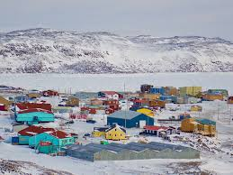
Bias and Socio-Legal Concerns
Current legislation is still operating from the narrative of the settler-colonial population
Lack of diversity within the judicial system and the legal system overall
Cases impacting society and programs

Slide 18
DISRUPTING BIAS AND CREATING ACCOUNTABILITY

Slide 19
STATUS QUO IS THE NORM, CHANGE TAKES DELIBERATE EFFORT
Beware of moments of personal vulnerability
Dedicate time and effort to mitigating strategies
A bias is a mental shortcut that influences decisions and behaviours
Over time, our mental shortcuts become routine and we can mistake them for robust thinking – leading us to have blind spots
Accept susceptibility bias
Care about the impact of bias
Expect challenge from others

Slide 20
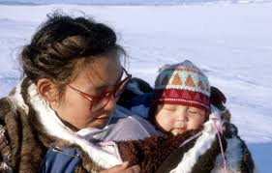
CREATING ACCOUNTABILITY SYSTEMICALLY
Identity formation
Forced Birthing Orders
Sexual abuse and domestic violence in communities
Child rearing practices

Slide 21
Pivoting the Future through the United Nations Declaration on the Rights of Indigenous Peoples (UNDA)
UNDA is Canadian federal law (passed in 2021) and is a vehicle for affirming the the United Nations Declaration on the Rights of Indigenous Peoples (UNDRIP)
UNDA federally operates through an envisioned Action Plan from 2023 – 2028
Action Plan includes 181 measures that reflect priority areas such as justice, education, child welfare, women’s safety, land, socioeconomic concerns and, etc.
Currently BC and NWT have committed to a provincial and territorial version

Slide 22
True Reconciliation
Knowing when to step up as the lawyer and knowing when to listen and understand the Indigenous perspective
Triggering experience of the MMIWG2+ Action Plan and other Negotiations
Collaboration of Government and Non-Government partners with Indigenous communities to report a holistic reconciliation process
Political Mandates shift with elections
Indigenous communities have lived experience but not the expertise or man-power to direct specific conversations
Notes:
Image: https://www.google.com/imgres?q=truth%20and%20reconciliation&imgurl=https%3A%2F%2Fyourvoiceprotected.ca%2Fwp-content%2Fuploads%2F2024%2F09%2Fndtr_sm_banner_1631541000973_eng.jpg&imgrefurl=https%3A%2F%2Fyourvoiceprotected.ca%2Frecognizing-the-importance-of-national-day-for-truth-and-reconciliation%2F&docid=N_zvlZWkgOjMJM&tbnid=9FFGLeIzRbwU8M&vet=12ahUKEwi-gLffiquMAxUekYkEHZNKH2YQM3oECGwQAA..i&w=1707&h=960&hcb=2&ved=2ahUKEwi-gLffiquMAxUekYkEHZNKH2YQM3oECGwQAA

Slide 23
Law & Reconciliation
Calls for Justice 10.1
We call upon the federal, provincial, and territorial governments, and Canadian law societies and bar associations, for mandatory intensive and periodic training of Crown attorneys, defence lawyers, court staff, and all who participate in the criminal justice system, in the area of Indigenous cultures and histories.
Calls to Action 27 – Federation of Law Societies of Canada (LSN)
We call upon the Federation of Law Societies of Canada to ensure that lawyers receive appropriate cultural competency training, which includes the history and legacy of residential schools, the United Nations Declaration on the Rights of Indigenous Peoples, Treaties and Aboriginal rights, Indigenous law, and Aboriginal–Crown relations. This will require skills-based training in intercultural competency, conflict resolution, human rights, and anti-racism.
Calls to Action 28 – Law Schools in Canada
We call upon law schools in Canada to require all law students to take a course in Aboriginal people and the law, which includes the history and legacy of residential schools, the United Nations Declaration on the Rights of Indigenous Peoples, Treaties and Aboriginal rights, Indigenous law, and Aboriginal–Crown relations. This will require skills-based training in intercultural competency, conflict resolution, human rights, and anti-racism.
Notes:
https://lawsocietyontario-dwd0dscmayfwh7bj.a01.azurefd.net/media/lso/media/about/initiatives/edi/consultation-report-indigenous-cultural-training-course-en.pdf

Slide 24
THE NUDGE FRAMEWORK HELPS DESIGN AND IMPLEMENT EFFECTIVE NUDGES
A nudge is a “mental push” that helps address behavioural change by disrupting things we think and do unconsciously
To develop nudges, consider what you want to target and decide on scope
Raise awareness
Modify the process
Reframe the issue

Slide 25
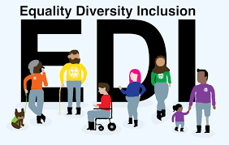
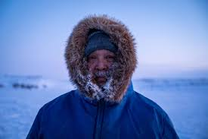
Strategies for Equity, Diversity, and Inclusion in Nunavut
Increasing Inuit representation in government and corporate leadership.
Providing culturally relevant education and workplace training.
Ensuring accessibility to equitable employment and career growth opportunities.
Addressing language barriers and incorporating Inuit Qaujimajatuqangit (IQ) principles.
Notes:
Image: https://www.google.com/url?sa=t&source=web&rct=j&opi=89978449&url=https://wwf.ca/stories/inuit-led-conservation-nunavut/&ved=2ahUKEwjOtf6276qMAxW-hIkEHasYI20Qh-wKegQIMBAD&usg=AOvVaw1dh6m-h5V6IRunWttelZ5h

Slide 26
YOU SHOULD NOW BE ABLE TO…
Disrupt bias by nudging your thinking, behaviour, and processes
Speak openly about social, information, and capacity bias at work
Articulate the business and human benefits of an inclusive workplace/culture
Better understand your own blind spots

Slide 27
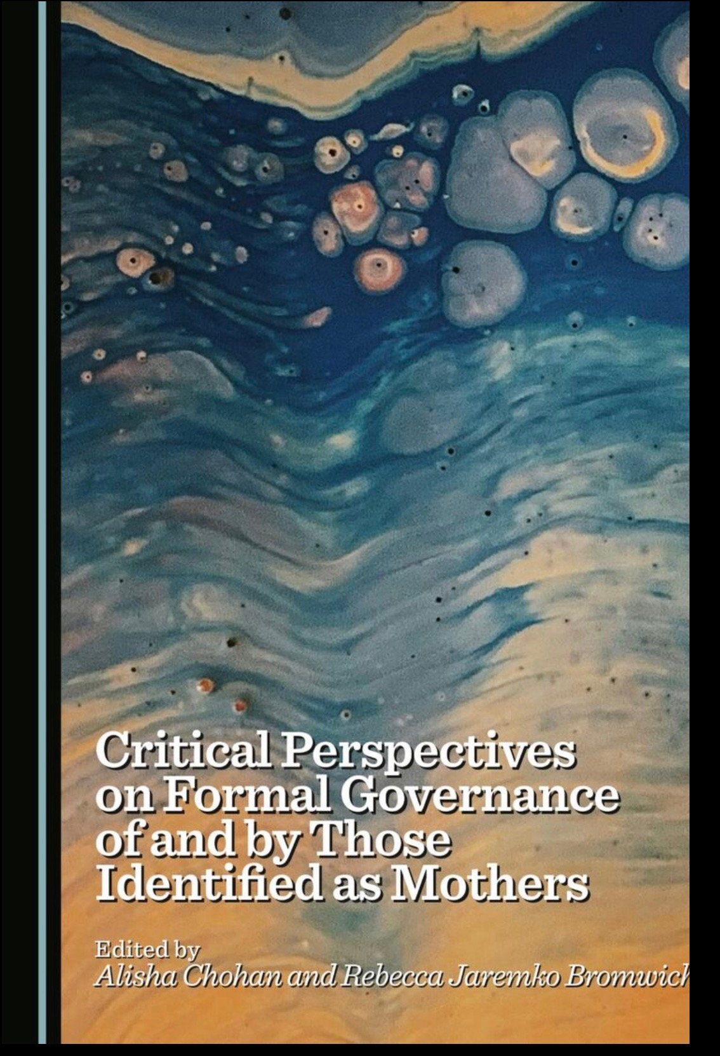
“Mothers" and Equality
Mothers face unique challenges in employment, including wage gaps and career progression barriers
Workplace policies like flexible hours, parental leave, and childcare support promote equality
Companies benefit from gender-diverse leadership and improved employee retention
Legal protections and cultural shifts are essential to breaking biases against working mothers
Our book from Cambridge Scholars’ Press released in February 2025

Slide 28
THANK YOU

