Slide 1
The Practice Guide
Meghan K. O’Brien
Sara Siebert
December 15, 2022

Slide 2
Introduction If you have any questions, do not hesitate to email us at : info@lawsociety.nu.ca

Slide 3
Introduction
The purpose of the Practice Guide:
a resource to assist members in carrying out their professional responsibilities
consolidates and highlights some of these key basic requirements
provides practical guidance on practice management.
not intended to set any new standards or expectations for members
The Legal Profession Act, Law Society Rules, Code of Professional Conduct, and many of the other resources cited in the Practice Guide are available on the LSN’s website

Slide 4
Regulatory Requirements

Slide 5
Regulatory Requirements
Annual Membership
Professional Liability Insurance
Client Identification and Verification
Identification
Verification

Slide 6
Regulatory Requirements (continued)
Books of Account
trust account interest payable to the Law Foundation: s. 57(2)
Duty to Respond to the Law Society

Slide 7
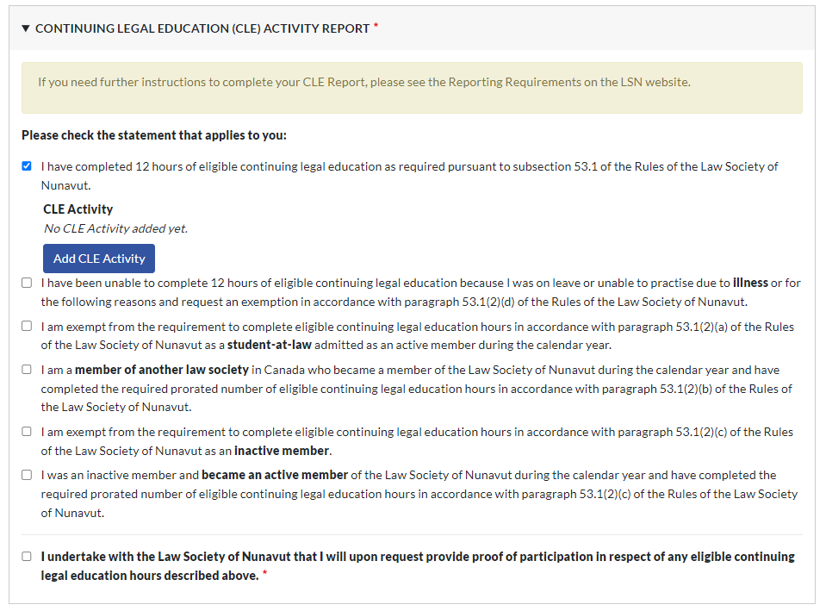
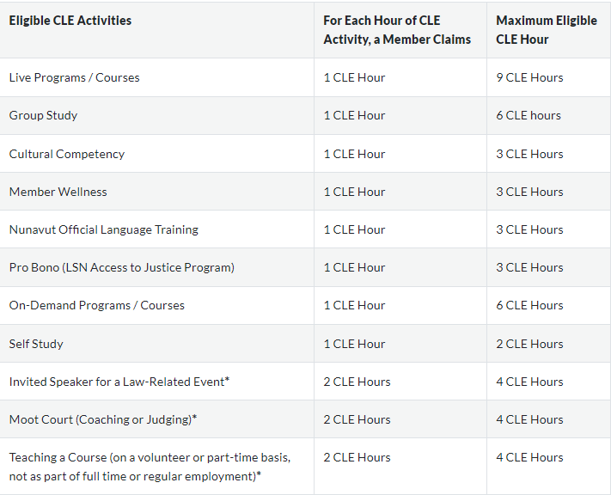
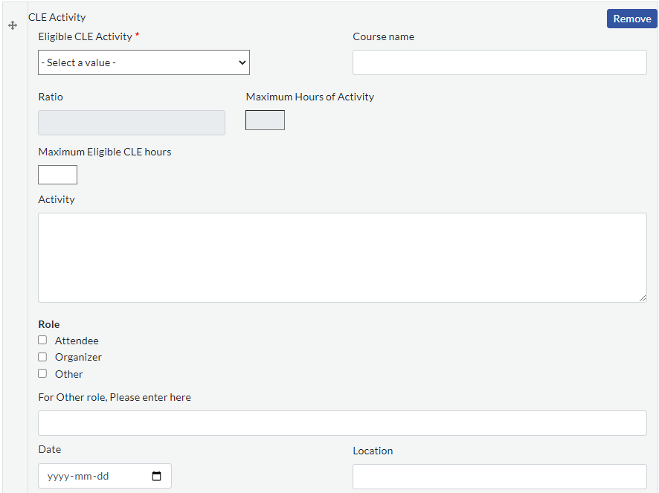
Regulatory Requirements (continued)
Continuing Legal Education (CLE)
12 hours of eligible CLE
Self-Report – Annual Membership Renewal

Slide 8
Regulatory Requirements (continued)
Duty to Report to the Law Society
Change of Address
Trust Shortages
Potential Claims
Unsatisfied Judgments
Insolvency and Bankruptcy

Slide 9
Regulatory Requirements (continued)
Duty to Report to the Law Society (continued)
Criminal or Quasi-Criminal Charges
Duty to Report Others

Slide 10
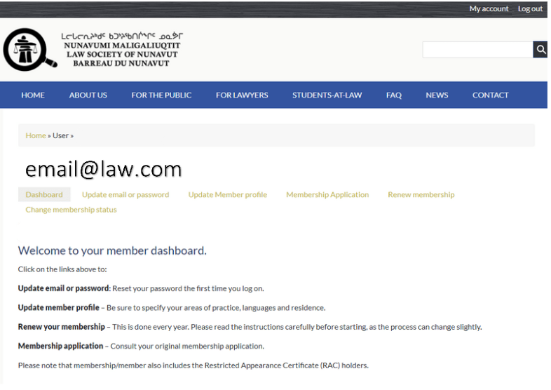
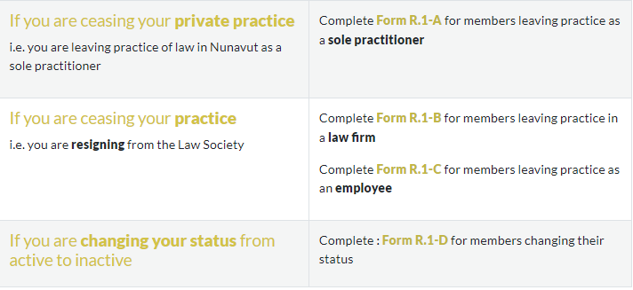
Regulatory Requirements (continued)
Change of Status - Cessation of Practice

Slide 11
Practice Management

Slide 12
Practice Management
Confidentiality
Client and File Lists
Conflict Checking
File reviews

Slide 13
Practice Management (continued)
Retainer (Engagement) Letters
Diarizing (Calendaring)
Checklists, Workflows, Templates and Precedents
Client Communication
Other Documentation

Slide 14
Practice Management (continued)
Client Property
Billing
Bookkeeping
File Closure, Retention, Destruction
Practice Absences, Interruption, and Succession Planning

Slide 15
Information Technology (IT)

Slide 16
Information Technology (IT)
Practice Management and Accounting
Document Creation and Management
Legal Research

Slide 17
Information Technology (IT) (continued)
CanLII
Nunavut Court of Justice Law Library
Law Society of Ontario Great Library
Westlaw, Quicklaw, and HeinOnline

Slide 18
Information Technology (IT) (continued)
Security
Minimum Standards for CLIA Cyber Insurance Coverage

Slide 19
Wellness

Slide 20
Wellness
Recognizing Potential Signs and Issues
NuLAP
Vicarious Trauma (Compassion Fatigue)

Slide 21
Wellness (continued)
Managing Wellness
Blocking Off time
Time Management and Focus
Healthy Habits
Support

Slide 22
Pro Bono
Legal Services

Slide 23
Pro Bono Legal Services
indemnification available for approved pro bono legal services rendered through the Access to Justice Program
Current list of approved pro bono projects on LSN website
Importance of being realistic re. your own capacity to take on pro bono work

Slide 24
New Private Practice Basic Checklist

Slide 25
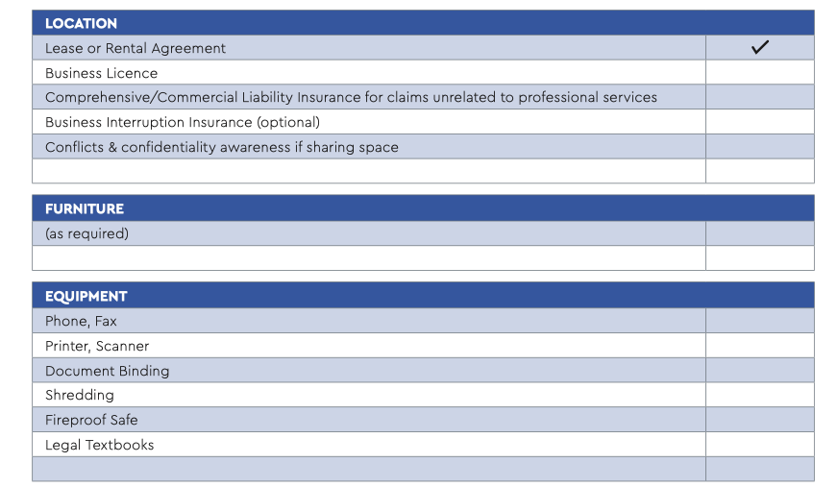
New Private Practice Basic Checklist

Slide 26
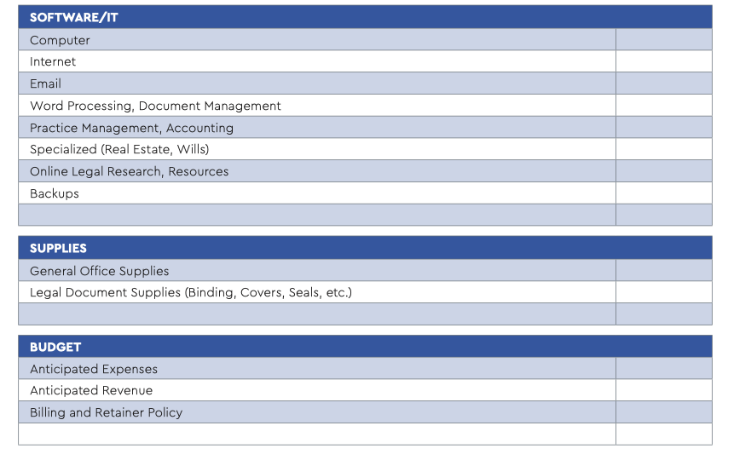
New Private Practice Basic Checklist (continued)

Slide 27
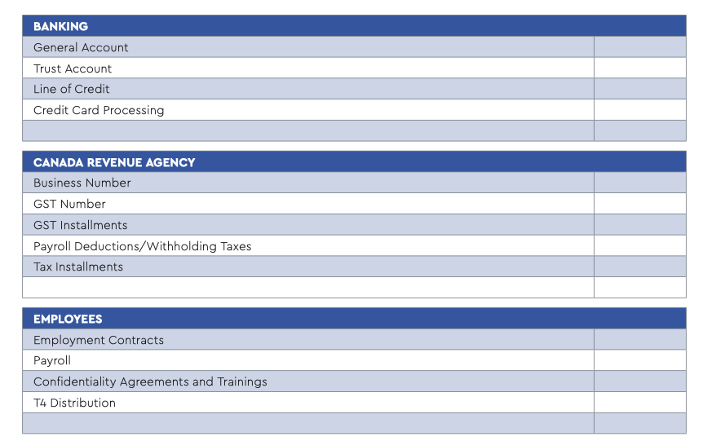
New Private Practice Basic Checklist (continued)

Slide 28
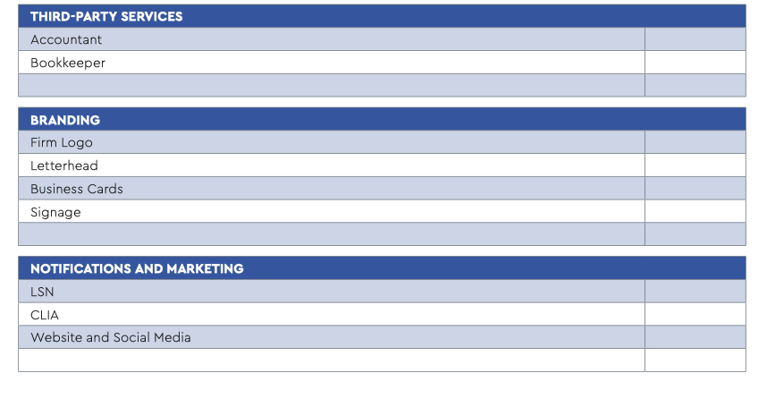
New Private Practice Basic Checklist (continued)

Slide 29
The Practice Guide
Thank
You
Meghan K. O’Brien
Sara Siebert

