Slide 1
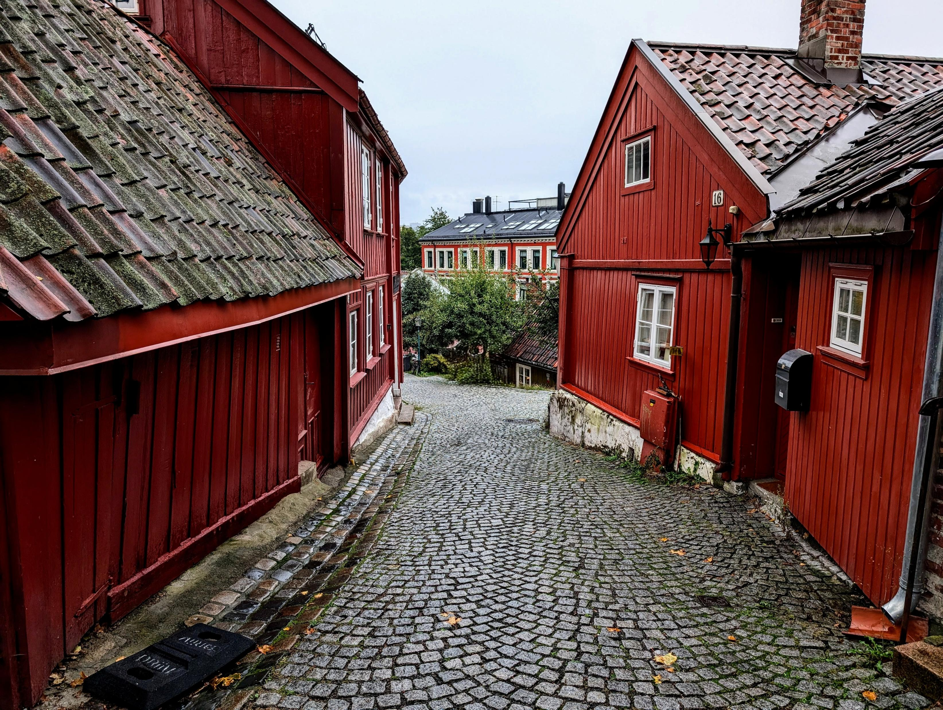
Trauma Informed Approaches to Legal Service Delivery and Design
Considerations for Mediators, Lawyers, and Legal Practitioners
By Aaron Leakey, ACE, MBC, UVic

Slide 2
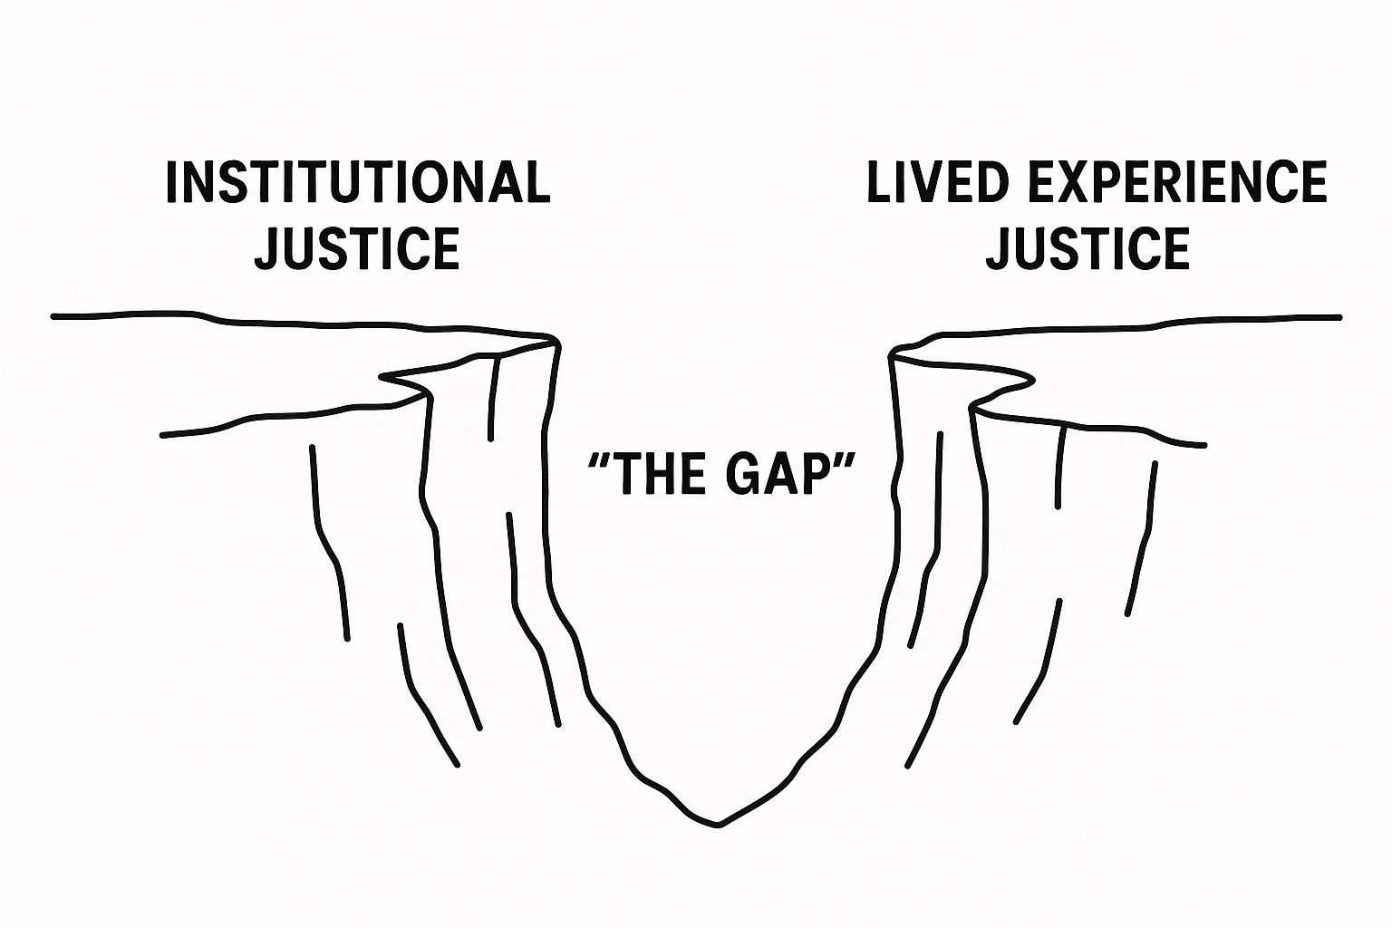
The “justice gap”
Universal
Institutional context
Static, linear
Procedural, distributive
E.g. retribution, adversarial, neutrality, equilibrium, fairness, inquisitorial, distributive, procedural
Subjective, perceived
Institutional and non-institutional contexts
Evolving, refracted, non-linear
Plural
E.g. agency, choice, voice, listening, accountability, apology, empowerment

Slide 3
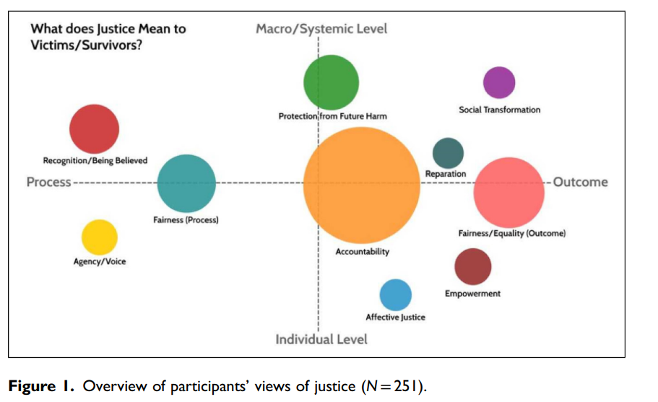
Hester et al. (2023) perceived justice among IPV survivors
Notes:
Hester et al. (2023)

Slide 4

Legal System Touchpoints and the Role of “Luck”
“Touchpoints”
“Luck”
Multiple points of contact/interaction
Each touchpoint as a whole justice activity
Each touchpoint contained with a whole justice system
Each touchpoint an opportunity for trauma-informed practice
Interactional v. procedural/distributive justice
“Being Lucky” (Saxton, 2012)
  A supportive Person
  A safe and helpful response
  The “right” legal actor

Slide 5
Trauma in Legal Institutions and Processes
Trauma Informed Practice
Trama: fear learning, body memory
“trigger”: flight, flight, freeze, fawn, tend and befriend
Core Need: Regulation
Window of Tolerance: Optimal Regulation Window
Arousal:
  Hyper: e.g. outbursts, anger
  Hypo: e.g. depressive, numb
Extinction:
  Trauma involves fear generalized across contexts
  Extinction is context specific

Slide 6
Indigenous Experience in Legal Institutions
Historical Trauma
Considerations
Caveat: A range of Indigenous experience
Caveat: risk of too close association of Indigenous experience and trauma
Intergenerational trauma: transmission of trauma at the level of the individual and the collective
“Western Universality”
Western legal systems can be “trigger”
“Embedded Assumptions” (press, 2021)
Unchanged power relationships
  Heirachy at the level of interpersonal and the level of system design
Q: How do we design legal systems and offer legal services in legally pluralistic societies?

Slide 7
Legal Pluralism and Trauma-Informed Approaches

Slide 8
What Lies Beyond: Pluralistic Legal Institutions
Considerations – Individual
Considerations - System
Critical Reflexivity
  Ambiguity in Identity
  Attention to the micro-dimensions of power
Awareness of trauma and it’s impacts
Provide culturally specific resources
Culturally rooted programing/mediation
Inclusion in the ‘design’ of legal systems and programs
“Plurality of Sovereigns” (Borrows, ?)
“Ethical space” (Ermine, 2007)
“Indigenous Law is Law” (Napoleon,
Critical engagement: “Did I break it?” (Napolean, 2019)
What lies “beyond”
  Deep Democracy (Connolly, 2005)
  Culturalized institutions (Connolly, 2005)
  Responsive law (Nonet and Selznick, 2001)

Slide 9
Trauma in Legal Institutions and Processes
Developmental Trauma
IPV and Attachment
Adverse Life Experiences (ACEs)
Formative stages of brain development
Internal working Models: internalization of the conditions of primarily relationships
Complex trauma: multiple, chronic
Attachment Insecurity: impacts one’s ability to regulate internal states
Attachment: emotional bonds
Attachment disruption
  Protest Behavior
  Reestablishing Strategies
Family Conflict
  Separation and Enmeshment
  De-enmeshment
Grief and Loss

Slide 10
Trauma in Legal Institutions and Processes
IPV
IPV
Impacts 1/3 of women globally and 1/4 of men
  Intersectional impacts
  Severe violence types
  Gender and Violence
Structural: patriarchy
‘submission and domination’
Post-structural: ‘agency in structures’
Coercion and Control (Stark, 2024)
Multiple, Intersecting Legalities: (i.e. family, criminal, immigration, housing, CP)
Legal Abusive: Law (and mediation) misused as a tool of coercion and control
Biases:
  IPV survivor as impaired in decision-making
  IPV survivor as vulnerable
  Not believed
Revictimization

Slide 11
Trauma in Legal Institutions and Processes
Trauma Informed Practice
Integrates TIP principles at all touchpoints of service delivery
Builds awareness of the normalcy of trauma experiences
Avoids re-traumatizing and promotes feelings of safety
Builds understanding of trauma symptoms and history of trauma
Considers trauma impact on development, adaptations to cope with trauma, and relationship with health
Factors in the possibility of return to maladaptive coping strategies

Slide 12
Trauma Informed Practice
Safety
Trust
Choice
Collaboration and Mutuality
Empowerment
Context

Slide 13
TIP: “safety” in Family Mediation
Considerations
Design
Mediation at infancy stage in adaption to IPV
  Needs better adaption to IPV
Tension between “safety” and “agency”
Factors
  Increased risk of harm at the point of separation
  Timeline from “point of violence”
  Type of violence
Physical Safety
  Any risk, mediation not the correct process
“window of tolerance” (Saini et al., 2025)
  Mundane conversations
Preliminary information: breaks, support persons, who attends, space, entrance and exits, ceremony, format, language, timing
Format: shuttle or virtual may be preferred
Separate and distinct preparation meetings
  Role play ‘voice’ and ‘feedback’
  Assign in-culture (when preferred) mentor
Agreements include ‘safety practices’
Tasking: counselling/therapy, group attendance, timeline, education,
Trauma: “cue” the mediator, ending process at mid-intensity,

Slide 14
Screening for Violence in Family Mediation
“Be prepared to meet the world’s most rational human being”
Considerations
Design
Extensive (additional) training is needed
Attempt to predict and prevent
Safety screening is dynamic and considers in-process and post-process harm
Safety screen is co-discerned with the impacted person’s perception of safety
Immediacy, frequency, and severity
“Static” and “Dynamic” factors
Consider the broader “social context” of violence
Use descriptive terms and probing questions, as ‘IPV’ holds different means across cultures
Have culturally specific IPV resources available
Coordinate support/resources (support, counselling)
Violence may still be unreported

Slide 15
Trustworthiness in Family Mediation
Considerations
Anthropological roots of conflict resolution
“Insider Mediators”
Authentic Relationships
Considerations: Time, Consistency, Familiarity, Predictability, Expectations, Transparency, Information Sharing, Comfortable Space, Listening, Presence
“Breakthrough only happens when mediators relate to parties more personally and engage with what lies behind the parties’ manifested behavior” - Irene Bruna Seu

Slide 16
Choice in Family Mediation
Critical Thinking: Should mediation be mandatory?
Considerations
Design
Individuals viewed as “experts in their own lives” (Saini, 2025)
Ethics of ‘self-determination’ and ‘agency’
‘agency-loss’ key feature of IPV
‘agency’ a core component of human-identity (Bush and Miller, 2020)
Co-design of mediation process
  Equity and design
Choices: timing, issues, preparation, support, mediator, documentation, style, process, ceremony, breaks, length, format
Waving Power: mediator takes more of less control of a process, pending responsible participation

Slide 17
Collaboration and Mutuality in Family Mediation
Positivist
Post-positivist
Impersonal, detached
Neutral/Impartial
Hierarchical
Non-mutual
Professional (exclusive)
Relational
Nuanced Impartiality
Problem Solving, Negotiation
Elements of Mutuality
Professional, Community

Slide 18

Collaboration and Mutuality in Family Mediation
Practically
Mutual Sharing and IPV
  Can be helpful
  Reflexive re-centering of their narrative
Critical Reflexivity
  Aware of projections, biases
  Healing and ‘activation’
  Actively shifts own power with participants
Collaboration
  Mediation Design
  Problem-Solving
Metaphor: Landscape

Slide 19
Empowerment in Family Mediation
Considerations
Design
Capability
  Lived experiences and skills/expertise as capabilities
  Can capabilities be developed?
Survivor viewed as the expert in their own experience
  Different modes of ‘vulnerable’ and ‘resilient’
  Best suited to co-discern their own safety
Non-hierarchical relationship w. mediator
  Empowerment in mediator relationship
‘Expert in your own conflict’
Considerations: coaching, training, role-play, education, counselling/therapy, choices
Consider mediation an activity of intrapersonal growth
In mediation: voice, narrative (own word), story-telling, validation, recognition, apology, being heard
Corrective imbalance: transparent and temporary imbalance in mediation to correct a domination-submission dynamic
  Relates to communication dynamics not legal issues

Slide 20
Context in Family Mediation
Considerations
Design
“Intersectional” safety
  Social categories (e.g. race, gender, sex, religion, status, ability) shape IPV experience
  Beyond “free from violence” to meeting basic human needs
  mastery, safety, social connectedness, stability, and meaningful access to resources
Address structural discourses at the level of the ‘micro’
Mediator can consider “social context” of violence
Nuanced Impartiality:
  Mediator does not adopt an impartial stance on issues of indigenous justice, identity, gender, and IPV
  Mediator is neutral/impartial on legal issues, but not on issues of communication and/or behavior
Identity, race, and gender in mediation
  Non-neutral
  Challenge (best from ‘insiders’ in cultural systems)
  Identity is not-negotiable

Slide 21
The “myriad” of power imbalances
Considerations
Mediator Power
  Mediator (almost) always hold the most power in a facilitated process
Legal Institution
  Advocacy; involvement in design; consultation; feedback
Balancing Power
  Intrapersonal: adjust in 1-1 interaction with an individual
  Noticing: make plain the power dimensions as you observe them
  Expectations: create an expectation that feedback is normal and to be anticipated
  Process adaption: (i.e. shuttle, virtual)
  Build capacity: includes emotional and legal capability
  Reduce vulnerability: address intersectional considerations and vulnerability reduction
  Voluntary compliance: use support, like relatives, to influence a high-conflict individual
  Voluntary process: emphasis the “process” is chosen and establish the requirements for participation
  Time: Elapse time to ensure integration of strategies
  Education: on the dynamics of violence/IPV

Slide 22
Restorative Mediation
Critical Thinking: How do we encourage responsibility taking?
High responsibility taking by person responsible for violence
Applies lessons from restorative justice and individually prepares parties:
  Person affected by IPV, to share the impacts of the harm and their needs
  Person responsible, to take ownership and bear the costs of repairing the harm
Community assists with accountability
May include legal concepts and/or be coordinated with a court process (i.e. recommendations given to court)
Time: long preparatory periods
Education: particularly for the person responsibility; community
Storytelling: viewed as a justice activity
Forgiveness/restoration:
  May occur, not a condition of activity
  Not pressured
Use of cultural symbols and ceremonies
Practical outcomes
  May include legal agreements
  May include restorative actions

Slide 23
Thank you
Aaron Leakey, aleakey@uvic.ca

