Slide 1


Overview of Anti-Money Laundering Rules
November 2025

Slide 2
Session Outline
Understanding anti-money laundering rules and how to comply
    Why do law societies regulate in this area?
    What are the rules and where can you find them?
    Introduction of practical tools to assist with understanding and compliance

Slide 3
History and rationale
Law societies have been involved in the fight against money laundering for more than 20 years
Started in response to federal government efforts to require lawyers to secretly report on clients engaged in suspicious and large cash transactions

Slide 4
Legal challenge
legal challenge launched in 2001 resulted in injunction preventing government from imposing suspicious and large cash reporting requirements on lawyers
Led to agreement between the law societies and government suspending litigation and requiring government to get the agreement of the law societies before imposing any other requirements on lawyers under the Proceeds of Crime (Money Laundering) and Terrorist Financing Act
legal challenge resumed in 2011 in response to government attempts to apply client identification and verification requirements to legal professionals
2015: SCC upheld that constitutional challenge, noting that the Model Rules adopted and implemented by the law societies were a reasonable alternative to federal regulation

Slide 5
Model rules
Working through the Federation, Canadian law societies have developed and implemented three model anti-money laundering rules:
  Model Rule on Cash Transactions
  Model Rule on Client Identification and Verification
  Model Trust Accounting Rule
  Together these rules limit the amount of cash lawyers may accept, impose extensive due diligence obligations on lawyers, and restrict the use of professional trust accounts

Slide 6
Nunavut AML rules
Cash Transactions
Rule 80.1
Client Identification and Verification
Rules 80.2-80.9

Slide 7
Cash Transactions
Rule 80.1
Limits value of cash a lawyer may receive in relation to a client matter
Subject to some exceptions lawyers may not accept cash in an aggregate amount of more than $7500 in relation to a client matter
Exceptions:
  received from a financial institution or public body
  received from a peace officer, law enforcement agency, or other agent of the Crown acting in official capacity
  used to pay a fine, penalty or bail
  received for professional fees, disbursements, or expenses
  Refunds of such cash must be made in cash

Slide 8
Receipt of cash checklist
Law Society of Nunavut has developed some precedents, charts and checklists to assist you in complying with the anti-money laundering rules
Receipt of cash checklist is one
  Serves as both a checklist and a record

Slide 9
Client Identification and Verification
Identification
    Required when providing legal services (Rule 80.3), subject to limited exceptions
  Verification
    Required when a financial transaction is involved ( Rule 80.4) unless an exception applies

Slide 10
IDENTIFYING INDIVIDUALS
  Rule 80.3(a) - obtain and record:
      full name
      home address and telephone #
      occupation(s)
      work address and telephone # (if applicable)
      the applicable date of the identification

Slide 11
Identifying organizations
Rule 80.3(b) – obtain and record:
      full name
      business address
      business telephone #
      incorporation # or business ID # (if applicable)
      type of business
      name, position, and contact information of person authorized to give instructions
      the applicable date of the identification

Slide 12
Exceptions to identification requirement
  Rule 80.2(2)
    providing legal services to your employer
    acting as an agent for another lawyer
    acting on a referral from lawyer who has already done the identification
    acting as duty counsel

Slide 13
Verifying client identity
Rule 80.6
When engage in or give instructions regarding a financial transaction must:
  Obtain and record information on the source of funds (80.6(1)(a)), and
  Verify the identity of the client (80.6(1)(b)) and obtain a copy of the documents relied upon (80.7)

Slide 14
Verifying identity of an individual
Four ways to verify the identity of an individual (including individual providing instructions for an organization) (Rules 80.6(2) and 80.61(a))
Photo identification issued by federal, provincial, territorial, or foreign government (other than a municipal government)
Information contained in Canadian credit file
Information from any two reliable sources containing the individual’s name and address, their name and date of birth, or their name and confirmation of a deposit account, credit card account or other loan with a financial institution (Dual method)
Using an agent
All documents used to verify identity must be valid and current

Slide 15
Timing of verification - individuals
  Upon engaging in or giving instruction regarding receiving, paying, or transferring of funds (also applies for individual providing instruction for organizational client) (Rule 80.63)

Slide 16
Verifying identity of an organization
If an organization such as a corporation, created or registered pursuant to legislation:
  Written information from a government registry confirming the existence, name and address of the organization, including the names of its directors, where applicable, such as:
  a certificate of corporate status issued by a public body;
  a copy annual filing
  a copy of a similar record obtained from a public body that confirms the organization's existence
Organizations such as trusts, partnerships:
  Copy of the organization's constating documents, such as a trust or partnership agreement, articles of association

Slide 17
identifying directors, shareholders and beneficial owners
Rule 80.62 requires you to obtain and record the following information for organizational clients:
the names of all directors of the organization, other than an organization that is a securities dealer;
the names and addresses of all persons who own, directly or indirectly, 25 per cent or more of the organization or of the shares of the organization;
the names and addresses of all trustees and all known beneficiaries and settlors of the trust; and
information establishing the ownership, control and structure of the organization.

Slide 18
Timing of verification - organizations
  Upon engaging in or giving instructions in respect of a financial transaction, but in any event no later than 30 days thereafter

Slide 19
Exceptions to verification requirement (rule 80.5)
  client is or funds are paid by/to financial institution, public body, or reporting issuer
  funds are:
    received from trust account of another lawyer
    received from peace officer, law enforcement agency, or public official acting in their official capacity
    paid or received to pay court order, fine, penalty
    paid or received for professional fees, disbursements, or expenses
  electronic transfer of funds (EFT)

Slide 20
Law Society Resources
Client identification and verification overview
Client identification and verification flow chart

Slide 21
Source of funds
When engaged in or giving instructions about a financial transaction on behalf of a client, lawyer must obtain and record, with the applicable date, information about the source of the funds being used for the transaction (Rule 80.6(1)(a))
“Source of funds” means the economic activity or action generating the funds being used for the transaction. Examples include savings from salary, insurance proceeds, inheritance, proceeds from the sale of property, and bank loan
Law society has new guidance on source of funds

Slide 22
Ongoing monitoring
Rule 80.9
Requires lawyers to periodically assess the business relationship with the client to determine whether
the client's information in respect of their activities
the client's information in respect of the source of the funds, and
the client's instructions in respect of transactions
is consistent with the purpose of the retainer and the information the lawyer has about the client and whether there is a risk the lawyer may be assisting in or encouraging dishonesty, fraud, crime or illegal conduct

Slide 23
Ensuring compliance
Ensuring compliance with anti-money laundering rules and acting when the rules are breached are essential elements of law society regulation

Slide 24
Assessing compliance – law society powers
  In an investigation the Law Society can compel a member to answer questions and produce documents (LPA 24(2))
  Law society also has power to audit member’s financial records (LPA 47)

Slide 25
Consequences for non-compliance
Law societies can and do discipline lawyers for breaching anti-money laundering and related rules
A finding of conduct unbecoming or professional misconduct can result in penalties ranging from reprimand, fine, suspension, disbarment (LPA 29.1-31)
Recent report by Federation of Law Societies of Canada on effectiveness of law society regulation includes comprehensive list of relevant discipline cases and outcomes

Slide 26
Examples of discipline cases
Law Society of B.C. v Dureault lawyer was possible dupe in facilitating crime; in using trust account failed to make reasonable inquiries or ensure sufficient connection to legal services; failed to comply with client identification and verification rules; agreed to 3-month suspension
Law Society of Ontario v Starr licence revoked for misconduct including: (a) receiving sums of cash over the allowed amount ($42,500) for one client matter; (b) using his trust account for purposes unrelated to legal services (c) drawing on trust funds held for other clients (d) proposing a scheme to launder money for his client
Law Society of Alberta v McKen lawyer suspended for 45 days with cost order of $7500 for failing to identify two clients as required by the rules
Law Society of Ontario v Davis lawyer disbarred for receiving money in cash ($157,400) where it was likely that the cash was the proceeds of crime

Slide 27
Law Society of Nunavut Resources
LSN Website: Code, LPA, Rules & al
Receipt of Cash Checklist
Client Identification and Verification Overview
Client Identification and Verification Flow Chart
Source of Funds Guidance

Slide 28
Other resources
Federation of Law Societies of Canada website contains extensive resources including an online educational program and guidance documents
Available here:
https://flsc.ca/what-we-do/fighting-money-laundering-and-terrorist-financing/

Slide 29
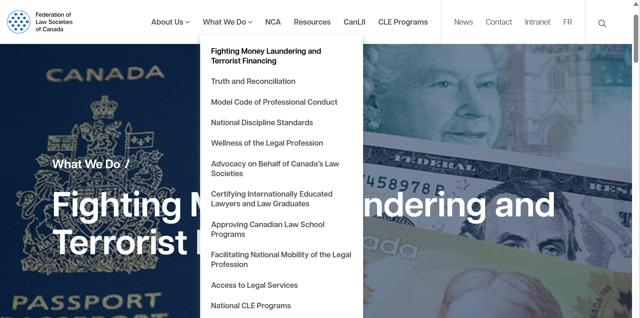

Other resources
Federation of Law Societies of Canada

Slide 30

Questions?

