Slide 1





Finding the Glimmers in Your Daily Life
Welcome to the launch of a workshop series on Mental Health
with Rachel Hollingshead, MSW, RSW
Rock & Willow Wellness

Slide 2
Workshop Series Purpose
Friday is World Mental Health Day
And so, it was chosen as a fitting time for this launch.
A series of Workshops will be facilitated over the weeks ahead, with the goal of building capacity for Nunavut Lawyers, in the Nunavut context, to recognize, and to respond to trauma, (and other mental health struggles), and to improve overall well being for your clients and yourselves.

Slide 3
Workshop Series Objectives
-to increase knowledge and awareness of mental health, trauma, and trauma informed practice
-to develop tools/skills for, and comfort in, recognizing and responding to trauma in clients
-to build insights, skills, and tools to support wellness for both clients and yourselves in the context of this challenging work

Slide 4
Lunch and Learn One
Trauma - Defining the terms and building understanding
What is trauma? (‘Big T’ and ‘little t’ trauma)
Understanding PTSD
Secondary Trauma and Vicarious Trauma
Compassion Fatigue (Empathic Distress), and Burnout
Hope and recovery

Slide 5

Lunch and Learn Two
Trauma Informed Practice
What is Trauma Informed Practice?
The Pillars / Principles of Trauma Informed Practice
The Benefits of Trauma Informed Practice
Trauma Informed Practice in application (some considerations)

Slide 6
In-person workshops
In-person workshops will include themes of:
Supporting Clients
Supporting Ourselves
Supporting One Another

Slide 7
In-person workshops
Didactic and experiential learning could include:
A Group Brainstorm – what are the biggest challenges, risks, and rewards of this work in the Nunavut context?
Mental Health and Wellness (an overview / general considerations)
Making space for Grief and Loss
Recognizing and challenging stigma
Other suggestions are welcome!!

Slide 8
Supporting Clients
In support of clients:
Strategies for building rapport and establishing trust
Communication (strategies for interviews; phrasing, validating, containing and redirecting)
Recognizing and responding to a trauma response
Suicidality (risks, awareness, support and follow up)
A deeper dive into Trauma Informed Practice (tools and strategies for working with and supporting clients)

Slide 9
Supporting Ourselves
In support of ourselves:
Tools and skills for supporting our own wellness
Strategies for ‘letting go’ of what is not ours to hold
Working / Living Within Our ‘Window of Tolerance’
Building Resilience
Recognizing ‘red flags’ (early), and responding
Asking for support
What does / could support look like?

Slide 10
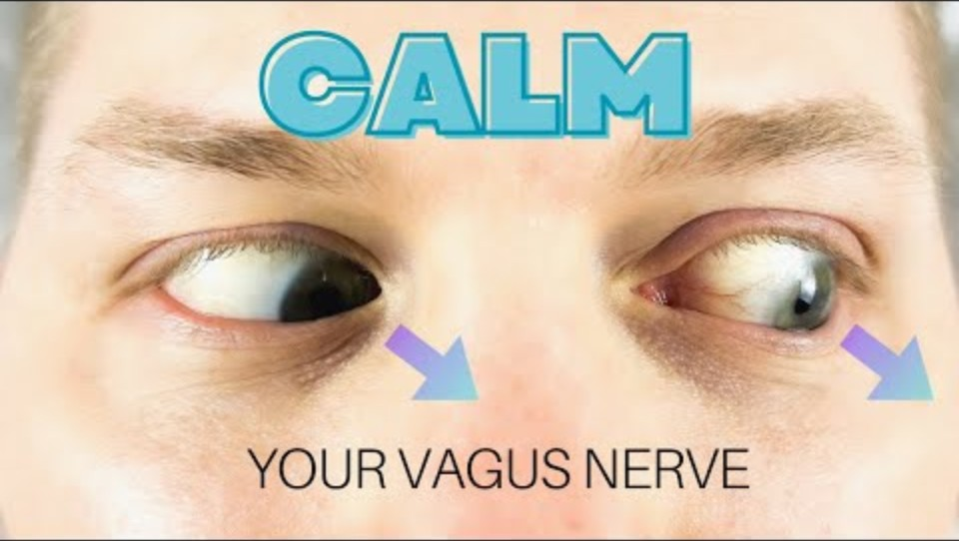
Supporting Ourselves

Slide 11
In Support of One Another
In support of one another
Moving beyond Self Care
Creating and Supporting a Culture and Community of Care

Slide 12
A Take-Away for Today
G L I M M E R S

Slide 13
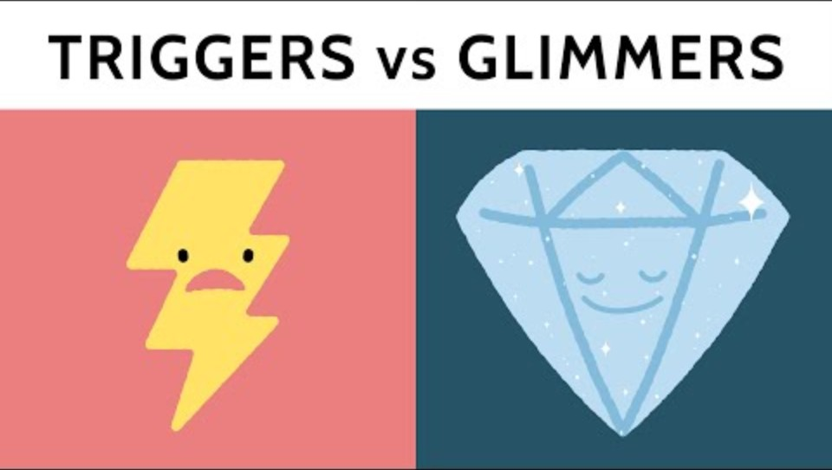

Slide 14
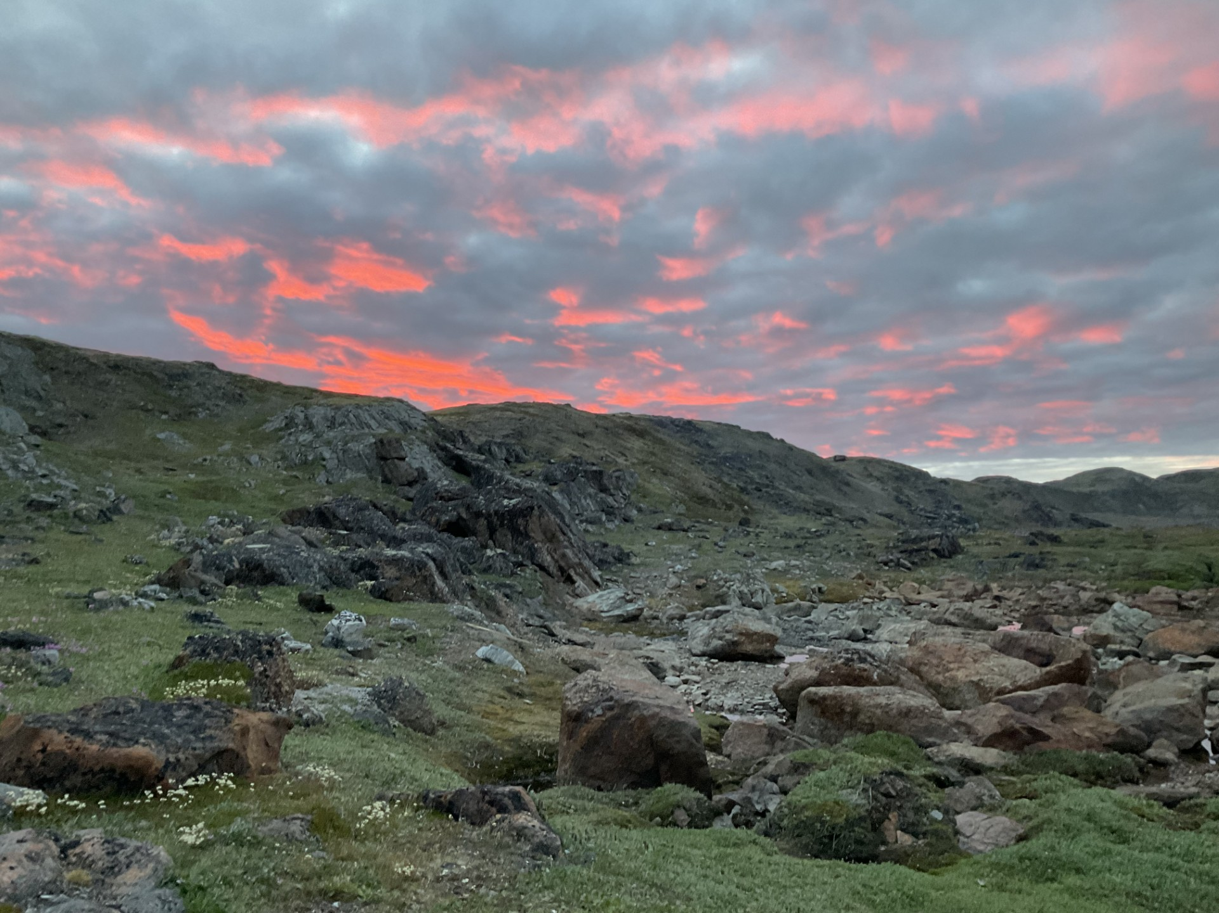
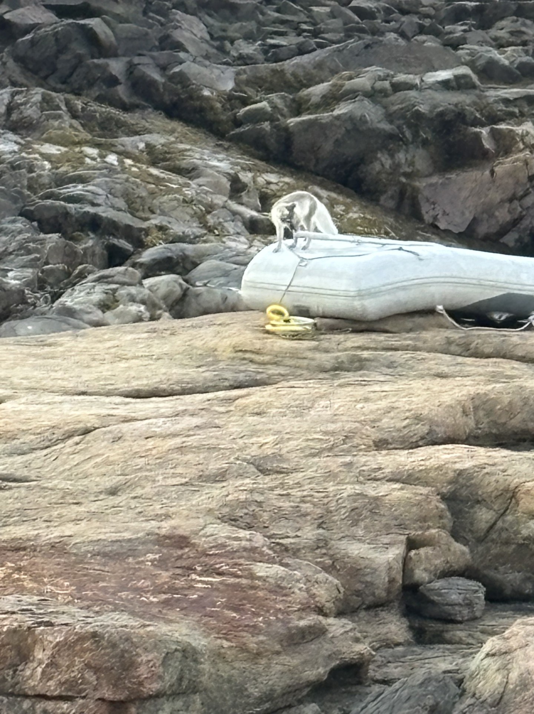
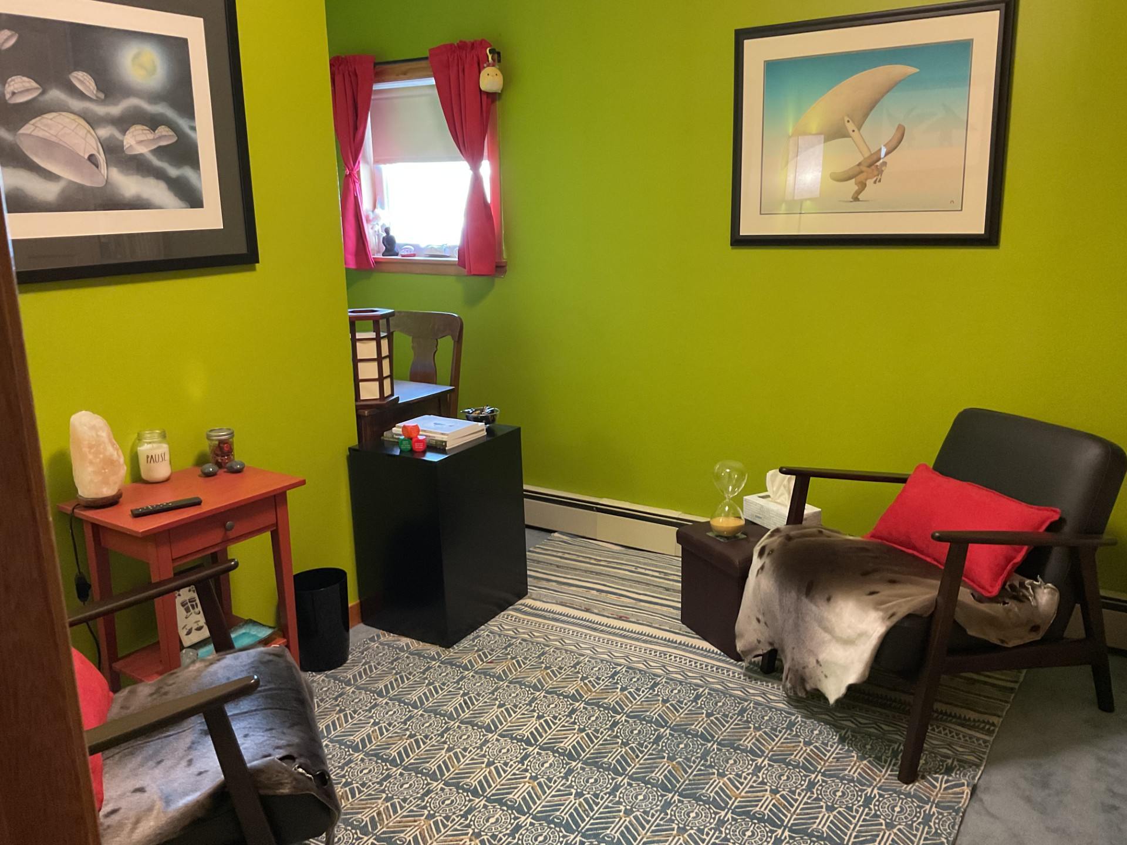
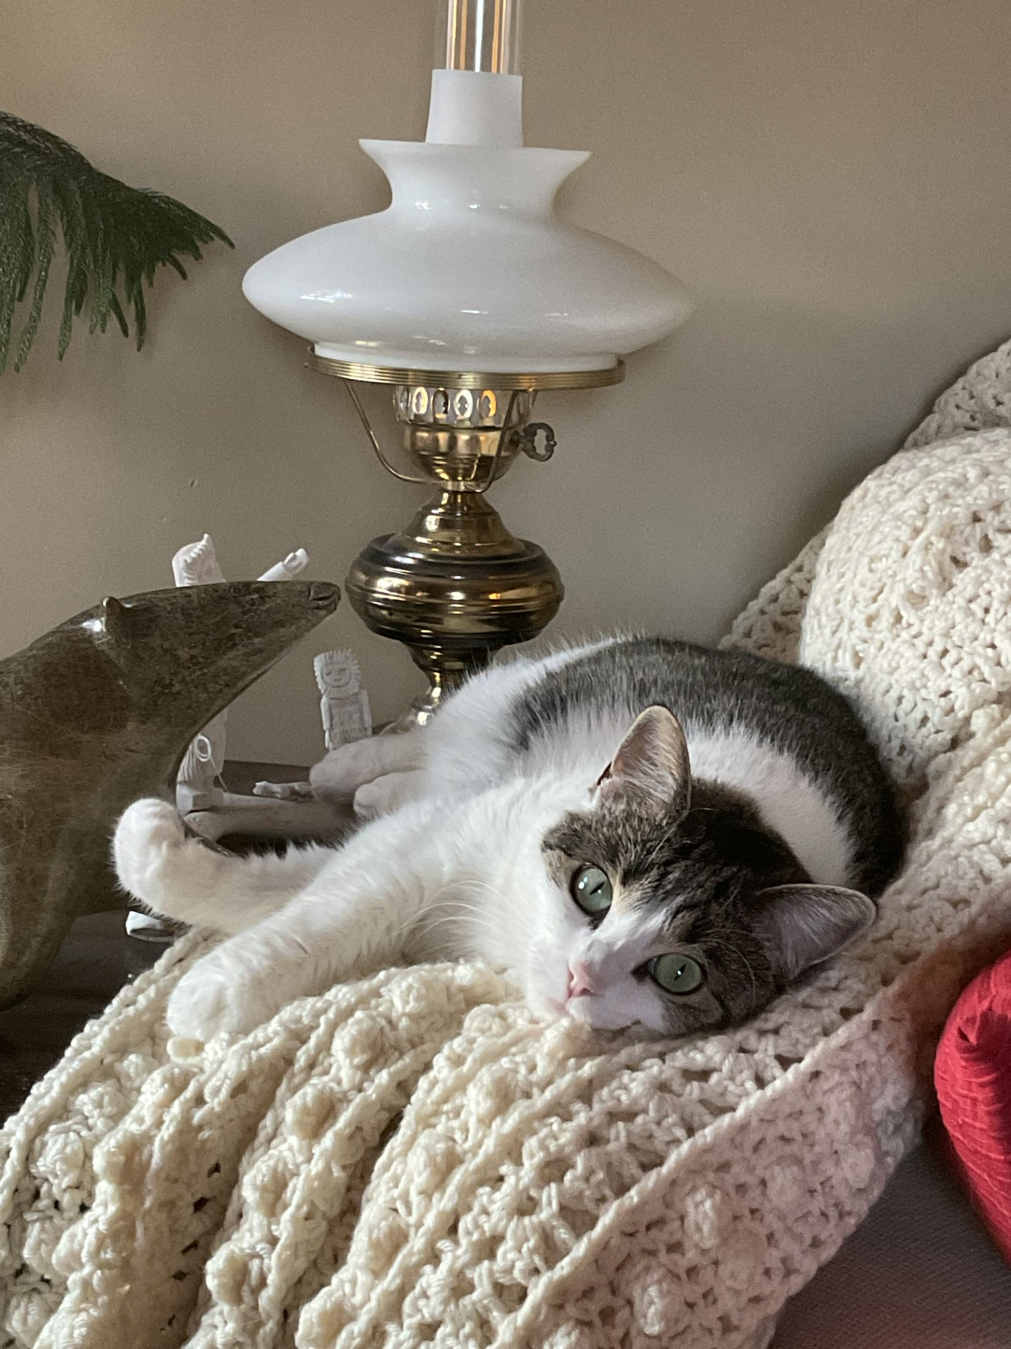
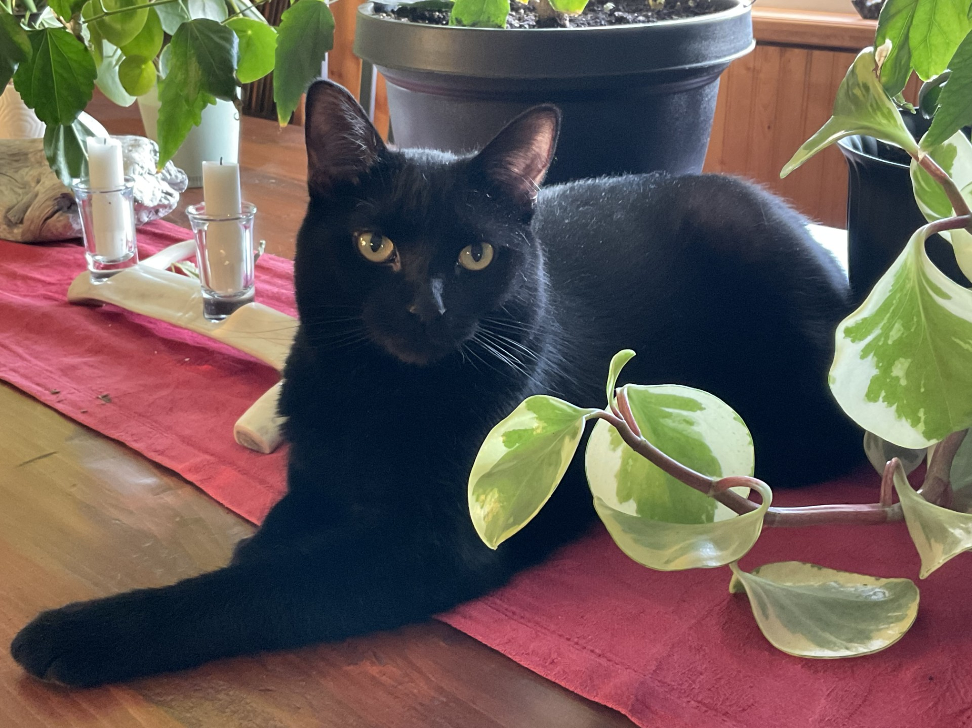
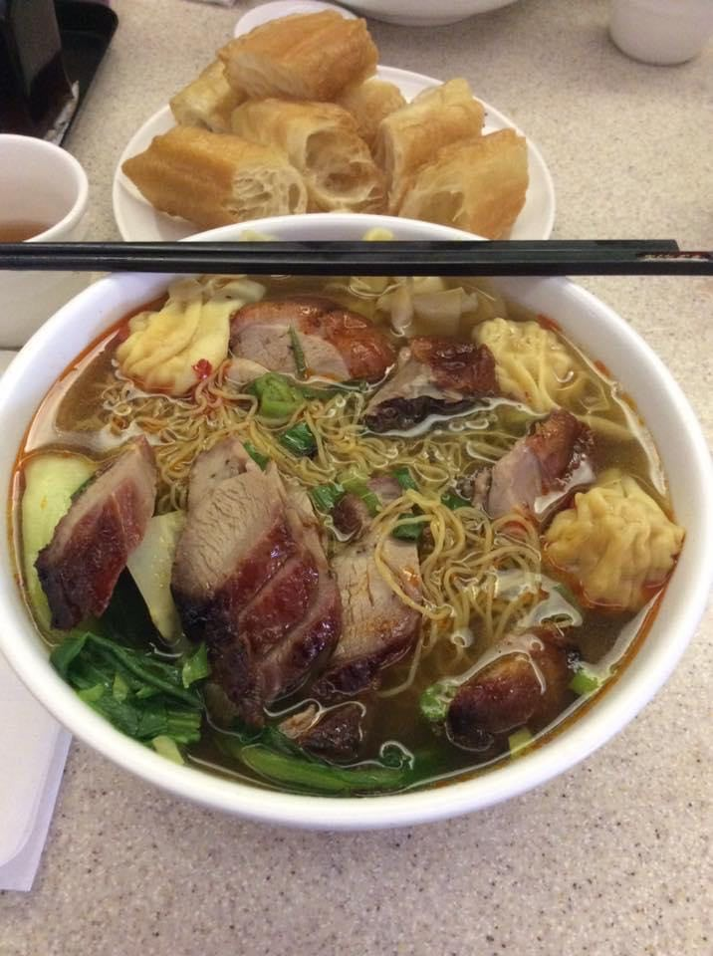
A Take-Away for Today
G L I M M E R S

Slide 15
Your Challenge (should you choose to accept it)
Find the GLIMMERS in your day to day!
Be curious
Be intentional
Write them down
Share them!
Notice their impact and allow it to be felt

Slide 16

Questions? Comments?
FeedBack?

