Slide 1
EDI and the Canadian Legal Profession
Dr. Rebecca Bromwich, PhD, MBA, LLM, LLB

Slide 2
Presentation Overview:
EDI Terminology and Concepts
2. History of EDI in Legal Profession
3. Some best practice suggestions

Slide 3
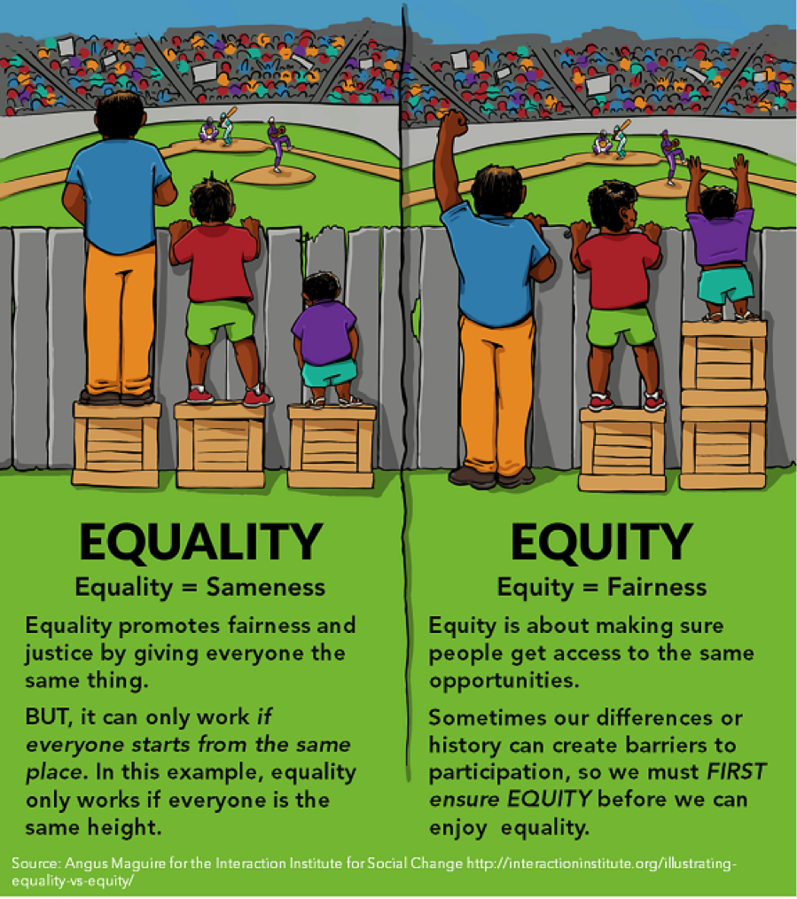
What is equity? ”substantive equality” s. 15(2) Charter

Slide 4
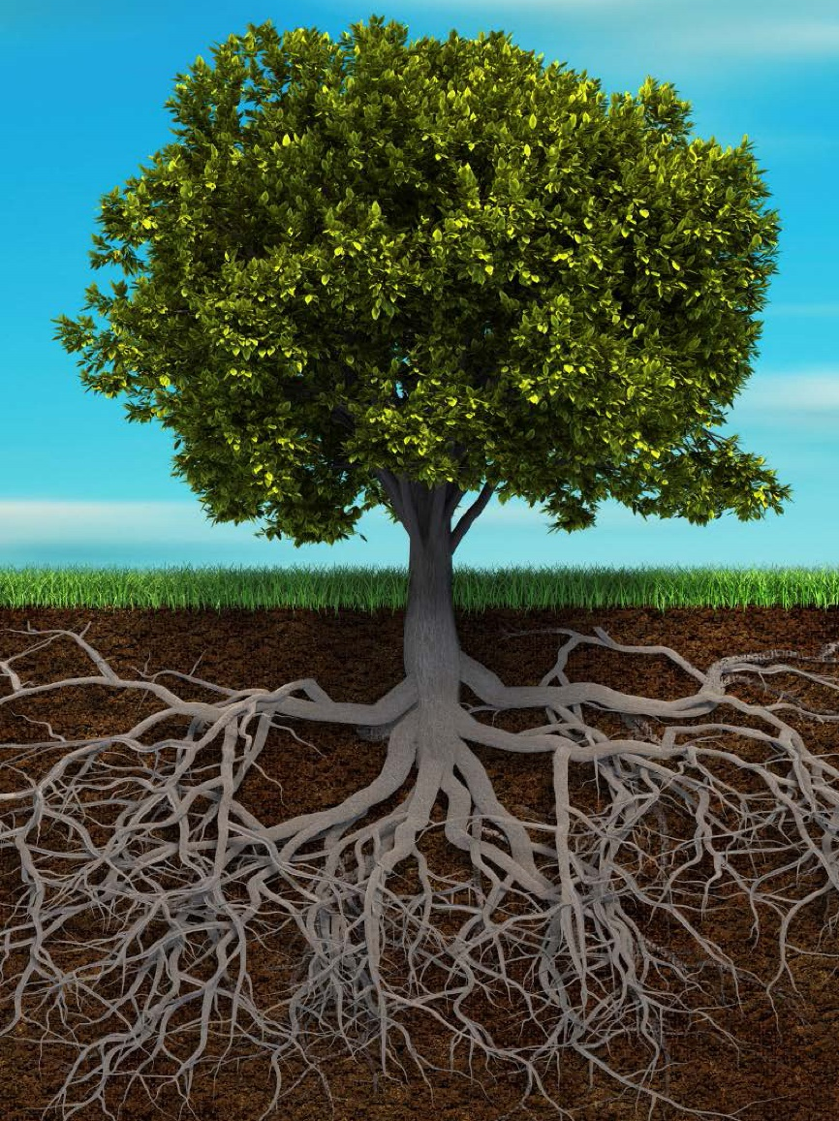
What do “diversity” and “Inclusion” mean?
Any uniqueness that can be used to differentiate groups and people from one another. It means respect for and appreciation of the full range of differences (and similarities) in ethnicity, gender, age, national origin, disability, sexual orientation, education, and religion.
Age
Gender expression
Gender
Physical ability
Race & ethnicity
Diversity
Some of which are VISIBLE…
Nationality
Education
Heritage
Gender identity
Talents
Non-visible disabilities
Beliefs
But many which are INVISIBLE…
Religion
Life experiences
Sexual orientation
Education
Marital status
Career responsibilities
Notes:
Notes:
Most often we find that diversity has been thought of in terms of the visible differences between people. These include: age, gender, physical ability, and race & ethnicity.
However, those visible features are often just above the surface.
There are many invisible characteristics that lie below the surface. These make up the majority of who we are.

Slide 5
THE GROUND-LINE OF VISIBILITY: HOW MUCH DO YOU REALLY KNOW SOMEONE?
Unconscious bias operates at a very subtle level and below our awareness
It results in almost unnoticeable behaviours – micro behaviours – such as:
paying a little less attention to what the other person says
addressing a person less warmly or talking less to them
These are cumulative and may create disadvantage
“This is what people perceive about me”
Visible characteristics of a person
Age
Gender expression
Gender
Physical ability
Race & ethnicity
“This is what people don’t realize about me”
The underlying characteristics which make up the vast majority of someone lie below the surface, out of sight
Heritage
Nationality
Education
Talents
Non-visible disabilities
Languages
Gender identity
Religion
Beliefs
Sexual orientation
Life experiences
Education
Marital status
Career responsibilities

Slide 6
What does “diversity” and “Inclusion” mean?
Inclusion
Recognizing, respecting, and welcoming the diversity of others to create an environment that promotes equality and fosters feelings of individual value and belonging.
Celebrating and fully leveraging people’s differences to the benefit of the organization, not merely tolerating them.
Notes:
Notes:

Slide 7
EDI and the legal profession: historical perspective
See e.g. Constance Backhouse, (2013) GENDER AND RACE IN THE CONSTRUCTION OF “LEGAL PROFESSIONALISM”: HISTORICAL PERSPECTIVES

Slide 8
Historical Inequalities
Antisemitism: in 1920s and 1930s, Bora Laskin, who went on to become a Supreme Court Judge, for several years could not find an articling position because he was Jewish and most firms would only hire white, Christian men.
Sexism: women struggled to find work as lawyers and continue to face “glass ceilings”, pay inequity, and sexual harassment
Racism: ongoing challenges faced by racialized lawyers in terms of disproportionate attrition, discrimination etc.
Cultural Genocide against Indigenous population.
Robert Sutherland became Ontario’s first black lawyer in 1855.
Clara Brett Martin became Ontario’s first female lawyer in 1897.
Low numbers of Indigenous persons called to the Bar.
Bora Laskin became the first Jewish justice to sit on the Supreme Court of Canada in 1970 and three years later, he became the first Jewish chief justice.

Slide 9
Ongoing challenges
TRC Calls to Action towards Reconciliation
“Statement of Principles” controversy and “Stop SOP” LSO Benchers
Throughout Ontario’s articling program, about 18 percent of students are racialized. However, Law Practice Program, alternative to articling, racialized students make up 32 percent of the total enrolment. These statistics suggest that the articling system’s hiring process has retained its historical prejudice.
Disproportionate attrition of women and racialized persons
Lower income levels by those who are not white men.

Slide 10
Some Best Practice Suggestions

Slide 11
5 Strategies for Recruiting Diverse Candidates
Representation - Recruiters/ Communications/ Job Description.
Collaboration – Work closely with law schools and professional groups
Neutralize Bias –
improve the Candidate Screening Process.
design an Interview Process Mindfully
Metrics Evaluate your Diversity Hiring Metrics.
Authenticity - Create and Review Policies Reinforcing Diversity and Inclusion.

Slide 12
DISRUPTING BIAS AND CREATING ACCOUNTABILITY: Interviewing

Slide 13
Equitable Interview Processes:
Multiple interviewers
Standardized interview questions
Questions set in advance
Questions should be purposeful
Evaluate using metrics
Use work samples or tests
Give ample time

Slide 14
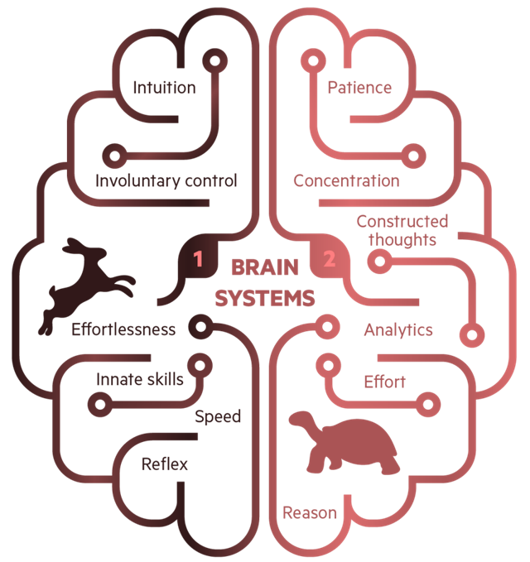
THE COGNITIVE SCIENCE BEHIND BIAS STEMS FROM TWO SYSTEMS OF THOUGHT
Story oriented
Unconscious
Requires time
Reflective
Slow
Minimal energy
Planner
Conscious
Factual
Automatic
Assumptive
Logical
Pattern Driven

Slide 15
CAPACITY BIAS: RUNNING ON EMPTY
It takes mental energy to exercise self-control and make decisions. When we’re tired we are more likely to make decisions based on emotion and default to the status quo.

Slide 16
INFORMATION BIAS: I HEAR YOU, BUT…
A slippery slope of opinion, biased information selection, double standards of evaluation and emotion – leading to over-confidence, and worrying about being right, more than caring about being wrong

Slide 17
EVEN IF I AM A LITTLE BIASED…
GO TO WEBSITE >>>

Slide 18
STATUS QUO IS THE NORM, CHANGE TAKES DELIBERATE EFFORT
A bias is a mental shortcut that influences decisions and behaviours
Over time, our mental shortcuts become routine and we can mistake them for robust thinking – leading us to have blind spots
Beware of moments of personal vulnerability
Dedicate time and effort to mitigating strategies
Accept susceptibility bias
Care about the impact of bias
Expect challenge from others

Slide 19
THE NUDGE FRAMEWORK HELPS DESIGN AND IMPLEMENT EFFECTIVE NUDGES
A nudge is a “mental push” that helps address behavioural change by disrupting things we think and do unconsciously
To develop nudges, consider what you want to target and decide on scope
Raise awareness
Modify the process
Reframe the issue

Slide 20
BIAS & NUDGE EXAMPLE: MEETING MECHANISMS
Social bias
Influences who we connect with I’m just like you…
Information bias
Influences how we make decisions I hear you, but…
Capacity bias
Influences our behaviour when we are low on mental energy
Meetings
Bias
Nudges
Diverse contributions/ opinions:
Establish ground rules that allow everyone to have their chance to contribute.
At critical moments in a meeting ask people to write down their individual views before open group discussion
Ask ‘quieter’ voices for their perspectives.
Groupthink & Loudest Voice:
Whoever speaks first sets the tone. OR
Loud and assertive personalities can dominate the floor.
Risk of being one-dimensional.
Unfair weighting on their point of view and others being influenced.
Diverse group:
Ensure that a broad range of participants have accepted invites.
Alter meeting times so that one person is not routinely excluded
Missing Voices: Unintended exclusion can occur based on who is invited, and who does the inviting.
Rushed Decision-making
Agenda items last on the list may not have the benefit of all perspectives and allow folks to challenge or add to our thinking
Balance the timing
Rotate agenda items at standing meetings, or better yet, shorten agenda topics to reduce capacity overload and provide sufficient time for discussion

Slide 21
Tracking EDI Metrics
TRUST - Ensure anonymity
ASK ABOUT:
Demographics
Representation
Advancements
Engagement
Inclusion
Establish a baseline and repeat surveying

Slide 22
EDI and Nunavut

Slide 23
Diversity, equity and inclusive lessons from a workplace in the Canadian Arctic
“The population of Nunavut is approximately 38,000 of which 85 percent are Inuit. There are 25 communities accessible only by plane during the year and by boat during the summer months. Living and working in this environment has unique challenges and offers learning opportunities about Inuit culture, leadership and its impact on the diversity, equity and inclusion (DEI) in the workplace.”
“The workforce is diverse, consisting of Inuit employees (30-60%) and others (40-70%) who are of varied ethno-cultural backgrounds, gender, abilities, immigration status and sexual orientation.”
Arijana Haramincic, "Diversity, equity and inclusive lessons from a workplace in the Canadian Arctic." (2022) A Field Guide to Managing Diversity, Equality and Inclusion in Organisations 147.

Slide 24
Presentation Recap:
1. EDI Concepts and Terminology
2. History of EDI in legal profession
3. Some best practice suggestions

Slide 25
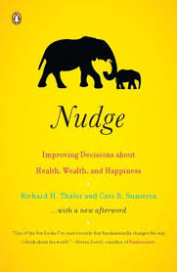
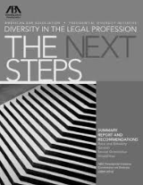
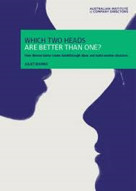
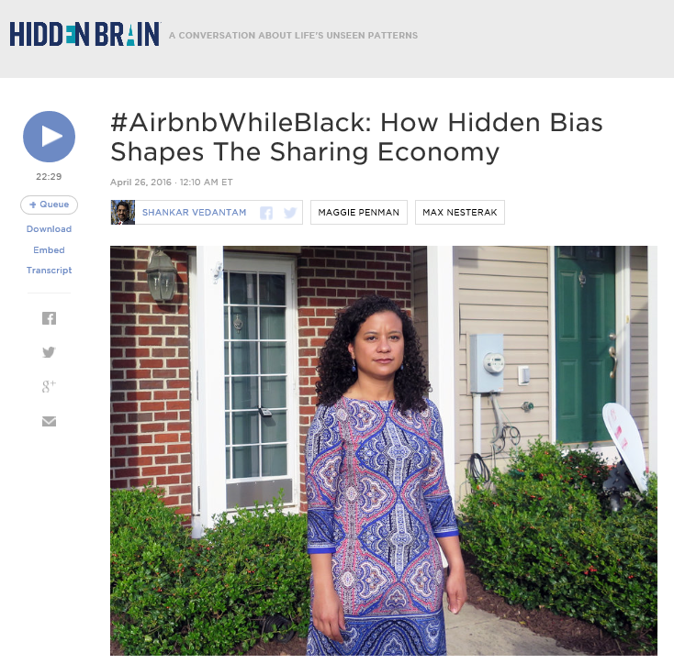
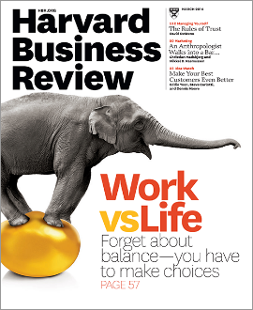
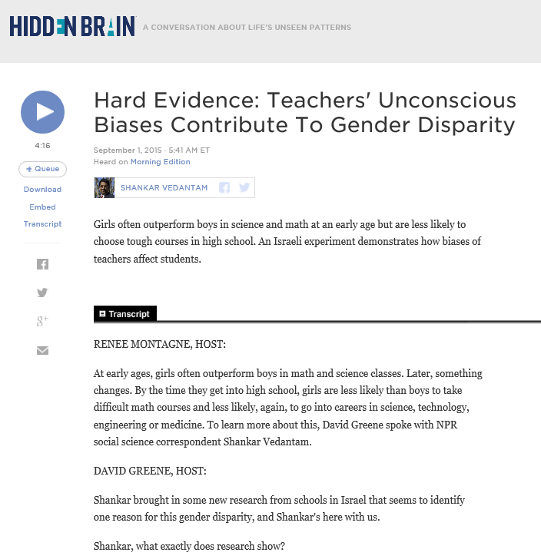
WANT TO KNOW MORE? BOOKS, ARTICLES, AND VIDEOS ON EDI
 | Nudge: Improving Decisions About Health, Wealth, and Happiness by Richard H. Thaler and Cass R. Sunstein
 | Affinity bias in the Legal Profession by Stella Tsai and Debra Rosen
 | Fear of Being Different Stifles Talent by Kenji Yoshino and Christie Smith, HBR article
 | Blindspot: Hidden Biases of Good People by Mahzarin R. Banaji and Anthony G. Greenwald
 | Which Two Heads Are Better Than One? by Juliet Bourke
 | Waiter, is that Inclusion in my soup? A New Recipe to Improve Performance Deloitte
 | Project Implicit Association Test Harvard University
 | NPR podcast on the role of racial bias in the sharing economy
 | NPR podcast on role of gender bias in teaching/learning

Slide 26
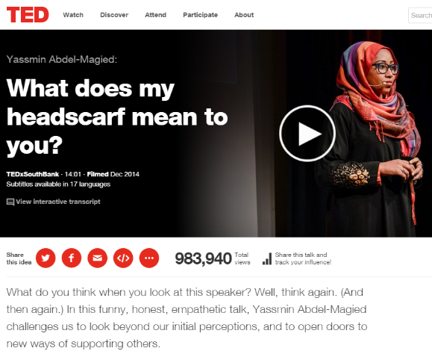
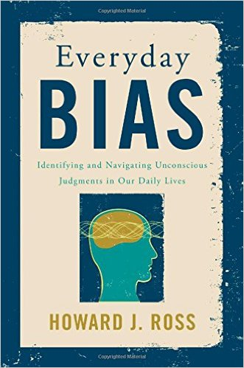
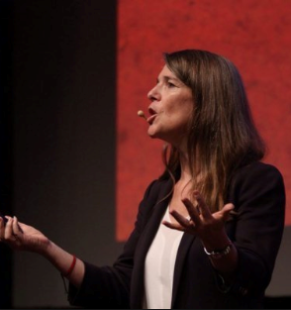
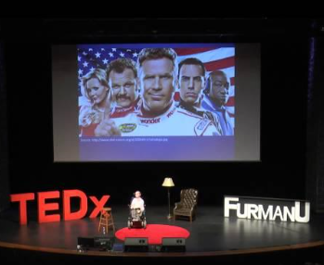
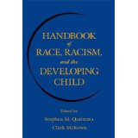
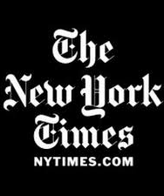
WANT TO KNOW MORE? BOOKS, ARTICLES, AND VIDEOS ON EDI (CONTINUED)
 | What Does My Headscarf Mean to You? by Yassmin Abdel-Magied
 | Diversity of Thinking by Juliet Bourke
 | How Corporate America is Tackling Unconscious Bias Fortune Magazine
 | Everyday Bias: Identifying and Navigating Unconscious by Howard J. Ross
 | The motherhood penalty The Globe and Mail by Anne-Marei Slaughter
 | Handbook of Race, Racism and the Developing Child by Stephen M. Quintana and Clark McKown
 | In & Out: Diverging Perspectives on LGBT Inclusion in the Workplace by CCDI
 | Covering at Work by Christie Smith
 | ’Whitening’ the Resume New York Times, 2009

Slide 27
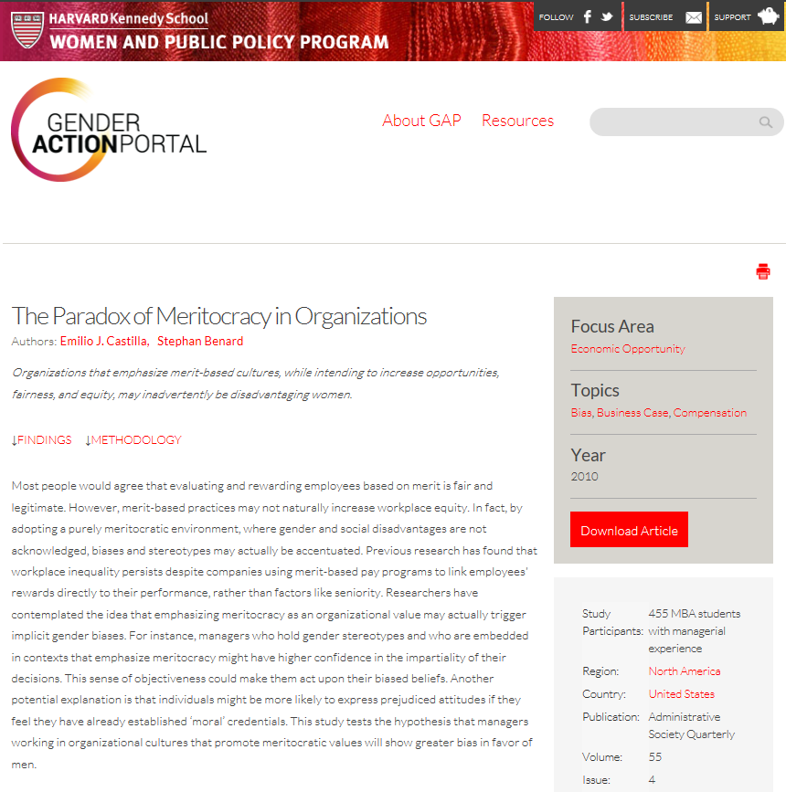
WANT TO KNOW MORE? BOOKS, ARTICLES, AND VIDEOS ON UNCONSCIOUS BIAS (CONTINUED)
WRAP UP
 | The 2017 Deloitte Millennial Survey Deloitte
 | Widening the Circle: Increasing Opportunities for Aboriginal People in the Workplace Deloitte
 | No Names, No Bias? The Economist
 | Bias Unveiled: Religion in the Workplace The Economist
 | The Paradox of Meritocracy in Organizations by Emilio J. Castilla Stephan Benard
 | Role Models: Benchmarking LGBTQ Equality Deloitte

Slide 28
Thank you
Dr. Rebecca Bromwich, PhD, MBA, LLM, LLB
Rebecca@apstrom.ca

