Slide 1
Nunavut Statutes Examination Special Meeting
February 28, 2024

Slide 2
Overview
Request for Feedback from the Membership
Special Examination (“Nunavut Statutes Examination”)
Student-at-Law Experience Survey
Barriers to Success
Professionalism & Ethics
Bar Admission Course & Examination
Articles of Clerkship & Workplace Training
Student-at-Law Mental Wellbeing
Harassment & Discrimination
Looking ahead

Slide 3
Request for Feedback from the Membership: Nunavut Statutes Examination as a Special Examination

Slide 4
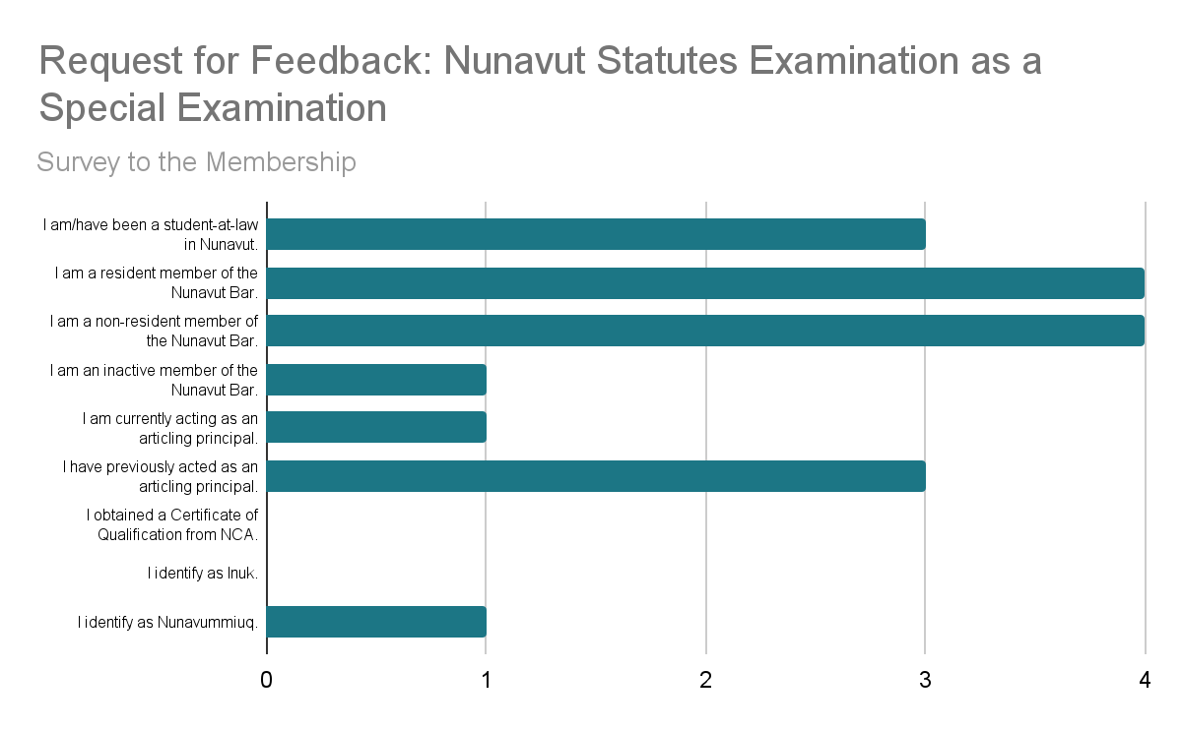
Notes:
Total of 9 survey respondents; nobody who responded to the survey identified as Inuk.

Slide 5
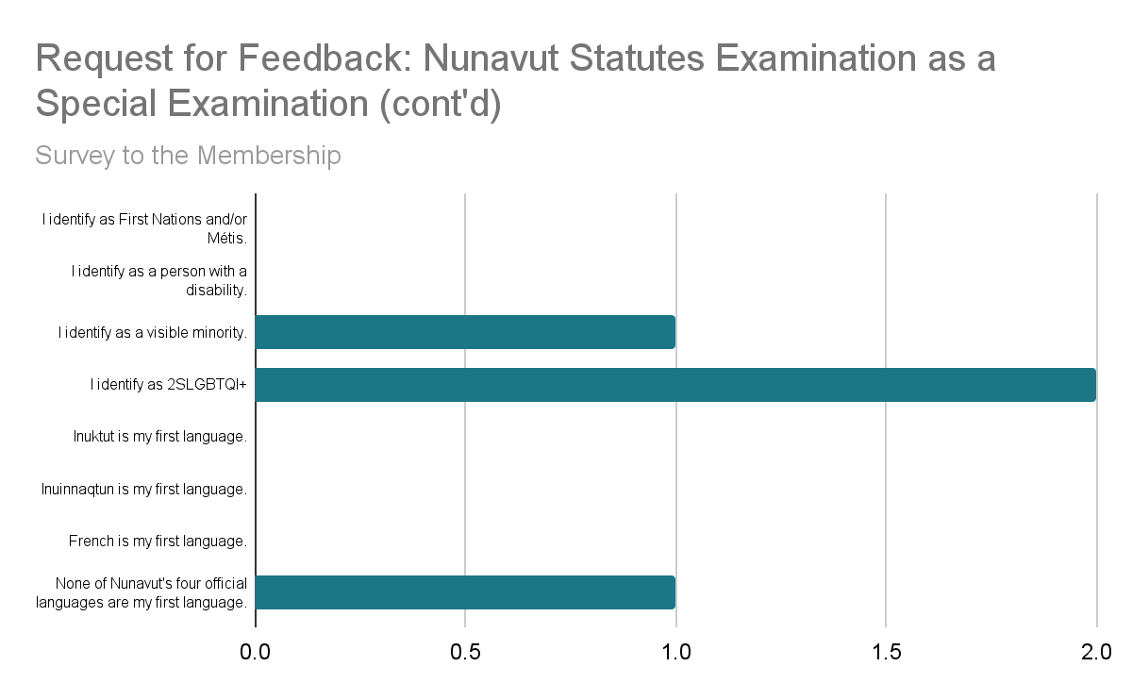

Slide 6
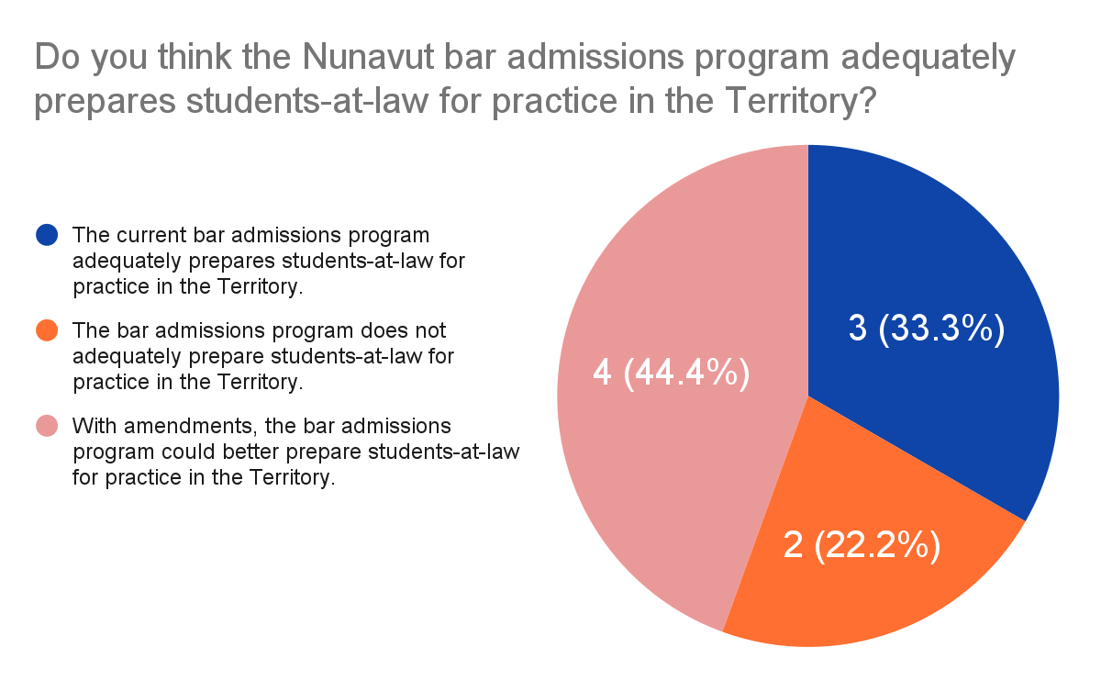
Notes:
While only 9 people responded to the survey, mixed results on this question.

Slide 7
Special Examination
(“Nunavut Statutes Examination”)

Slide 8
Recommendation #1 Taskforce recommends the requirement for students-at-law to write the Nunavut Statutes Examination as part of Nunavut’s Bar admission program be immediately abolished.

Slide 9
PART A
May 2022 Nunavut Statutes Examination
Substantive Law (66 statutes)
Closed book
Pass mark: 65% (39/60)
Multiple choice
PART B
Ethics
Open book (Model Code of Professional Conduct)
Pass mark: 70% (7/10)
Notes:
2000: LSN’s Membership and Admissions Committee established a three-hour, open-book NSE, divided into two parts – Part A (substantive) and Part B (ethics) – with test takers examined on a list of 30 statutes.
The list of statutes was consistently updated since 2000 to reflect legislative amendments.
In 2019, the list consisted of 106 statutes; in 2022, consisted of 66 statutes.
First version of NSE borrowed its form and contents from the Law Society of the Northwest Territories’ Statutes Exam, including that it was required for any person seeking to practice law in the territory.
Eventually, was only prescribed for students-at-law, in conjunction with a bar admission course.
As early as 2003, LSN flagged the need to develop a Nunavut Bar admissions program and issues with the legal framework applicable to students-at-law.
May 2022 Examination: pass mark for Part A was set at 65% (39/60) and for Part B at 70% (7/10), with students having to pass both Part A and Part B of the Examination.
Before 2022, passing mark for the Exam was 70%.

Slide 10
Changes made to the Nunavut Statutes Examination in 2022
In 2022, the LSN made significant changes to the NSE, which included changing:
Part A of the Examination from open-book to closed-book and from short answer to multiple choice;
the ability for students-at-law to select their preferred date to write the Examination and instead introducing Examination sittings; and
the language availability of the Examination (student-at-law was able to write the Examination in one of two language formats: English/Inuktitut and English/French).
*For more information on the changes made to the Nunavut Statutes Examination, please see the Nunavut Statutes Examination Information Note for Students-at-Law (March 2022) and Nunavut Statutes Examination Revised Rules and Protocols (May 2022).

Slide 11
50%
of the students-at-law who wrote the May 2022 sitting of the Nunavut Statutes Examination passed.

Slide 12
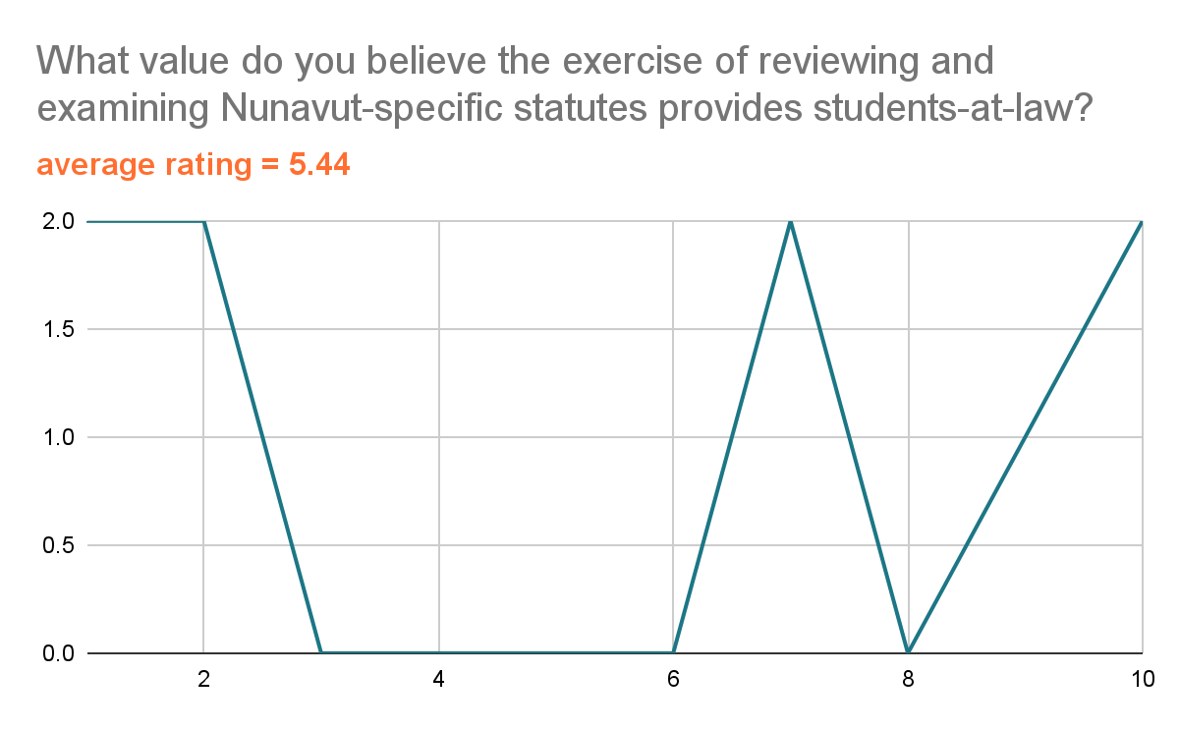
Notes:
As the list of Nunavut-specific statutes to review and examine has changed to reflect legislative amendments, the number of statutes has fluctuated:
in 2000, the list consisted of 30 statutes;
in 2019, 106 statutes; and
in 2022, 66 statutes.
The most recent list of statutes can be found here: https://www.lawsociety.nu.ca/en/bar-admission-course-and-examinations
*1 star is not very valuable and 10 stars is extremely valuable.

Slide 13
FLSC National Requirement
The Federation of Law Societies of Canada’s National Requirement currently requires applicants to bar admissions programs across the country to meet certain competency requirements, three of which are to have demonstrated:
the ability to use techniques of legal reasoning and argument, such as case analysis and statutory interpretation, to analyze legal issues;
an understanding of the foundations of law, including the process of statutory construction and analysis; and
an understanding of the principles of public law in Canada, including the constitutional law of Canada, including federalism and the distribution of legislative powers, the Charter of Rights and Freedoms, human rights principles and the rights of Aboriginal peoples of Canada.

Slide 14
FLSC National Requirement Review (26 June 2023)
Review has included numerous meetings with Indigenous groups and individuals in spring 2023 in connection with the Truth and Reconciliation Commission’s Call to Action #27 and #28.
A non-exhaustive list of the proposed changes include:
referencing "Indigenous legal orders, issues, perspectives, and contexts" in the introduction to substantive knowledge section;
adding “Indigenous Law and Legal Orders" as a fourth category of substantive legal knowledge;
referencing the constitutional rights of Aboriginal peoples and Canadian criminal law as it relates to Indigenous peoples in the description of Canadian public law;
including a clause stating that academic programs must demonstrate integration of Indigenous legal issues and perspectives, where applicable, throughout the curriculum; and
referencing the ethical duties to Indigenous peoples in the section on ethics and professionalism.

Slide 15
FLSC Model Code of Professional Conduct Draft Amendments re: Call to Action #27
Consultation process is underway until May 31, 2024 dealing with proposed changes to the Model Code that address the issues raised in TRC Call to Action #27.
Proposed changes to the Model Code developed by the Federation’s Standing Committee on the Model Code of Professional Conduct with the guidance of the Federation’s Indigenous Advisory Council, and engagement with a variety of Indigenous individuals and organizations.
Consultation will include a broad spectrum of Canada’s legal community, including the legal academy, law societies, and practitioners.

Slide 16
Student-at-Law Experience Survey

Slide 17
32.2%
of former or current students-at-law responded to the survey.

Slide 18
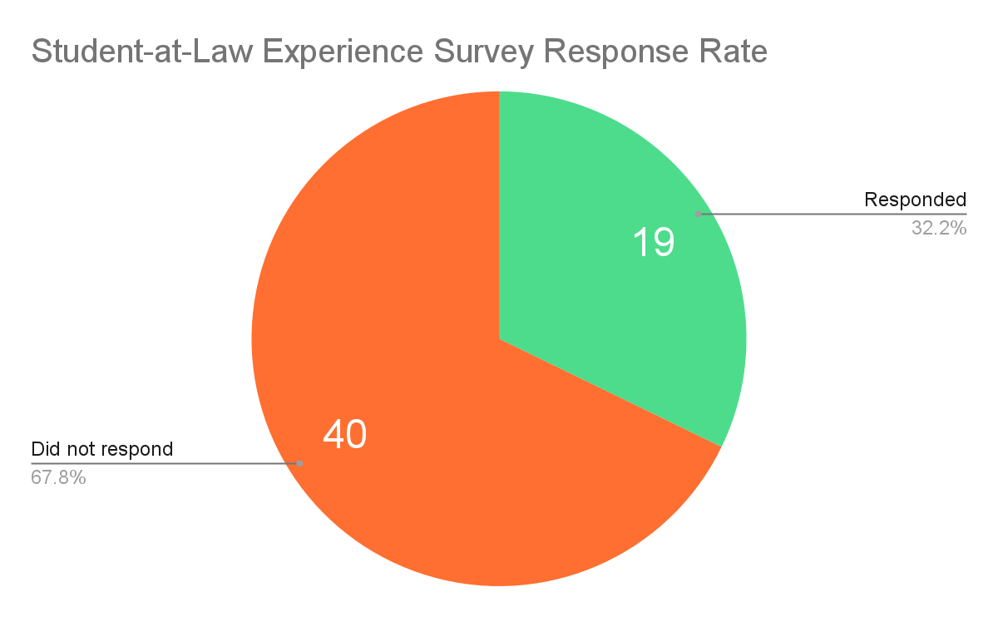

Slide 19
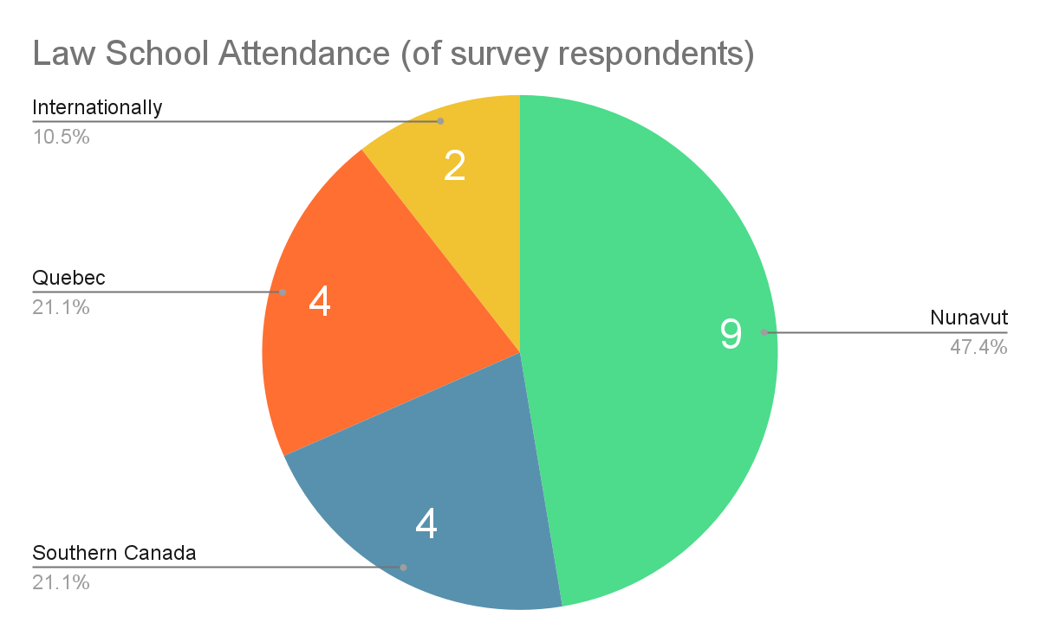

Slide 20
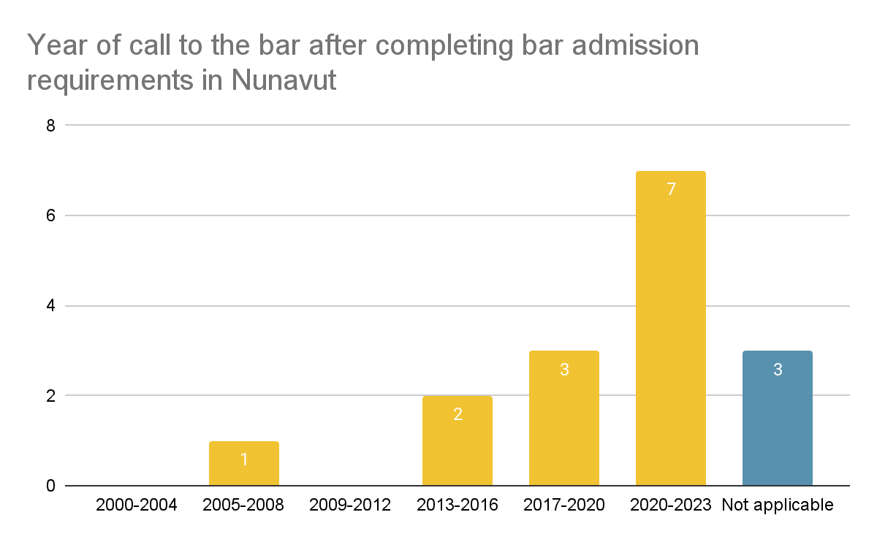

Slide 21
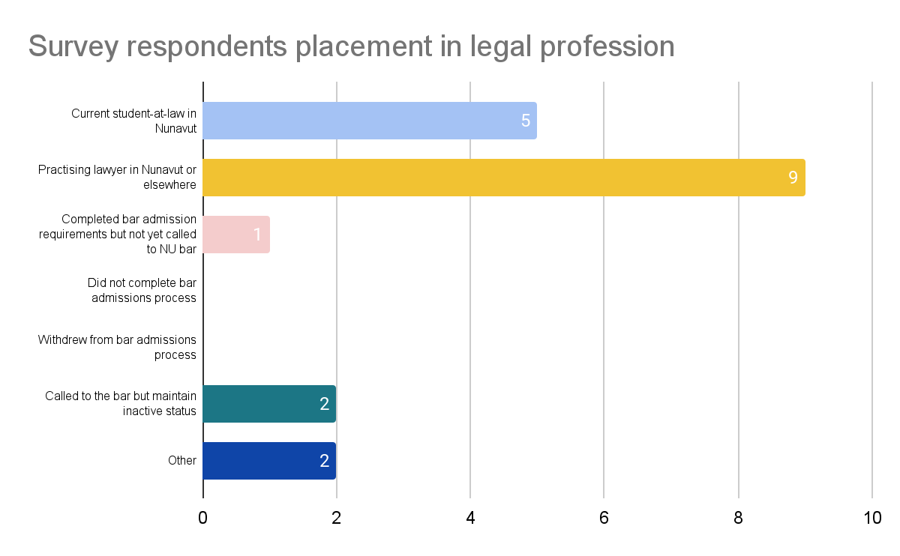

Slide 22
Barriers to Success

Slide 23
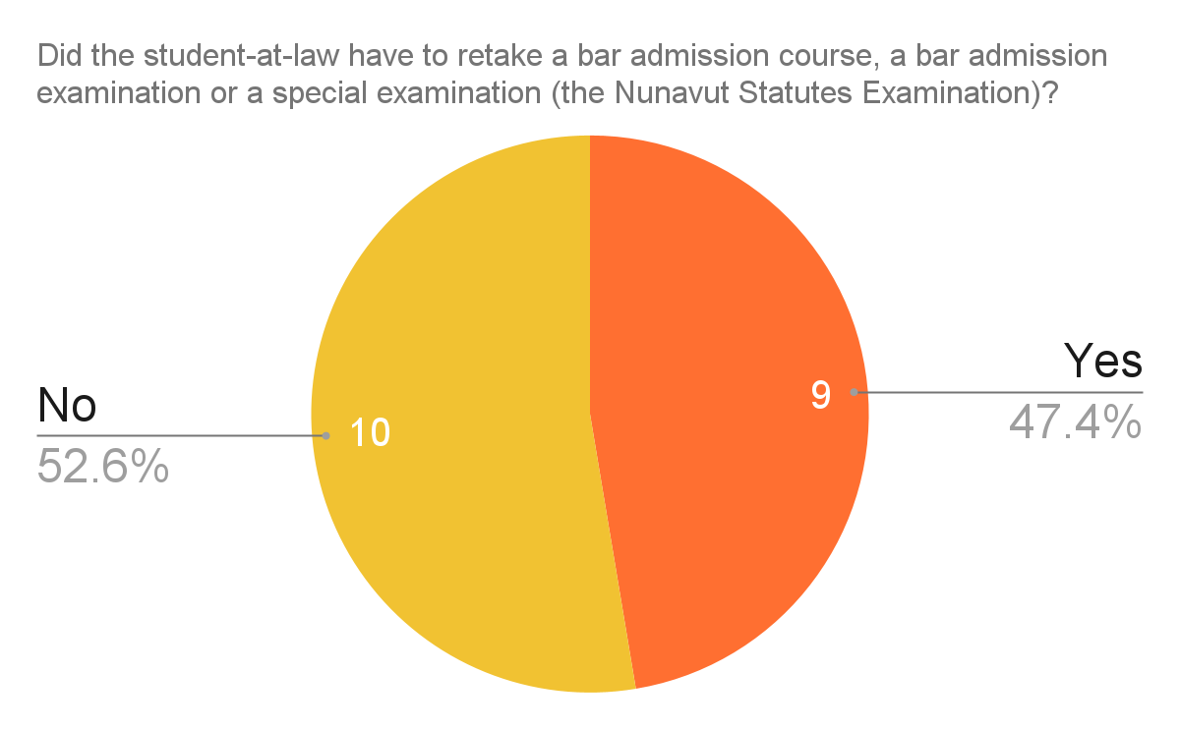

Slide 24
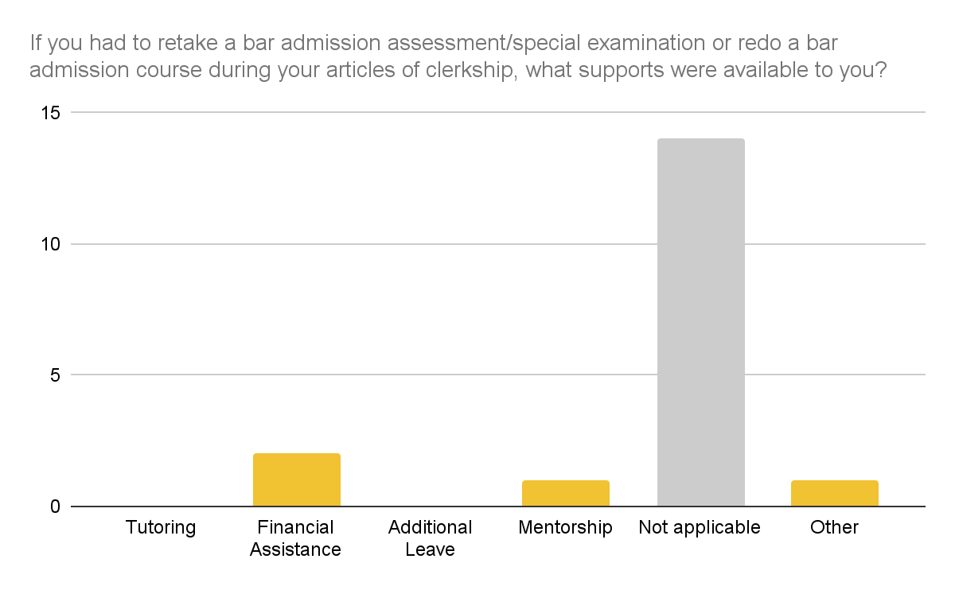
Notes:
Tutoring and additional leave were not available to students-at-law who had to retake a bar admission assessment/special examination or redo a bar admission course during a student-at-law’s articles of clerkship.

Slide 25
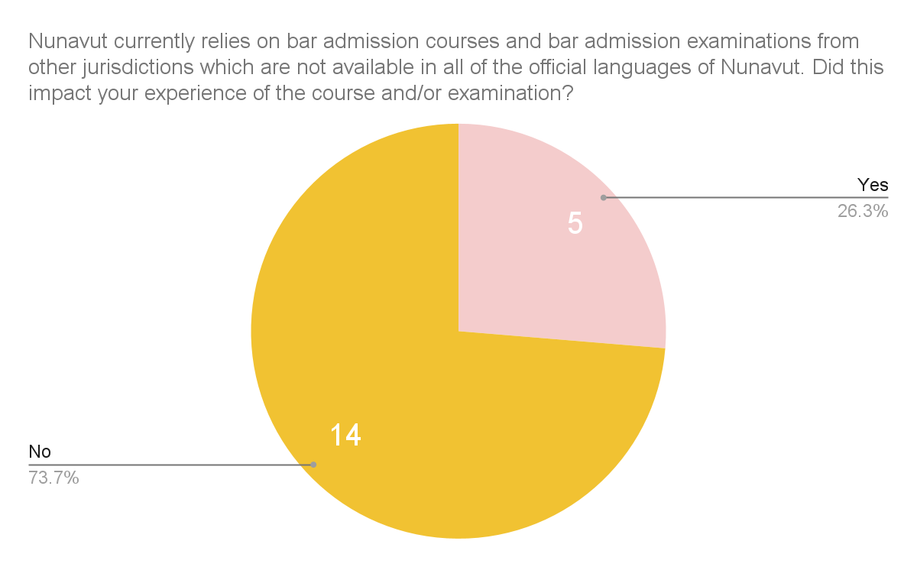

Slide 26
Professionalism & Ethics

Slide 27
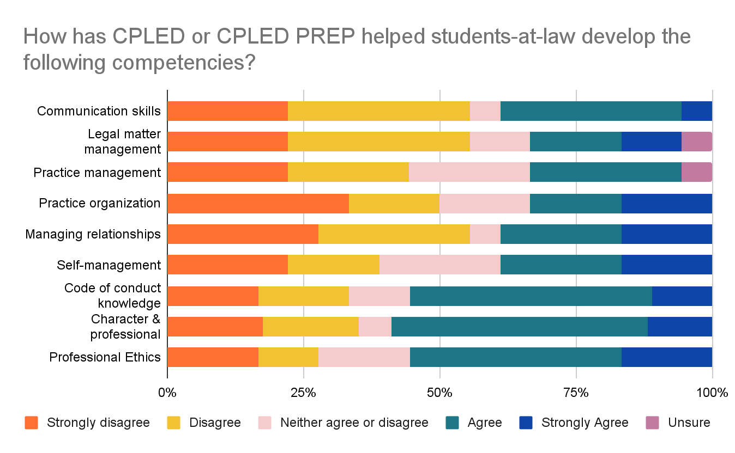
Notes:
Focus on the last three points: (1) code of conduct knowledge, (2) character & professional responsibility; and (3) professional ethics.

Slide 28
Bar Admission Course & Examination

Slide 29
Recommendation #2 The LSN Executive shall issue a written statement to reflect that the requirement in s. 18(2) (b) of the LPA that requires passing a Bar admissions examination is satisfied by a Bar admissions program that includes an evaluation or assessment.

Slide 30
Is the Nunavut Statutes Examination a bar admission examination or a special examination under the LPA?
NSE is considered a “special examination”, which is defined in the LPA as “an examination at university standards in subjects pertaining to substantive law in force in Nunavut”.
Not a “bar admission examination”, defined in the LPA as “an examination in general subjects related to the practice of law, including practice, procedure, ethics and the Acts of Nunavut or the Acts of Canada or both”.
The final capstone assessment of CPLED PREP satisfies the bar admission examination requirement.

Slide 31
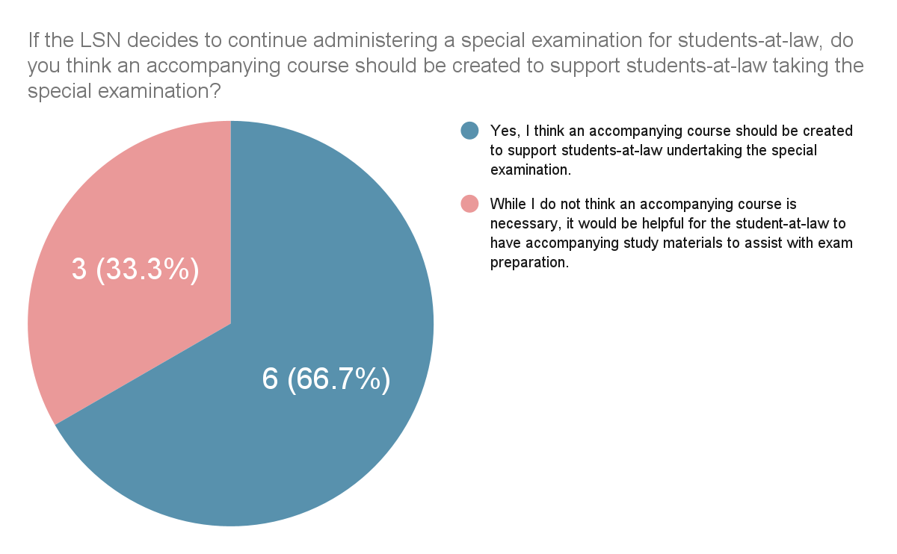

Slide 32
Recommendation #4 The Taskforce recommends establishing an anti-racist Nunavut-specific Bar admission program for students-at-law within two years to replace CPLED’s PREP course as the Bar admission course and Bar admission examination for Nunavut within two years. Part of this inquiry will explore whether there should be a different Bar admissions program for students-at-law who completed their legal education outside of the Territory and are seeking admission to the LSN from other jurisdictions, including those applying after completing NCA Accreditation.

Slide 33
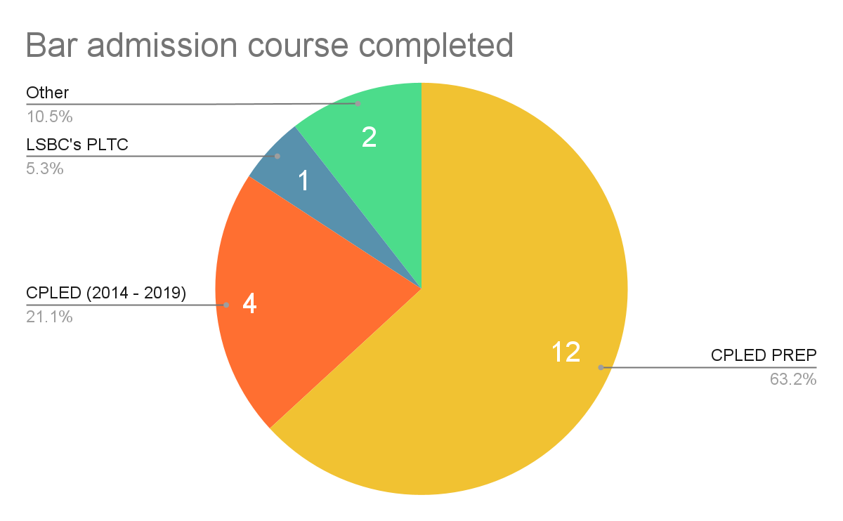

Slide 34
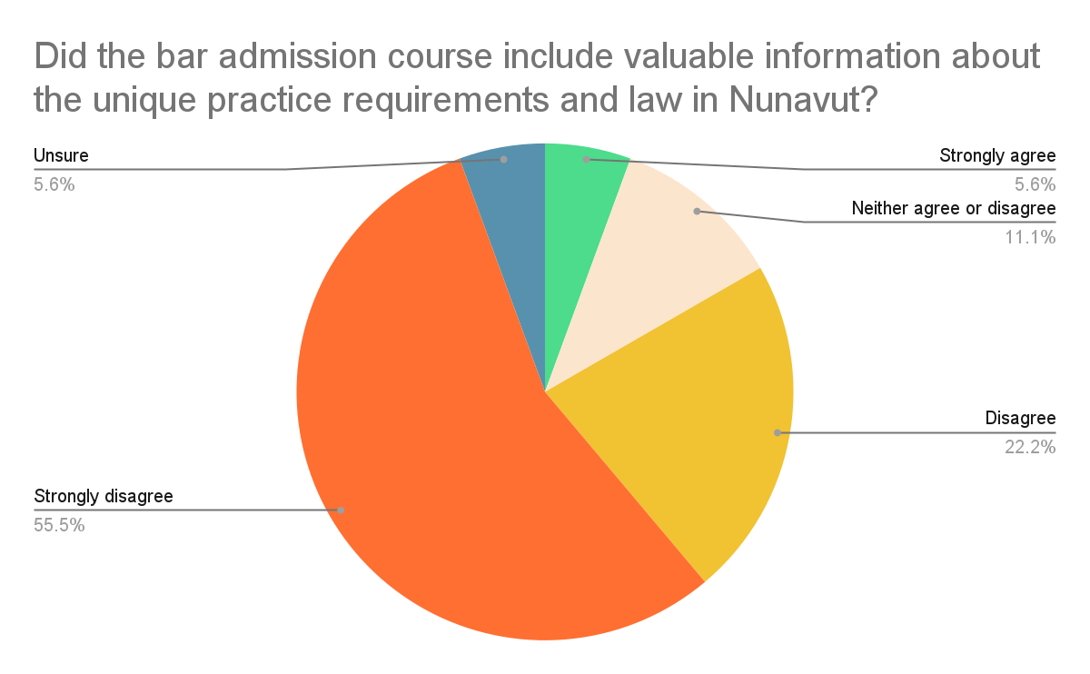

Slide 35
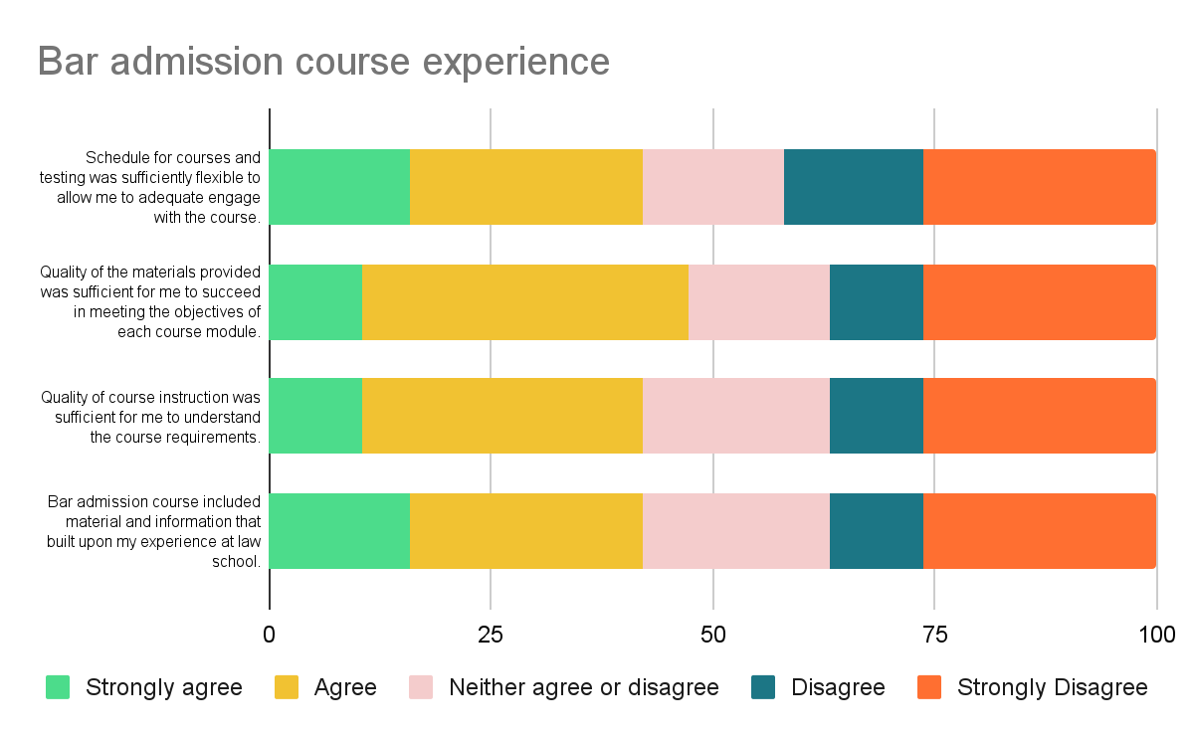

Slide 36
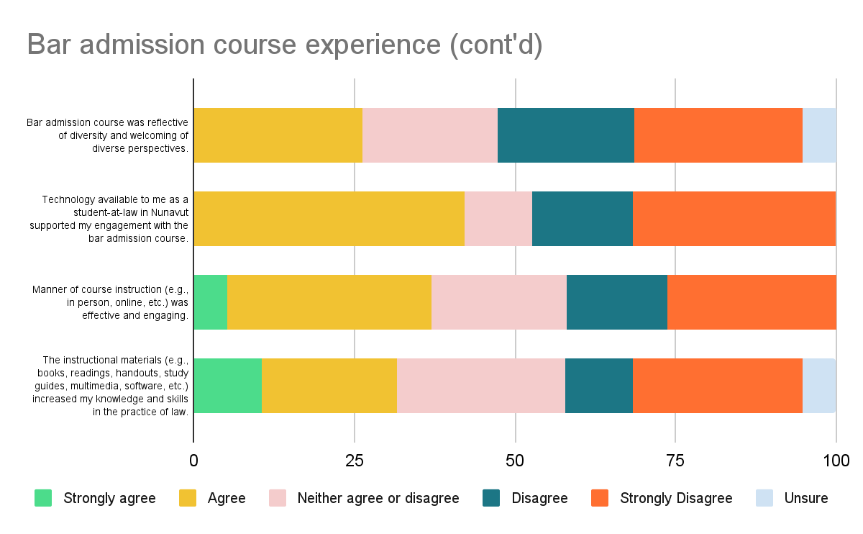

Slide 37
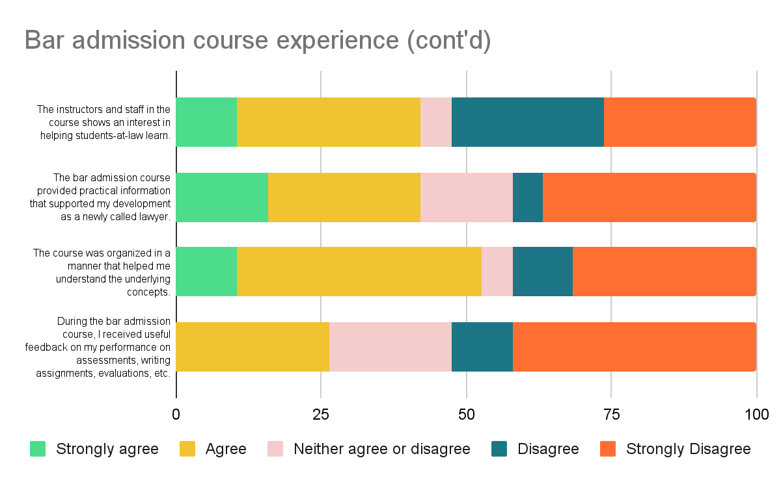
Notes:
Were there other competencies and/or qualities you hoped to better develop during CPLED/CPLED PREP?
“hoped for more Nunavut-specific materials in the bar admission course”
“applying Nunavut laws”
“skills needed for government lawyers. Given NU's context, the biggest employers of lawyers are the GN, PPSC and LSB. CPLED's context is heavily based on private practice which is not always applicable when practicing law in the mentioned institutions.”
“client interviews”
“hoped to develop actual practical skills. In reality it sucked half the time I could have been working on articling tasks where I was genuinely learning to complete busy work. Materials lacked cohesion and were at times incoherent. The organization of materials was abysmal. As an example information required to complete assignments was in 3 different places on the platform (rubric, manual, module itself and at time other documents) making it virtually inaccessible. Assignments did not provide sufficient information, and clarifying questions were not permitted. uch of the material was covered in law school. There were also inaccuracies in materials. Further, for all the lip service about diversity, it was clear that this course was written by and for a very narrow group of people.”
“more Nunavut specific competencies and qualities would have been ideal.”
“did like CPLED PREP's emphasis on code of conduct and ethics.”
“cultural relevance was weak.”
“I felt like it was all stuff we learned in law school... it made me feel like why the heck am I just redoing law school with more stress in the fact that I knew I couldn't even get through the first foundation modules.”
“more tips/exercises using Canlii for searching cases. More tips/exercises on court etiquette/rules.”
“practical application of standard forms and court procedure”
“all the available resources were very helpful.”
“hoped to gain a better understanding of drafting pleadings within NU but of course at the time of my enrolment I had to choose a southern jurisdiction and follow their Rules of Court. These are definite transferable skills but also were a bit of a hardship/extra hurdle in the process.”

Slide 38
Articles of Clerkship & Workplace Training

Slide 39
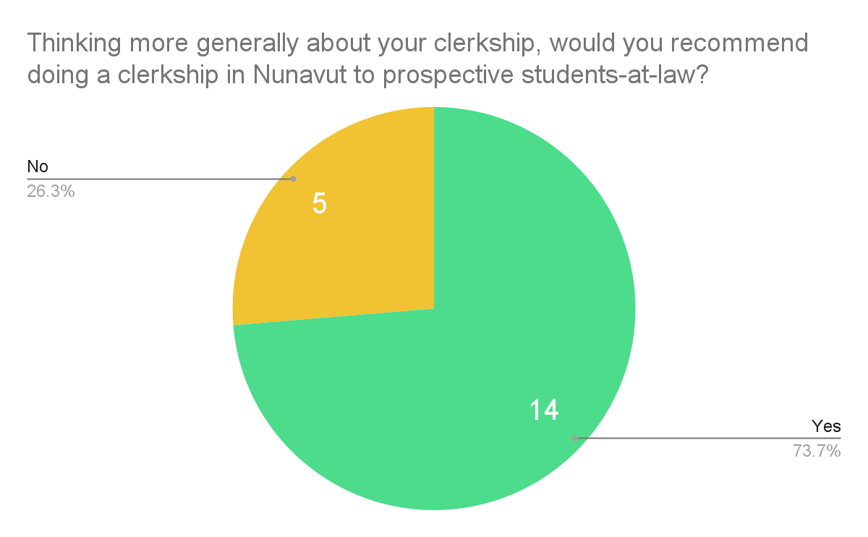

Slide 40
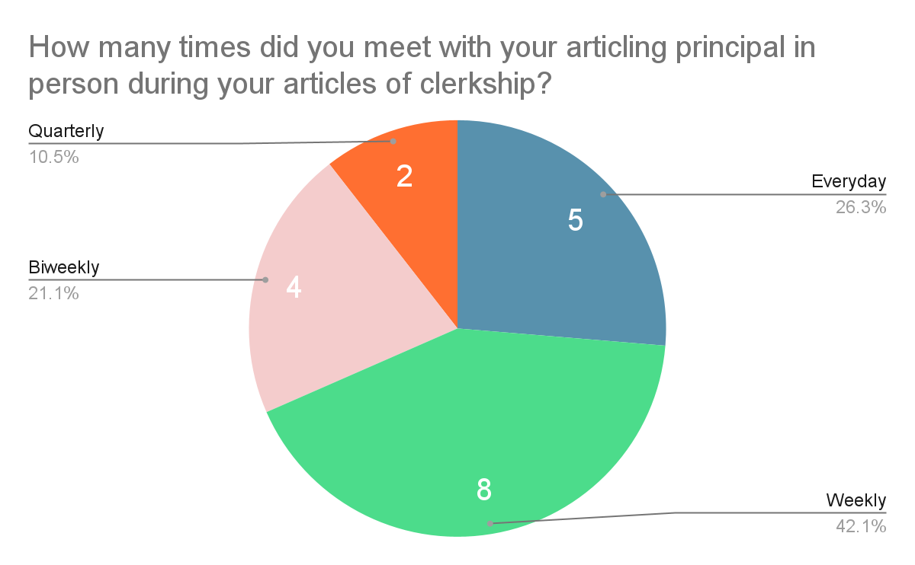

Slide 41
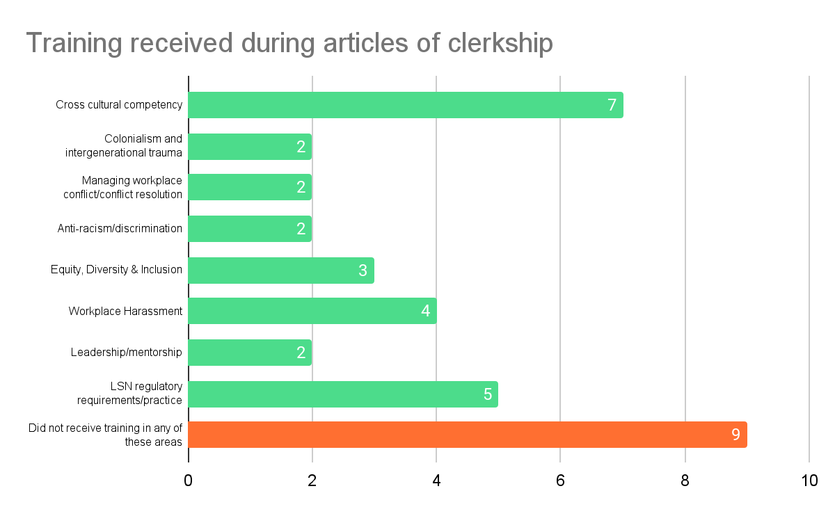

Slide 42
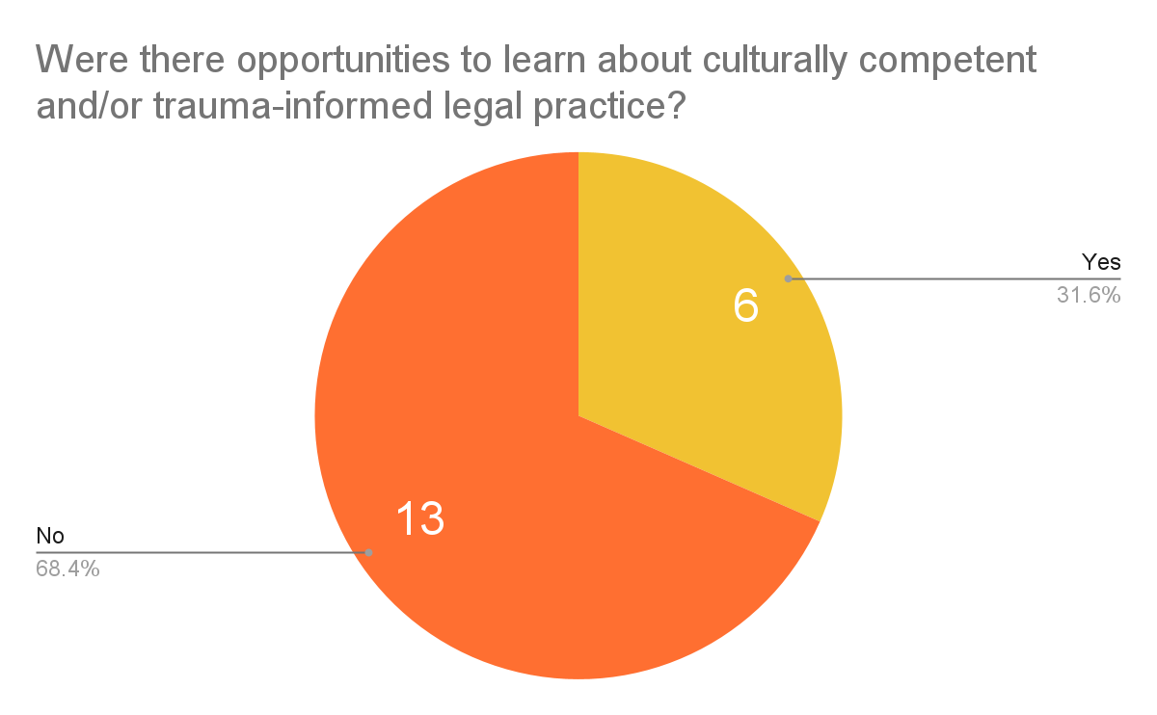

Slide 43
Student-at-Law Mental Wellbeing

Slide 44
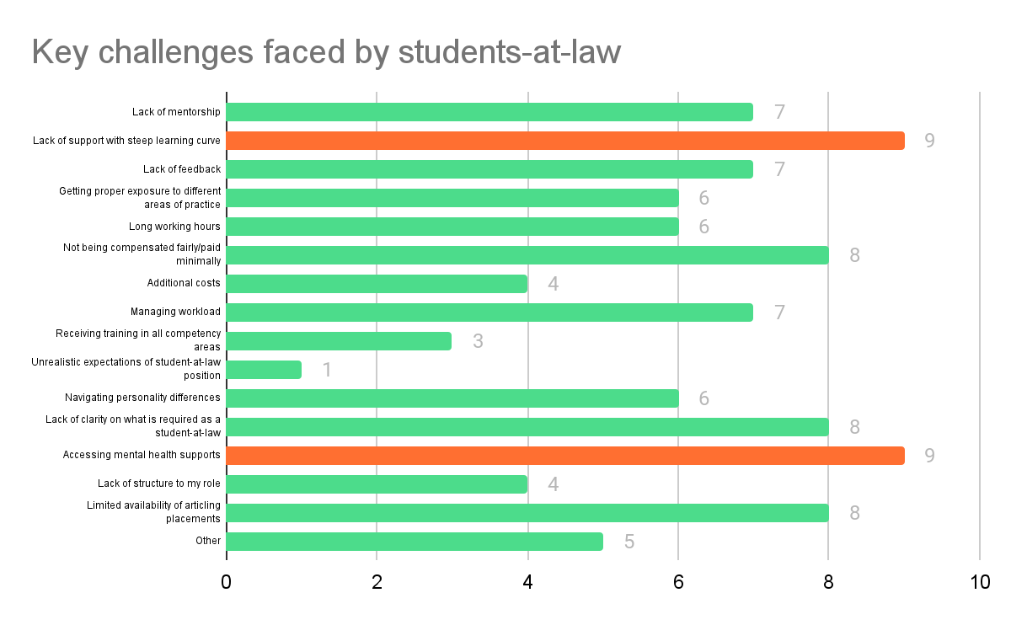

Slide 45
52.6%
of respondents shared that based on their cumulative experience, their participation in a bar admissions course affected their mental wellbeing to the point that it hindered their ability to succeed in the bar admission program.

Slide 46
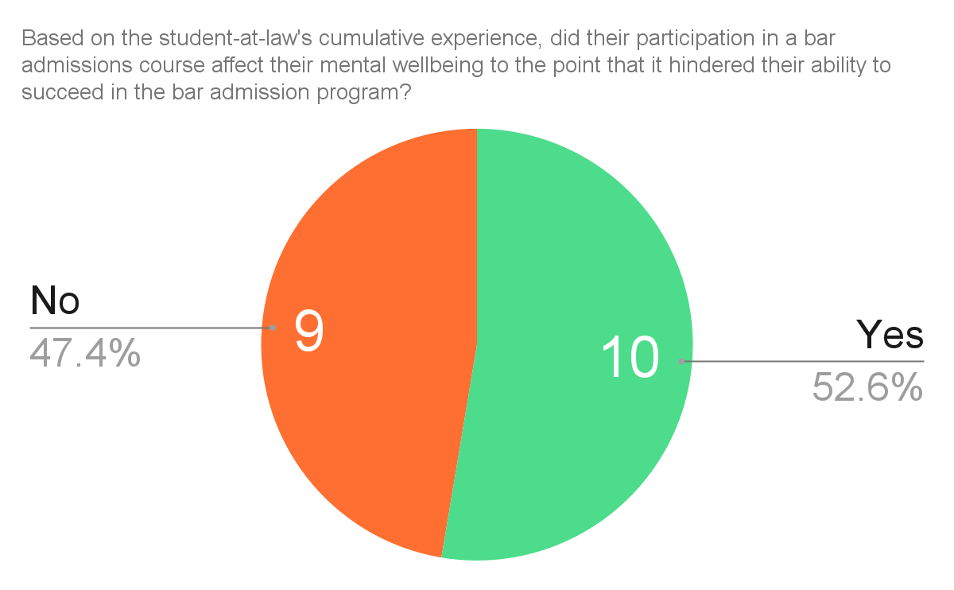

Slide 47
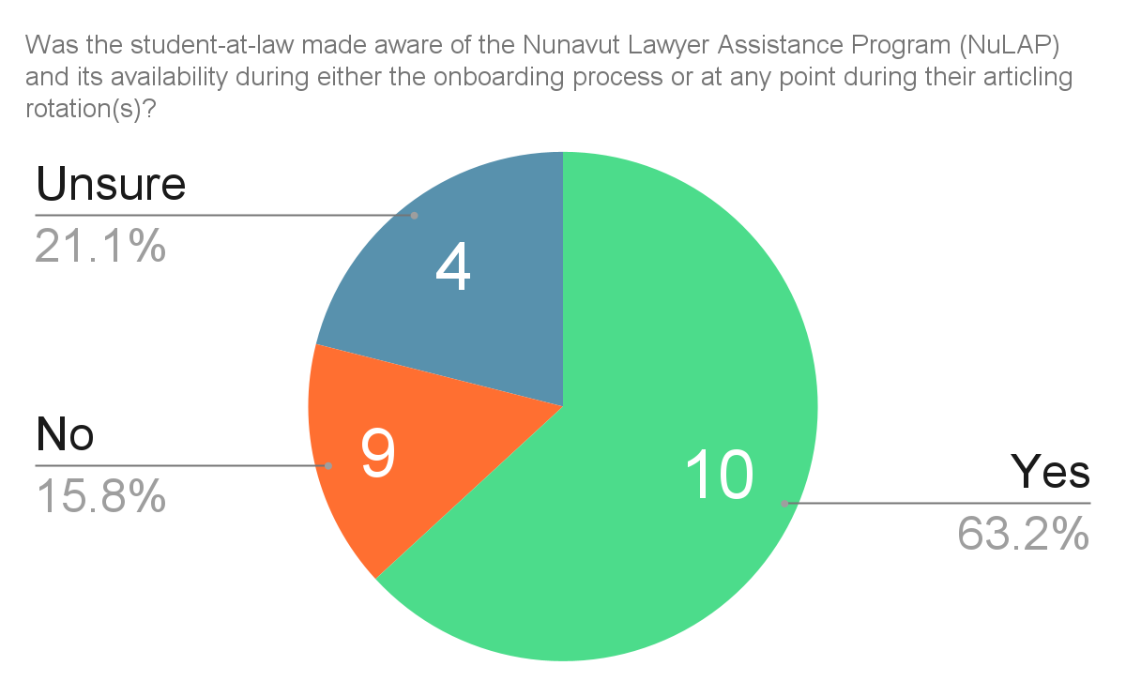

Slide 48
Harassment & Discrimination

Slide 49
15.8%
of respondents experienced discrimination and/or harassment related to their age, ancestry, colour, race, citizenship, ethnic origin, place of origin, creed, disability, family status, marital status, gender identity, gender expression, sex and/or sexual orientation, or other factors during the recruitment process of any of their articling rotations.

Slide 50
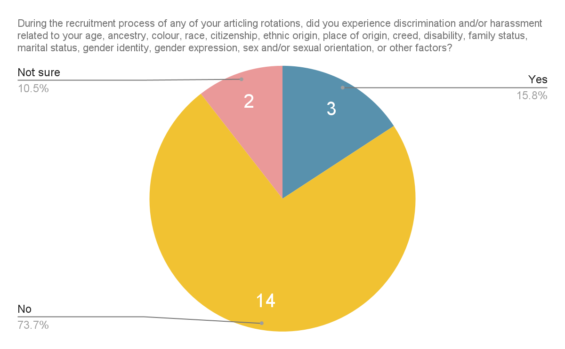

Slide 51
22.2%
of respondents experienced discrimination related to their age, ancestry, colour, race, citizenship, ethnic origin, place of origin, creed, disability, family status, marital status, gender identity, gender expression, sex and/or sexual orientation, or other factors during their articles of clerkship.

Slide 52
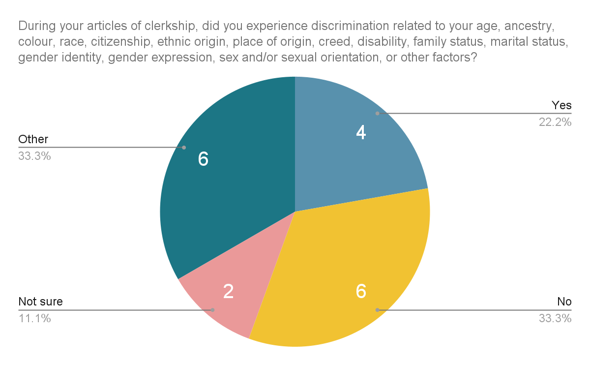

Slide 53
26.3%
of respondents experienced harassment by someone at the firm/organization related to their age, ancestry, colour, race, citizenship, ethnic origin, place of origin, creed, disability, family status, marital status, gender identity, gender expression, sex and/or sexual orientation, or other factors during their articles of clerkship.

Slide 54
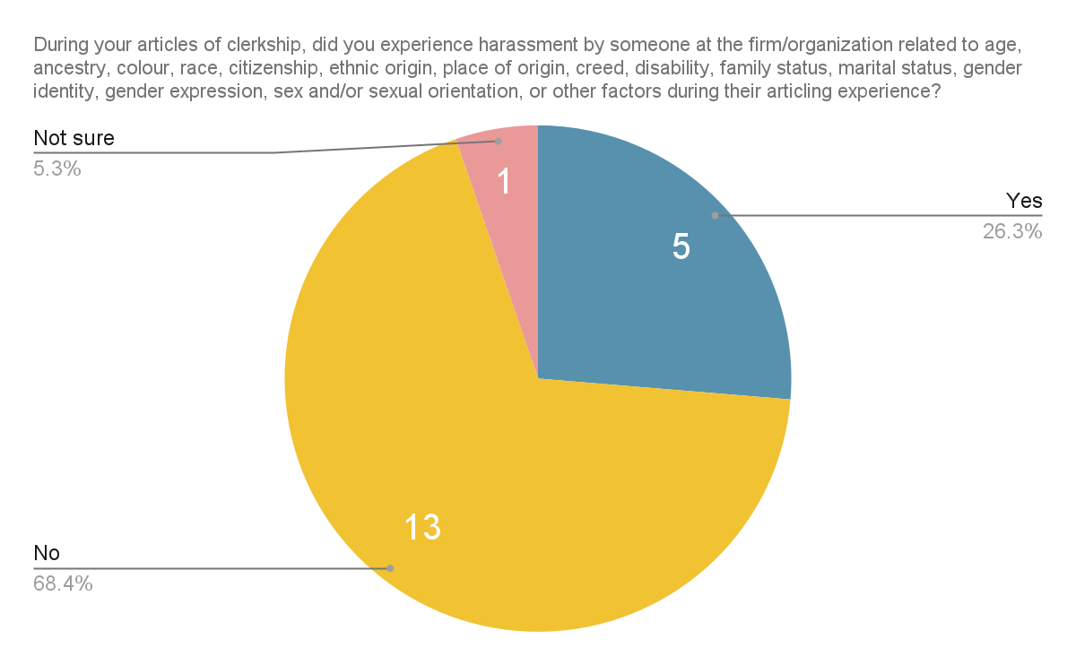

Slide 55
36.4%
of respondents said there were no resources available to address the discrimination and/or harassment experienced.

Slide 56
63.4%
of respondents said they were not sure whether resources were available to address the discrimination and/or harassment experienced.

Slide 57
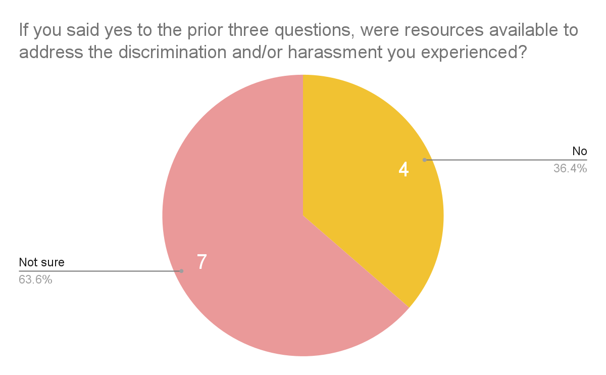

Slide 58
Looking ahead

Slide 59
LSN President Statement (22 June 2023)
“The Executive welcomes the opportunity to engage in a collaborative and respectful discussion with the membership about our shared goals as members of the legal profession in Nunavut including working together to identify how to make improvements; to support diversity and inclusion; to consider Nunavut’s unique history and culture; and to aim to remove barriers to the admission process in Nunavut all while balancing the standards of practice required in a self-regulating profession. The Executive also wishes to confirm that given the ongoing work to consider and respond to issues identified in the Taskforce Report, the Executive is continuing the waiver of the requirement to complete the Statutes Examination for admission to the Nunavut Bar until the earlier of March 31, 2024, or the completion of the work referenced above.”

Slide 60
Decision from Feburary 2024
The Special Examination in its current form will not be administered going forward and will not be a requirement for admission to the Nunavut Bar.
If a special examination is implemented in the future, it will be re-drafted and take into consideration the findings from the Task Force to be a defensible exam.
CPLED will continue to serve as the “bar admission couse” with CAPSTONE being the “bar admission examination”.
Discussions with CPLED to address concerns raised by Nunavut articling students.
Goal: to have all current articling students called to the bar by July through a defensible process – looking for collaboration with CPLED.

Slide 61
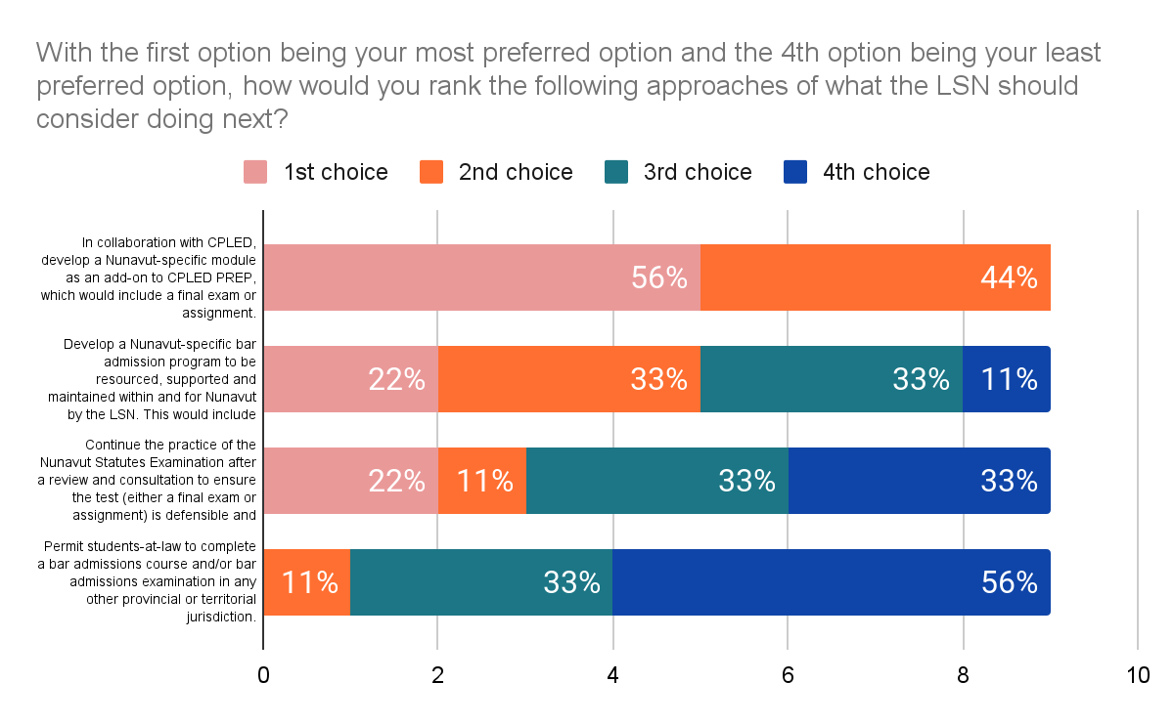
Notes:
The most popular choice was the first one (“In collaboration with CPLED, develop a Nunavut-specific module as an add-on to CPLED PREP, which would include a final exam or assignment.”)

Slide 62
Discussion

