Slide 1


Special Meeting
November 24, 2025
Updates from the President
Membership Directory and member’s status in other jurisdiction(s)
Conflict, Quorum and Voting among the Executive – Amendments to the LSN Rules
Articling and Bar Admissions
Member Referral System Overhaul

Slide 2

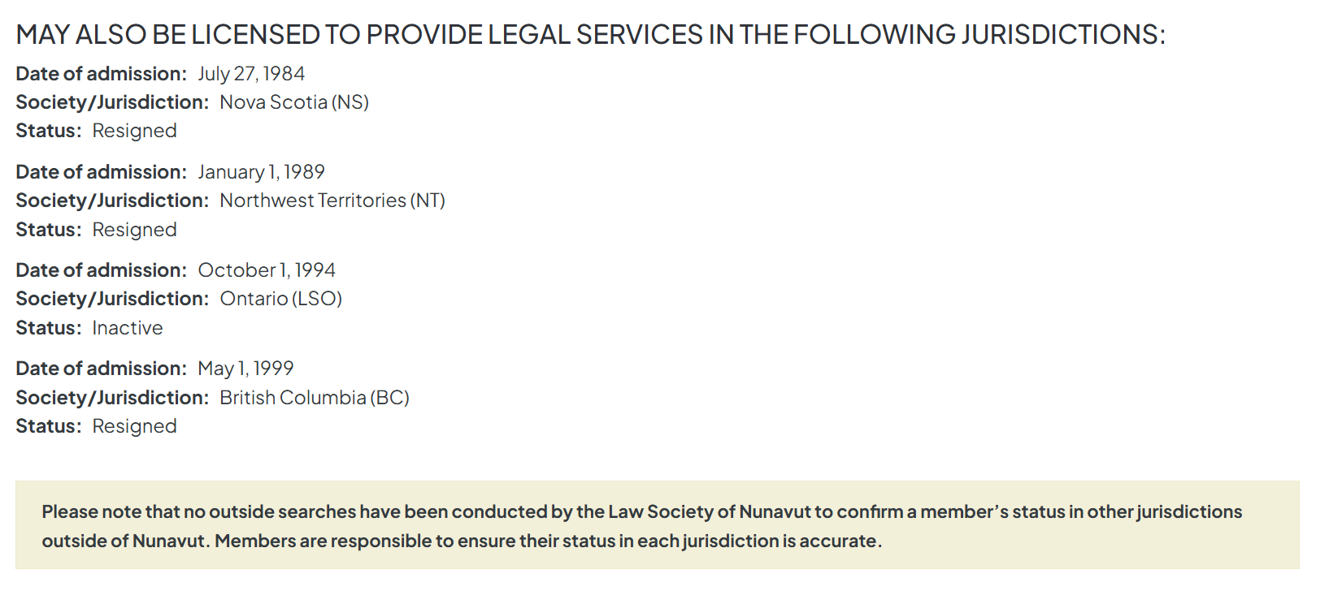
Membership Directory and member’s status in other jurisdiction(s)
Notes:
2023-24 AGM member request – delayed due to budget consideration. Budget required for Drupal platform migration from version 8 to 10 which was plan over 2 years to manage the overall cost of roughly $25,000.

Slide 3
Conflict, Quorum and Voting among the Executive
June 2020 LSN AGM - Initial concerns raised. However, member motion did not passed.
June 2021 LSN AGM - Concerns raised again. Member motion adopted.
Concern on how conflict of interests are being handled and whether there is a specific policy for that; and
Motion to require the Executive Committee to develop a written policy on real and apparent conflicts of interests.
Covid-19 pandemic halted the process.
March 2023 - Executive Committee Policy adopted and shared with the Rules Committee and Membership.
2023- 2025 - Several exchanges took place between the Rules Committee and the Executive Committee to ensure the amendments would allow for a clear and comprehensive framework and process to deal with the potential issues arising from the context of a small jurisdiction.
Notes:
Resolution is before the membership this evening. Thank you to the Rules Committee for their dedication and collaborative efforts and LSN’s designated team. Rebecca Jaremko will be presenting the resolution today. Rebecca is the lead support for the Rules Committee with guidance from member Merrilee Rasmussen and coordination support from Santana Stallberg.

Slide 4
Reminder - LSN June 23 AGM:
The presentation on the Student-at-Law Experience Survey Results will be delivered after the President's Report.
PowerPoint presentation and Executive Summary
Next Steps:
Changes to the Articling Plan and Evaluation Process & Tools;
Handbook and Training for Principals; and
Changes to CPLED PREP Bar Admission Program.
Ongoing Designated Manager for S@L: Lana Walker.
Articling &
Bar Admissions
Notes:
Student-at-Law Survey follows the Membership feedback survey; a detailed jurisdictional scan was completed over the summer and presented to the ABA WG to identify next priorities

Slide 5
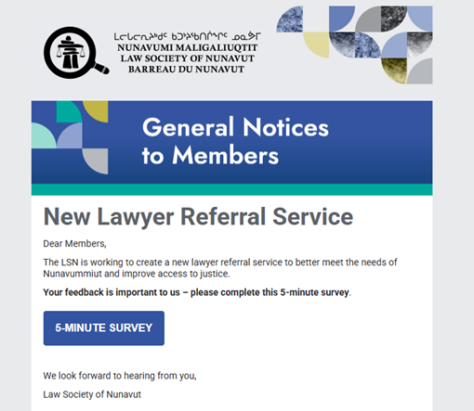
Member Referral System Overhaul
Notes:
Survey circulated over 2 months ( August-September)

Slide 6
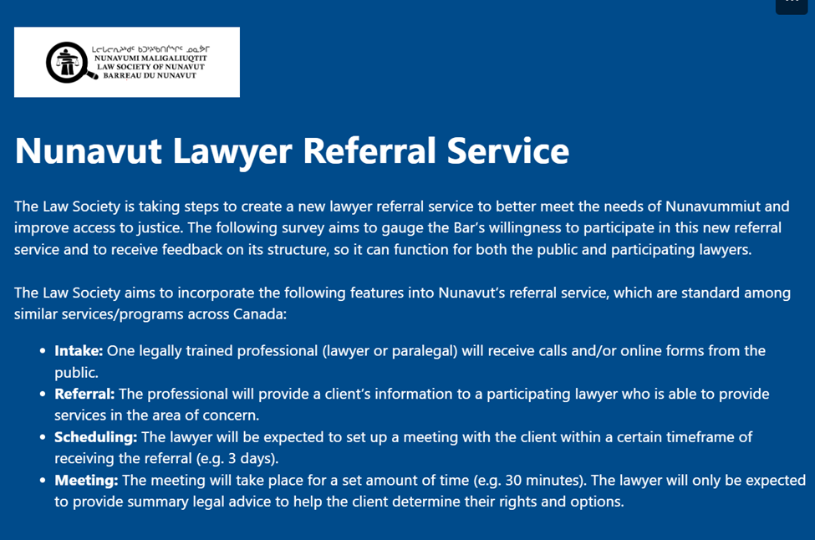
Member Referral System Overhaul
Notes:
4 mains areas the survey was focusing on

Slide 7
Bird’s eye-view summary:
• 21 responses with general interest to support.
• Members/organizations may not be able to assist due to statutory limitations of mandate, conflict or areas of practice.
Next steps:
Seek small grant from the NLF to conduct further research on what model and elements exist in other jurisdictions that could work for NU and conduct interviews with key organizations in NU and leaders from organizations that are offering such referral programs.
The PLEAC network is a good place to start. PLEAC has Community of Practice focusing on legal hotlines and law referral services.
Gaining a better understanding of what could be available in NU and efficient programs/elements that exist elsewhere will offer further insight on how to build a model that would be beneficial for Nunavummiut.
Member Referral System Overhaul
Notes:
PLEAC = Public Legal Education Association of Canada

Slide 8
LSN Volunteers
Standing Committees
Discipline
Ethics and Legal Practice
Membership and Admissions
Rules
Articling and Bar Admissions Working Group
Representative on the Legal Services Board of Nunavut - Julie Bedford
New FLSC Council Member - Eric Cheng

Slide 9
New Directors:
Andrea Clarke (October)
Dominique Nouvet (End of November)
Current Directors:
Sarah Arngna'naaq- Chairperson
Victoria Perrie
Eva Tache-Green

Slide 10

Questions?

