Slide 1
Student-at-Law Experience Survey
June 2025

Slide 2
32.2%
of former or current students-at-law responded to the survey.
⭐ In comparison, only 23% of articling students completed the AB, MB and SK survey.

Slide 3
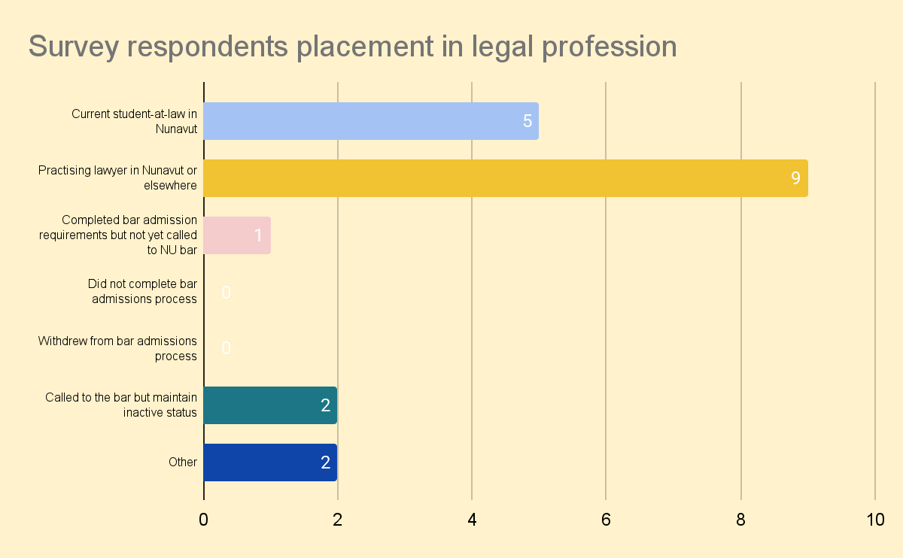

Slide 4
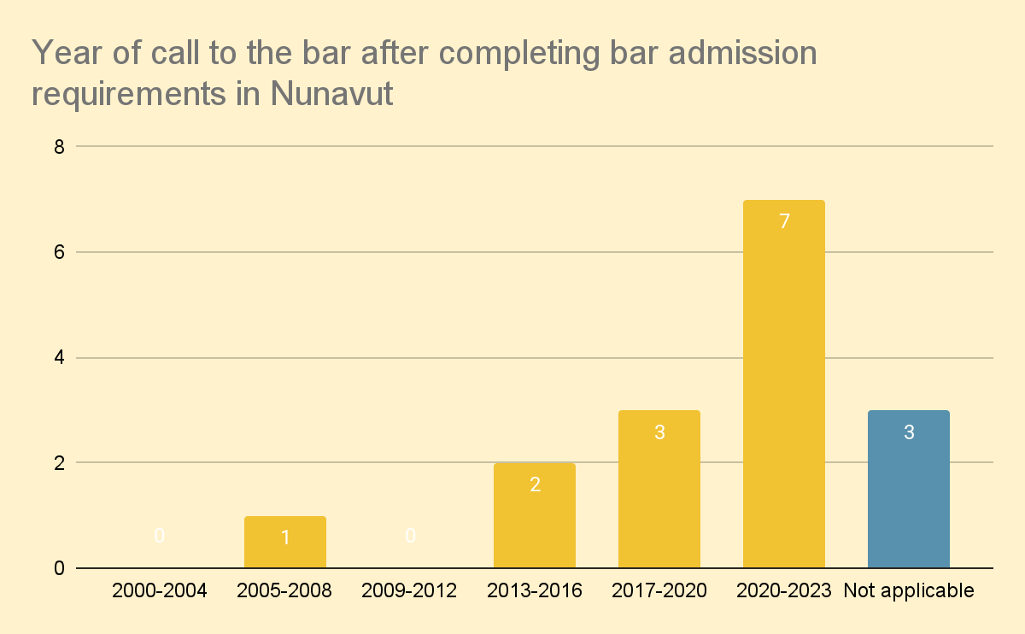

Slide 5
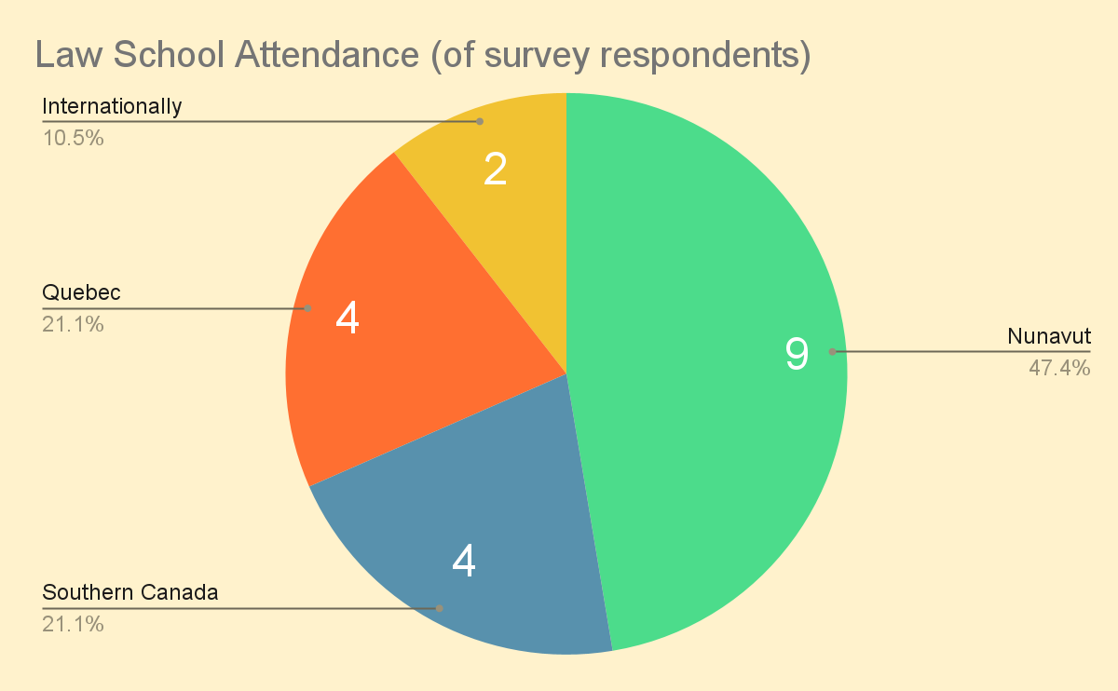

Slide 6
High-Level Insights (1)
Lack of housing
Inadequate infrastructure for articling rotations
Delays in hearing back from LSN
Challenges with articling principals/employers given high turnover in the North
Need for more Nunavut-specific training (especially for non-NLP students-at-law)
Less time in CPLED and more hands-on-training
78% either disagreed or strongly disagreed that their bar admission course included valuable information about the unique practice requirements and law in Nunavut.
79% completed 2 or more articling rotations; only 15.8% completed one.
GN was the most frequent employer, followed by Arms Length/NGO, followed by the fed gvt
16% respondents would have liked to complete their articles of clerkship in Ottawa but were unable to

Slide 7
High-Level Insights (2)
Attendance at settlement conference + staff and office management were the competencies that students-at-law felt they least developed
Reports of not being paid during articles
Significant variation in # of days off during articles (32% noting no agreed upon leave)
47% respondents did not receive training in EDI, cross-cultural competency, workplace harassment etc. during articles
68% didn’t have an opportunity to learn about culturally competent and/or trauma-informed legal practice (32% did)

Slide 8
High-Level Insights (3)
Lack of support with steep learning curve and accessing mental health supports were the two biggest challenges faced by students-at-law
74% would recommend doing a clerkship in the Territory to prospective students-at-law
53% reported that participating in a bar admissions course affected their mental well-being to the point that it hindered their ability to succeed in the bar admissions program
63%were aware of NuLAP
79% were either very satisfied or satisfied with their articling experience
Getting hands on experience was one of the most positive aspects of the articles of clerkship for ALL respondents

Slide 9
Barriers to Success

Slide 10
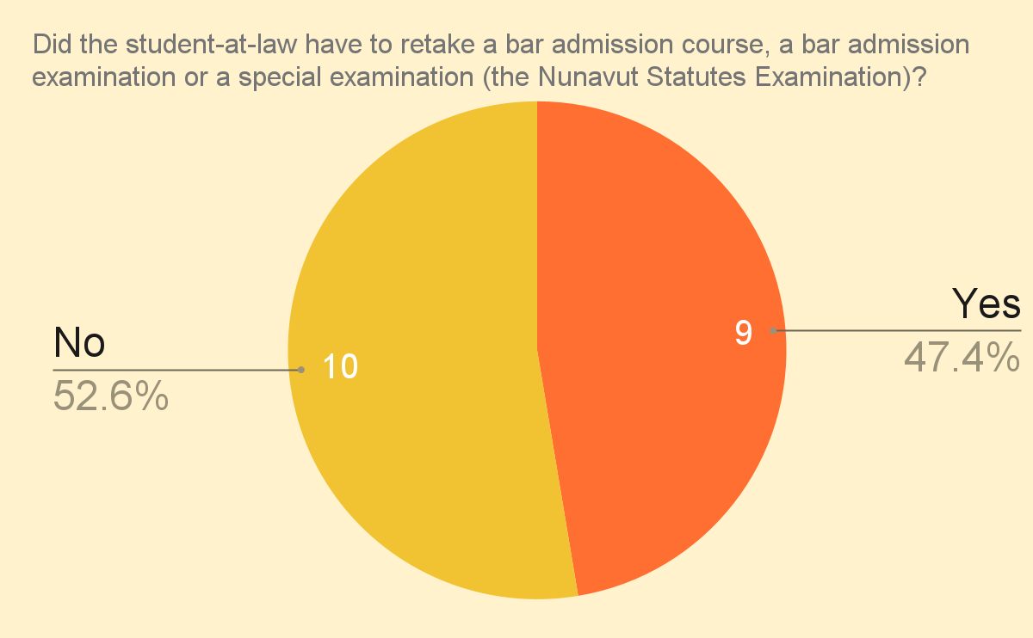

Slide 11
CPLED 2022/2023 Report
For a reference point, CPLED reported in 2022/2023 that:
There were 565 students registered in the Summer PREP 2022. Students are required to complete all four PREP phases and pass the Capstone to successfully complete PREP. Of the 565 students, 91% successfully passed their Capstone and completed PREP.
The Winter 2021 PREP intake welcomed 167 students, of which 81% of students successfully passed and completed PREP.

Slide 12
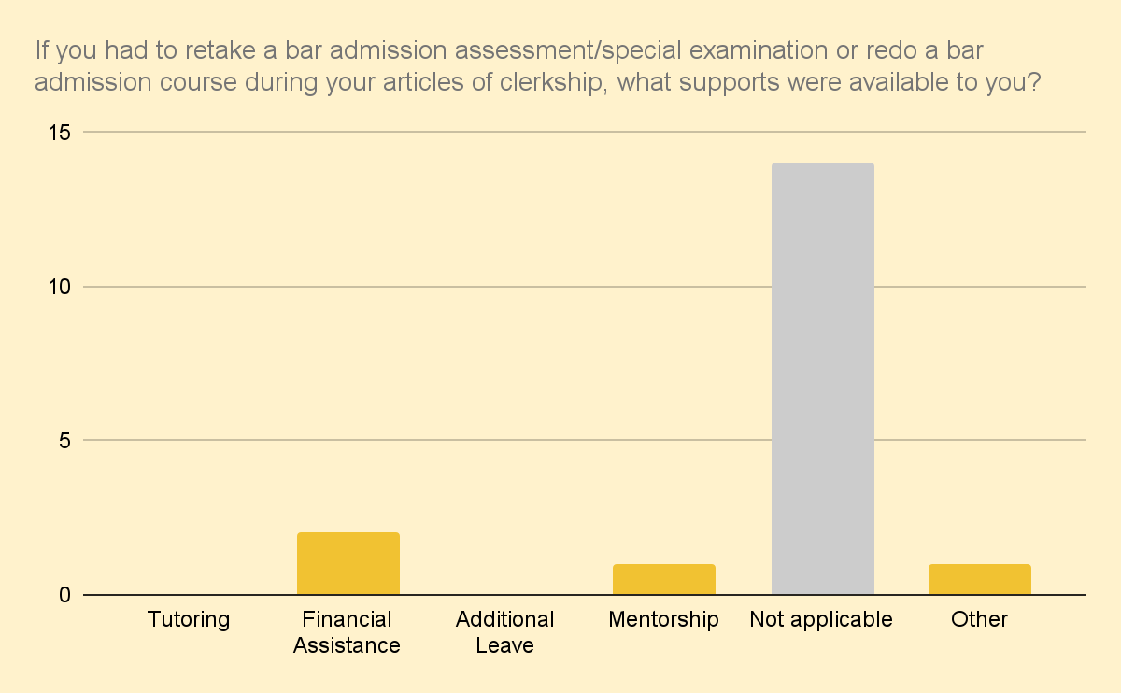
Notes:
Tutoring and additional leave were not available to students-at-law who had to retake a bar admission assessment/special examination or redo a bar admission course during a student-at-law’s articles of clerkship.

Slide 13
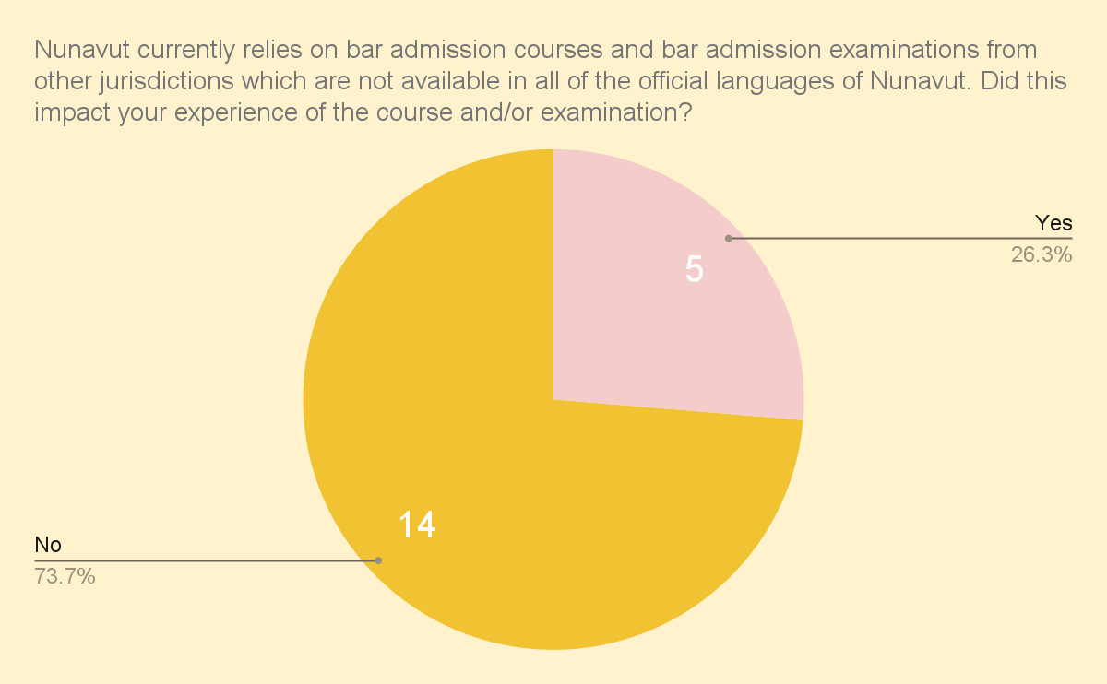

Slide 14
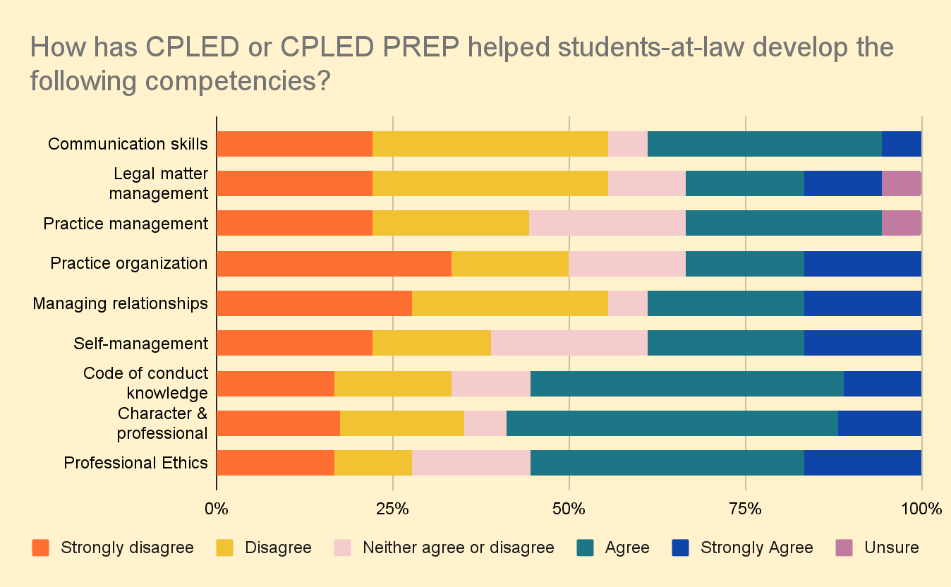
Notes:
Focus on the last three points: (1) code of conduct knowledge, (2) character & professional responsibility; and (3) professional ethics.

Slide 15
Bar Admission Course & Examination

Slide 16
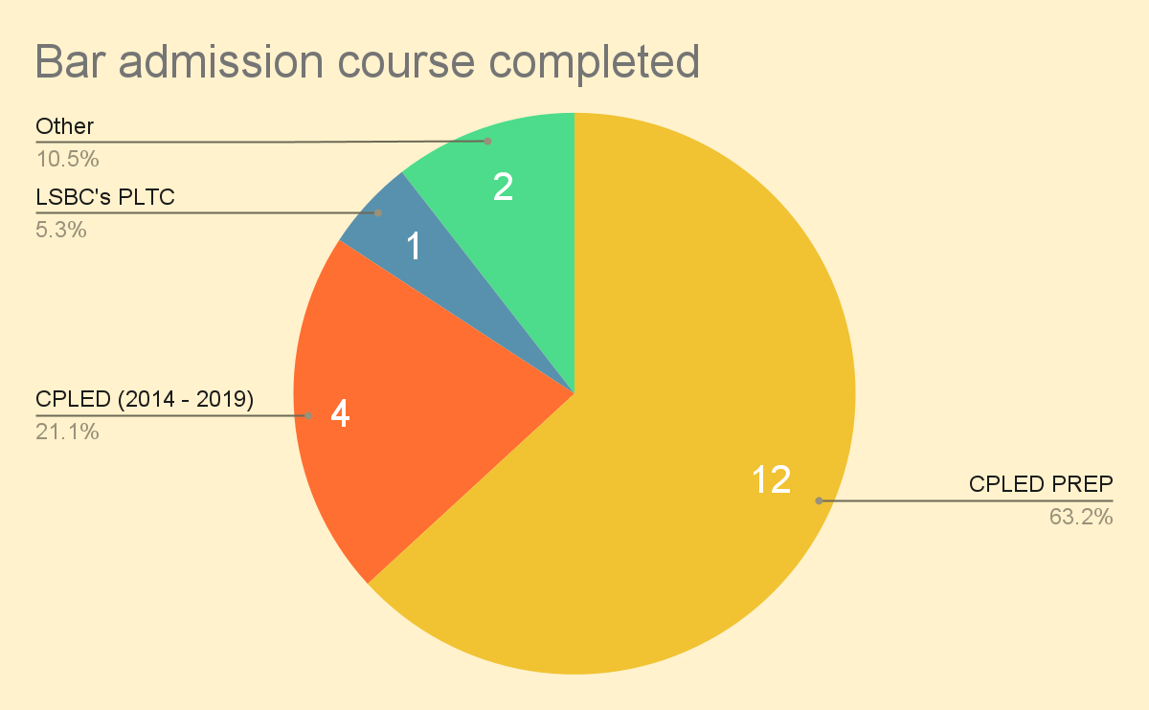

Slide 17
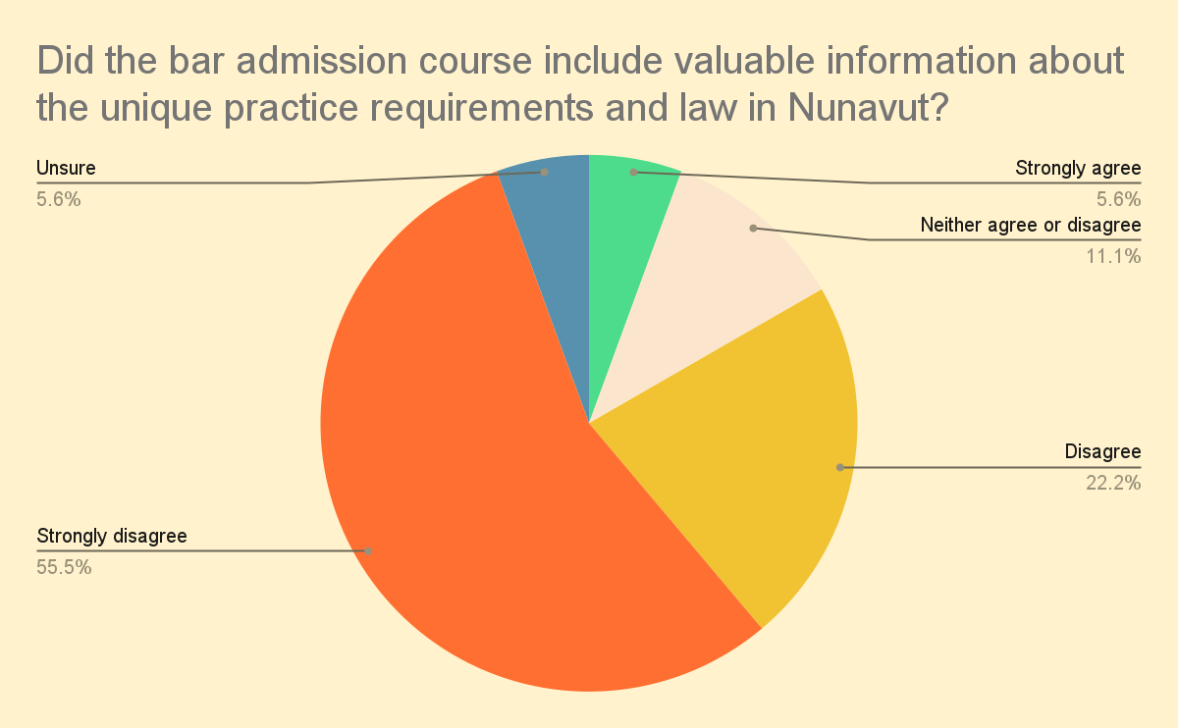

Slide 18
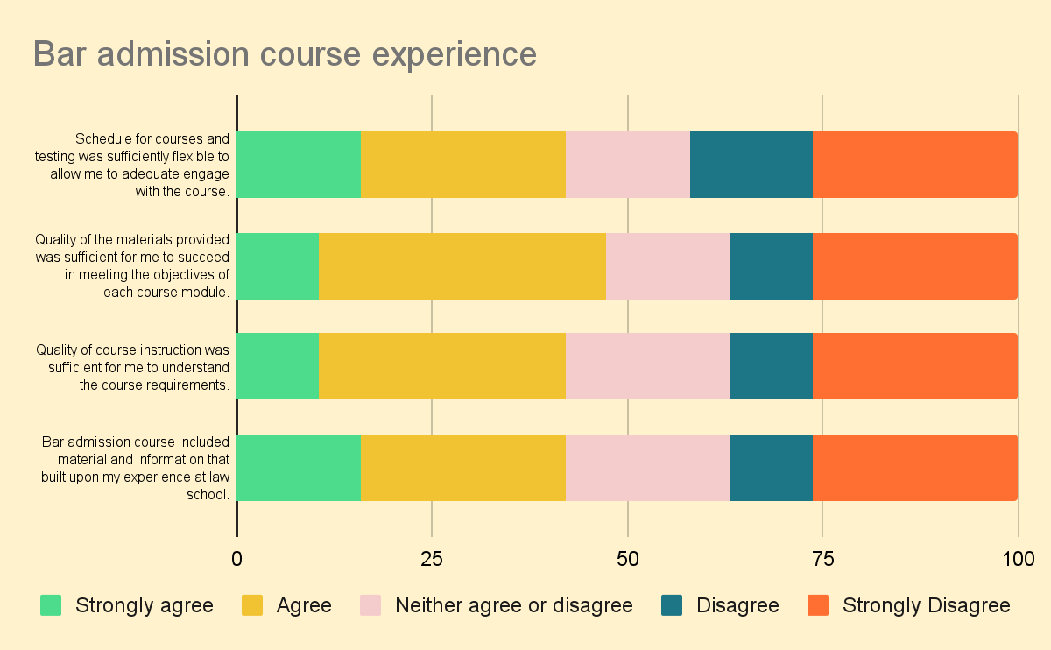

Slide 19
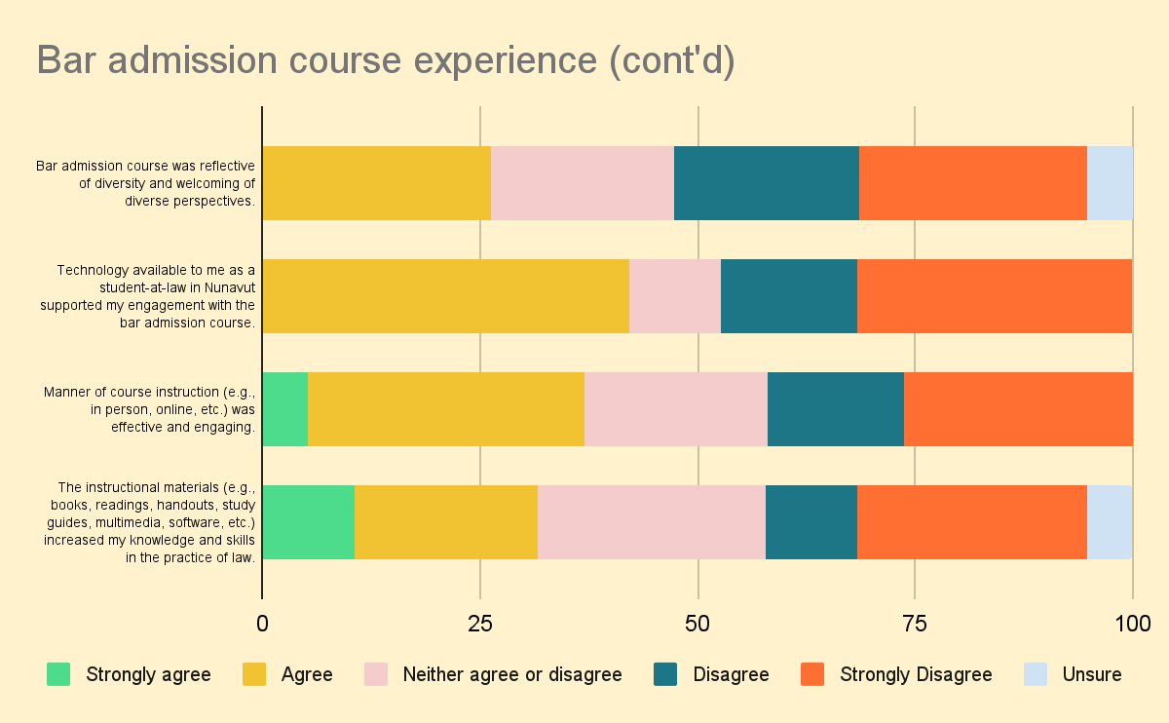

Slide 20
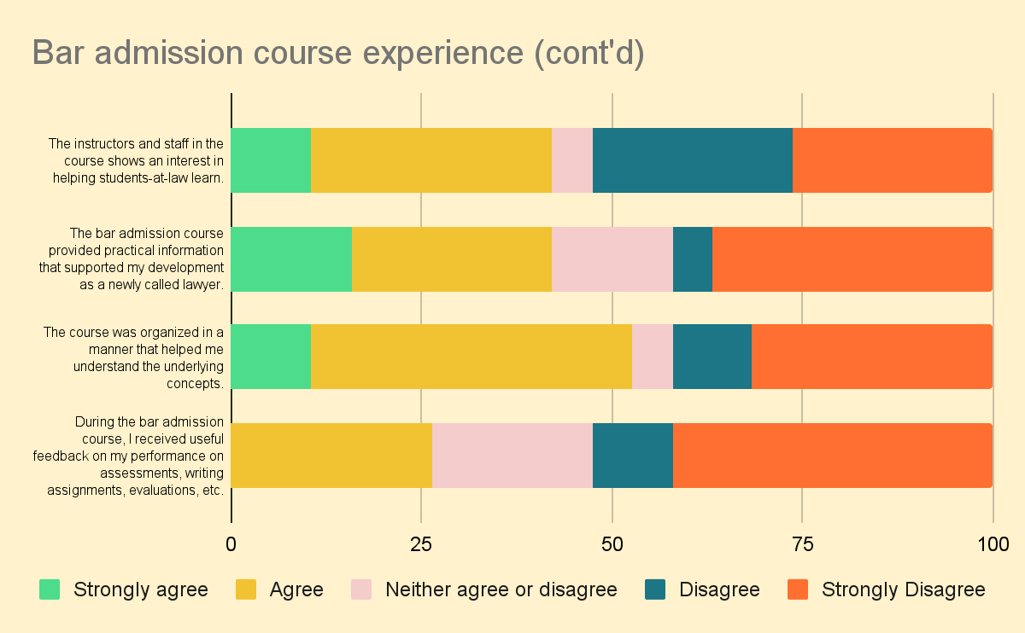
Notes:
Were there other competencies and/or qualities you hoped to better develop during CPLED/CPLED PREP?
“hoped for more Nunavut-specific materials in the bar admission course”
“applying Nunavut laws”
“skills needed for government lawyers. Given NU's context, the biggest employers of lawyers are the GN, PPSC and LSB. CPLED's context is heavily based on private practice which is not always applicable when practicing law in the mentioned institutions.”
“client interviews”
“hoped to develop actual practical skills. In reality it sucked half the time I could have been working on articling tasks where I was genuinely learning to complete busy work. Materials lacked cohesion and were at times incoherent. The organization of materials was abysmal. As an example information required to complete assignments was in 3 different places on the platform (rubric, manual, module itself and at time other documents) making it virtually inaccessible. Assignments did not provide sufficient information, and clarifying questions were not permitted. uch of the material was covered in law school. There were also inaccuracies in materials. Further, for all the lip service about diversity, it was clear that this course was written by and for a very narrow group of people.”
“more Nunavut specific competencies and qualities would have been ideal.”
“did like CPLED PREP's emphasis on code of conduct and ethics.”
“cultural relevance was weak.”
“I felt like it was all stuff we learned in law school... it made me feel like why the heck am I just redoing law school with more stress in the fact that I knew I couldn't even get through the first foundation modules.”
“more tips/exercises using Canlii for searching cases. More tips/exercises on court etiquette/rules.”
“practical application of standard forms and court procedure”
“all the available resources were very helpful.”
“hoped to gain a better understanding of drafting pleadings within NU but of course at the time of my enrolment I had to choose a southern jurisdiction and follow their Rules of Court. These are definite transferable skills but also were a bit of a hardship/extra hurdle in the process.”

Slide 21
Articles of Clerkship & Workplace Training

Slide 22
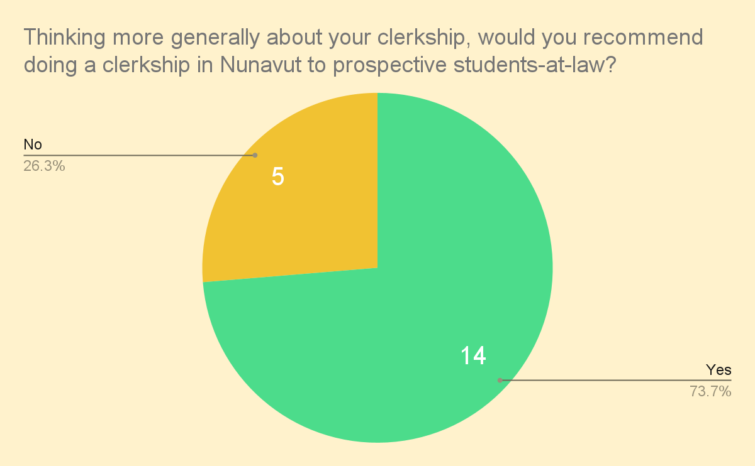

Slide 23
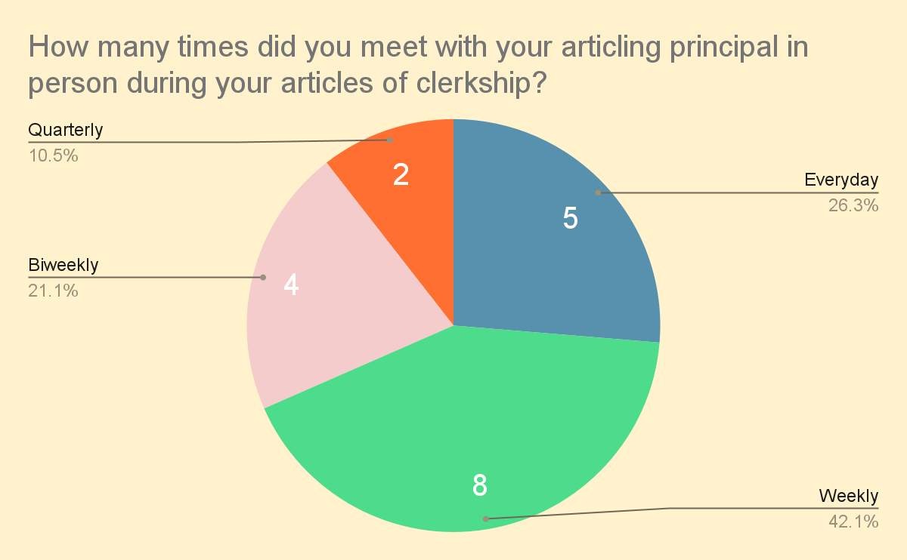

Slide 24
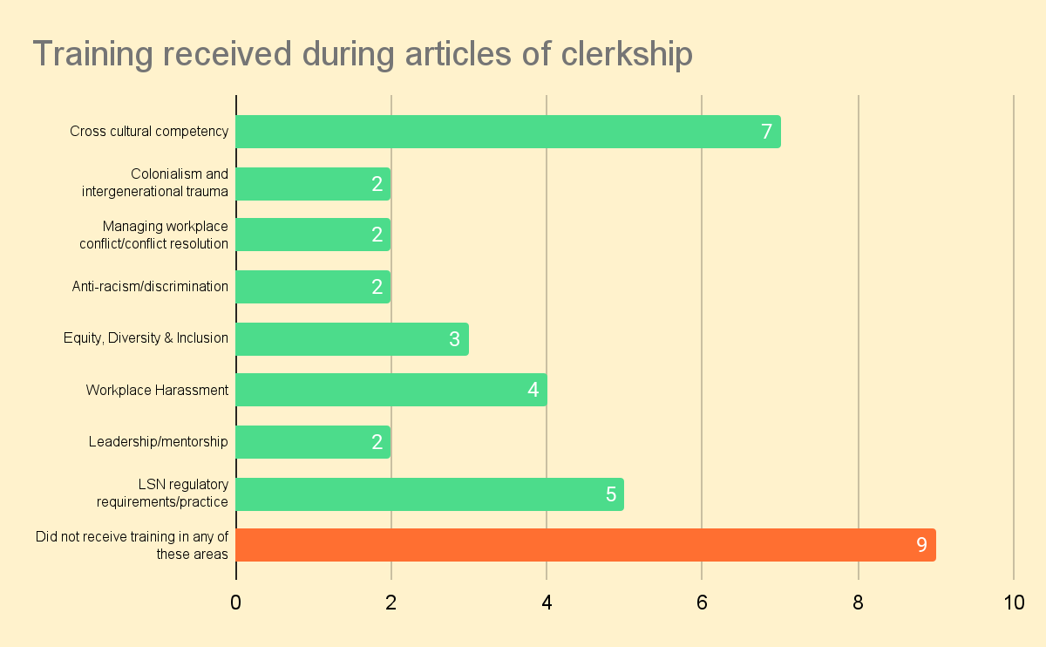

Slide 25
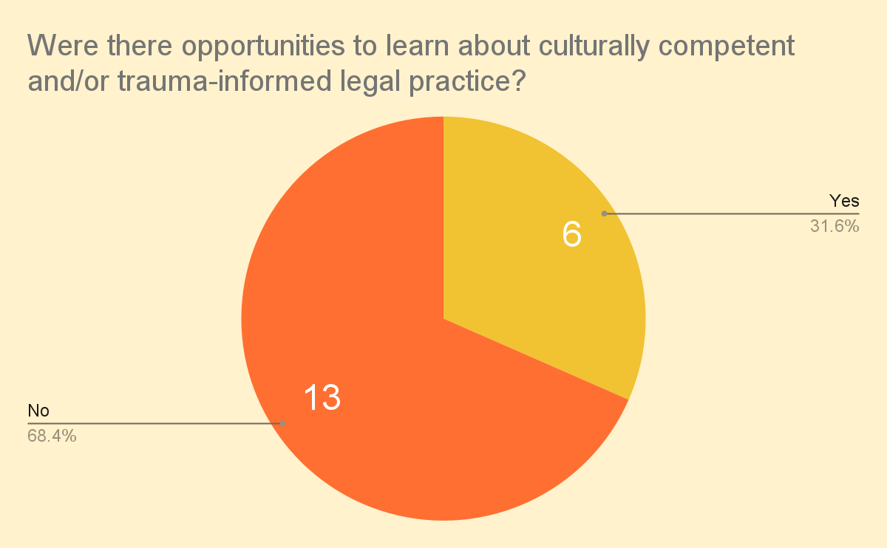

Slide 26
Articling Plan

Slide 27
Articling Plan + Evaluations
Articling Plan
Mid-Term Evaluation
Final Evaluation

Slide 28
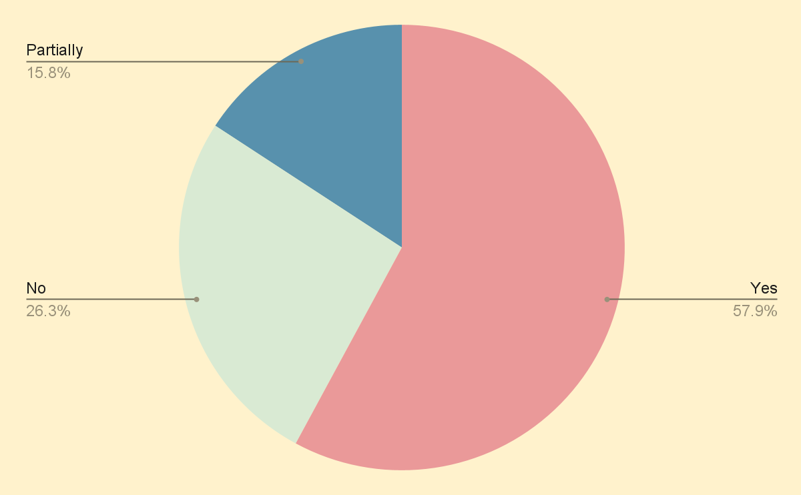
Did you use the LSN’s guide to develop your articling plan?

Slide 29
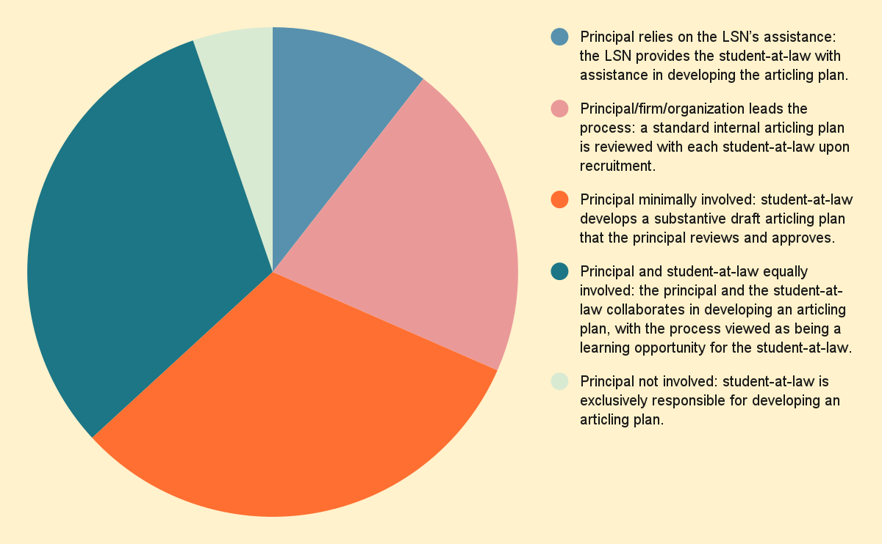
Involvement in Articling Plan Development

Slide 30
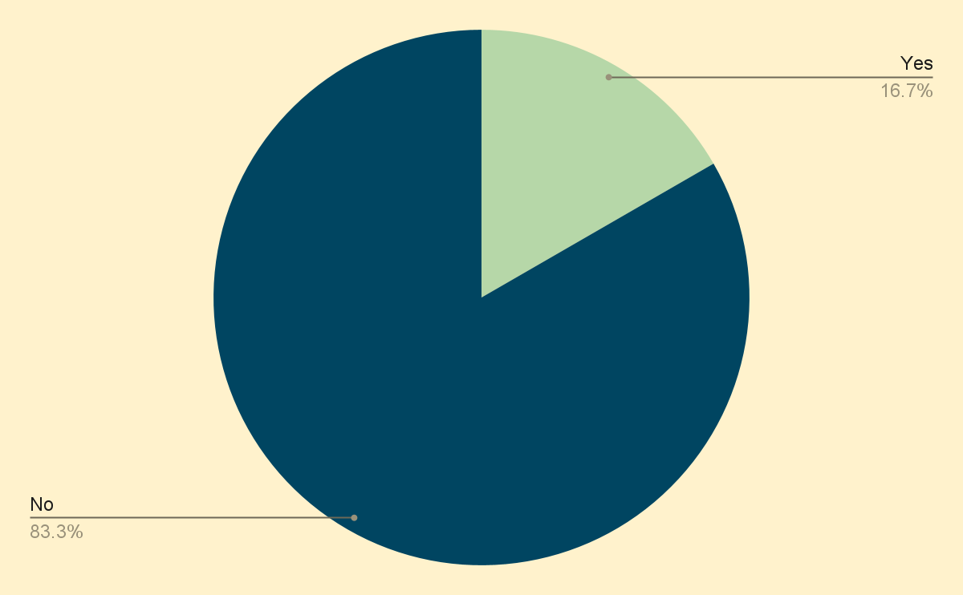
Other documents that could have been developed with Articling Principal to assist with understanding articling expectations

Slide 31
Comments
Need for articling plan to align with the articling evaluations, particularly to track development of core competencies
Articling plan and evaluations currently not well set up for multiple rotations or principals
More opportunities for both principals and students-at-law to disclose when there are issues or concerns during articling process

Slide 32
Student-at-Law Mental Wellbeing

Slide 33
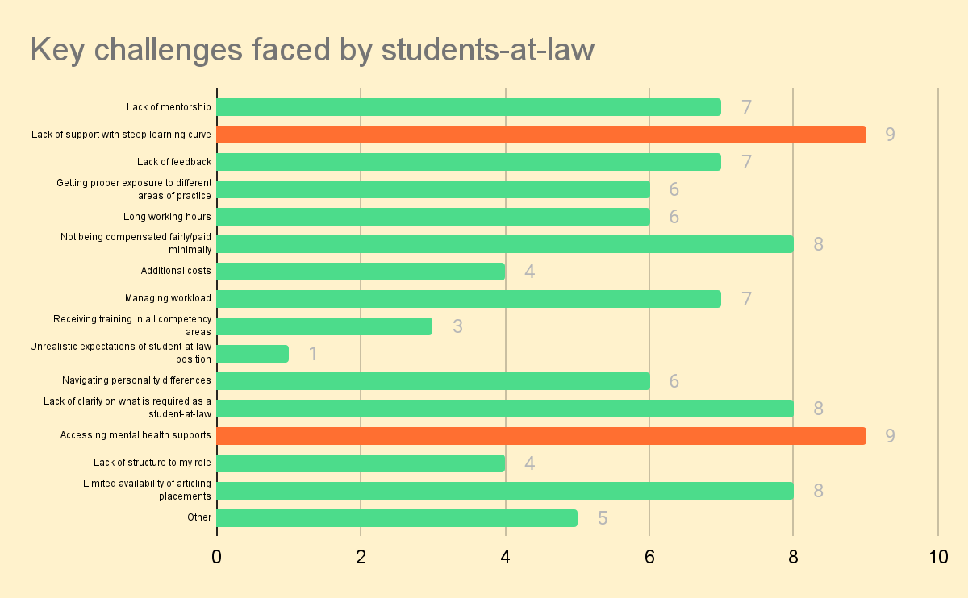

Slide 34
53%
of respondents shared that based on their cumulative experience, their participation in a bar admissions course affected their mental wellbeing to the point that it hindered their ability to succeed in the bar admission program.

Slide 35
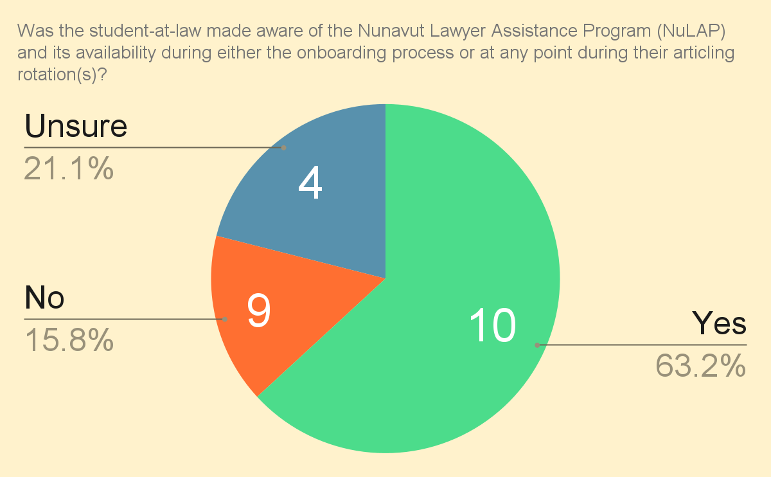

Slide 36
Harassment & Discrimination

Slide 37
16%
of respondents experienced discrimination and/or harassment related to their age, ancestry, colour, race, citizenship, ethnic origin, place of origin, creed, disability, family status, marital status, gender identity, gender expression, sex and/or sexual orientation, or other factors during the recruitment process of any of their articling rotations.

Slide 38
22%
of respondents experienced discrimination related to their age, ancestry, colour, race, citizenship, ethnic origin, place of origin, creed, disability, family status, marital status, gender identity, gender expression, sex and/or sexual orientation, or other factors during their articles of clerkship.

Slide 39
26%
of respondents experienced harassment by someone at the firm/organization related to their age, ancestry, colour, race, citizenship, ethnic origin, place of origin, creed, disability, family status, marital status, gender identity, gender expression, sex and/or sexual orientation, or other factors during their articles of clerkship.

Slide 40
36%
of respondents said there were no resources available to address the discrimination and/or harassment experienced.

Slide 41
63%
of respondents said they were not sure whether resources were available to address the discrimination and/or harassment experienced.

